Slide 1
The Members of Congress
Chapter 10 Section 4

Slide 2
Personal and Political Backgrounds
Not representative of U.S. diversity
Mostly white
Mostly male, though there is an increase in females
Almost all are married and average 2 children
Most are religious

Slide 3
Personal and Political Backgrounds (cont.)
Mostly
Lawyers, Politicians and Businessmen
have advanced degrees
born in state they represent
have considerable political experience

Slide 4
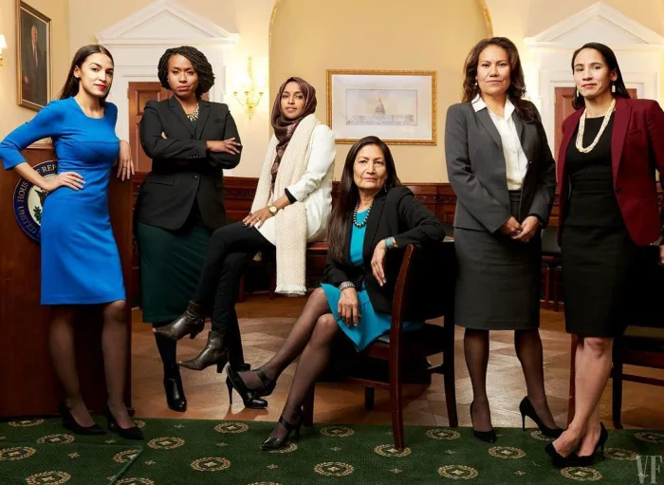
116th Congress Diversity
88% Christian
General population – 73%
24.6% Female
Percent Non-Hispanic White
Senate – 91%
House – 72%
General population – 62%
First 2 Native Women and first 2 Muslim Women – House
Currently 6 women chair Congressional Committees, only 26 in history
Average Age
Senate – 62.9 years
House – 57.6 years

Slide 5
The Job
Legislators
Representatives of constituents
4 voting options
Trustee- each question must be decided on its merits- conscience and judgement are their guides
Delegate- agents of “folks back home”
Partisan- vote in line with party platform
(leading factor to influence votes)
Politicos- attempts to balance it all
Write and Pass Laws
Primary Function

Slide 6
The Job (cont.)
Committee members
Screen proposals
Oversight function- oversee exec. Branch
Servants- try to keep votes by serving people
“Switchboard Operator”
“Red Tape Cutter”
Expediter

Slide 7
Compensation
Salary
$174,000
Speaker=$223,500
Senate president pro temp=$193,400
Non-salary Compensation
Special tax deduction for 2 homes
Travel allowances
Franking privilege
Free health insurance
Free printing
Pension

Slide 8
Politics of Pay
Two limits
President’s veto
Fear of voter backlash
Membership Privileges
Privilege from arrest while in session
Can’t be questioned about a speech in court (protect freedom of legislative debate)

