Slide 1
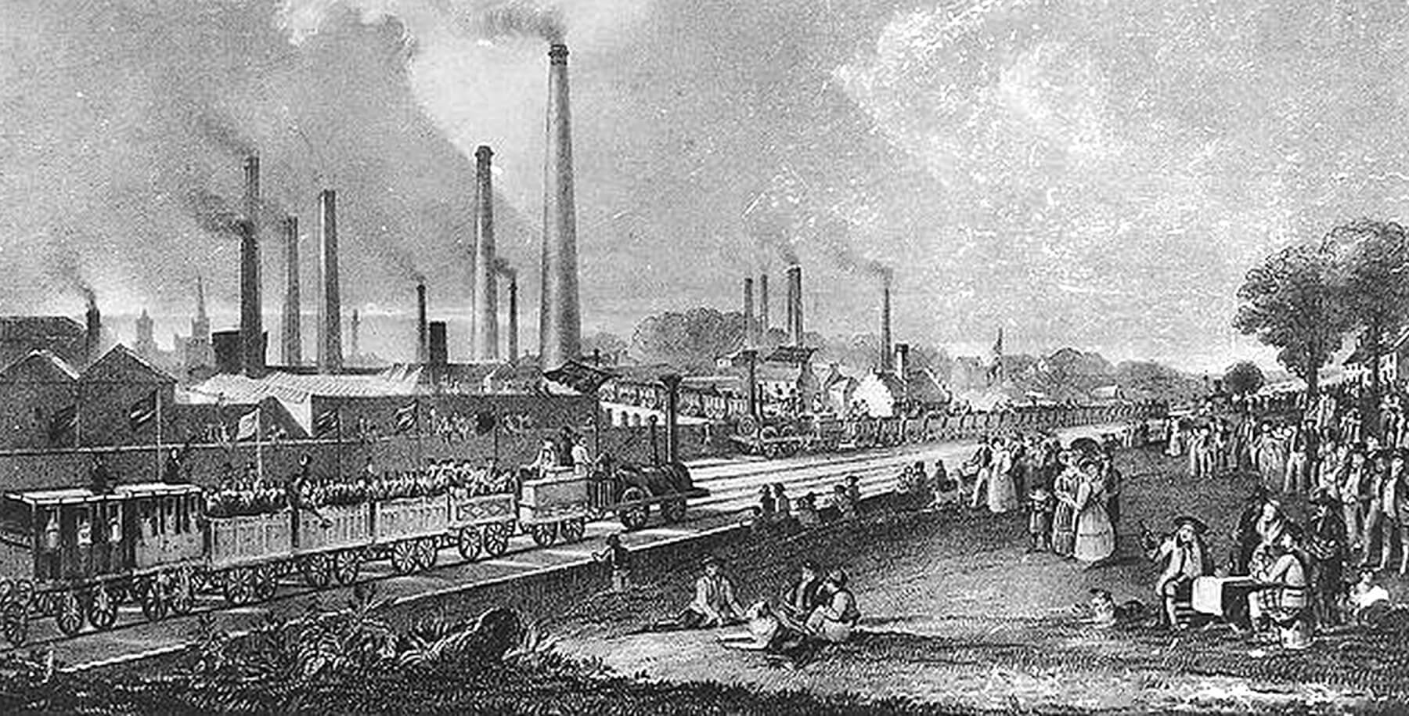
The Industrial Revolution

Slide 2
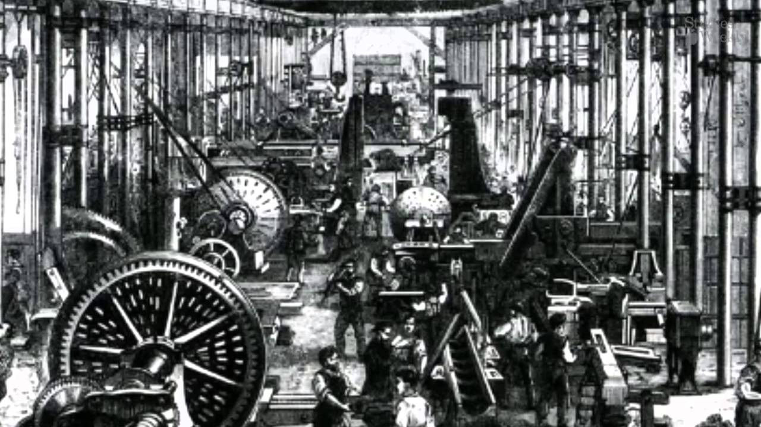
What is the Industrial Revolution?
The rapid changes in the organization of manufacturing industry that transformed countries from rural agricultural to urban industrial economies
Notes:
The Industrial Revolution refers to the rapid changes in the organization of manufacturing industry that transformed countries from rural agricultural to urban industrial economies. It began in the late 18th century in the Midlands area of England, then spread throughout the country, into continental Europe, and to the northern United States.

Slide 3
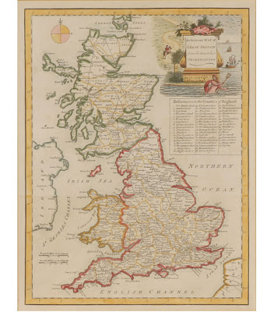
Great Britain
The Industrial Revolution began in Great Britain during the 18th Century
Why there?
Consider the resources we talked about in our activity

Slide 4
Right Time – Right Place
Abundant natural resources
Favorable Geography
Favorable climate for new ideas
Good banking and finance system
Political stability

Slide 5
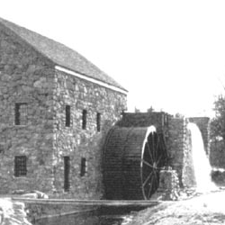
Natural Resources
Coal
Iron Ore
Rivers and Waterways

Slide 6
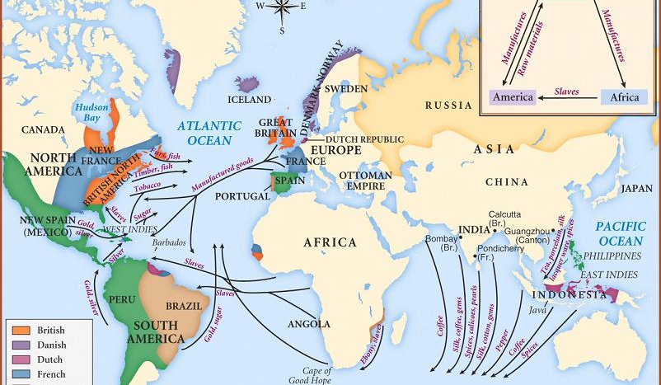
Favorable Geography
With a fleet of over 6000 ships, Great Britain had established extensive trade routes around the world where goods could be bought and sold

Slide 7
Favorable Climate for Creativity

Slide 8
Banking & Financial System
Britain had a good banking system with plenty of money to invest and lend for new machines, factories, and new methods of production

Slide 9
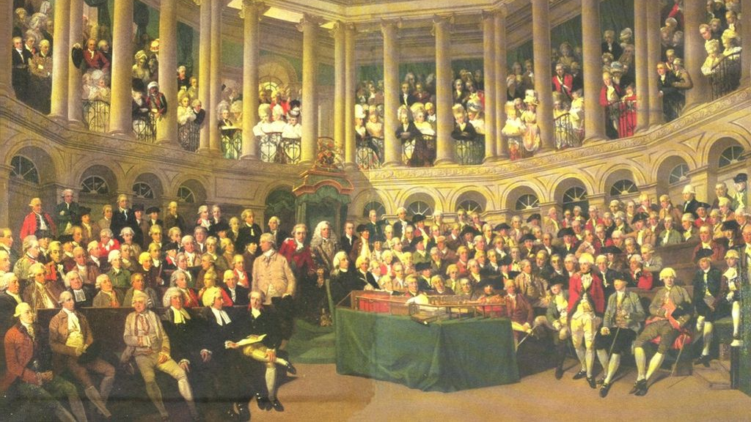
Government Stability
Great Britain was relatively stable during this time with no at-home wars to disrupt industrial progress

Slide 10
The Cotton Industry
Cotton Imported to Great Britain – Mainly from America
What is the trend?
Is it consistent across the century?
Notes:
Look carefully at this table. The figures on the right are in British pounds. Most of the cotton imported to the British Isles during the 18th century came from the Americas. How do you think the American Revolution affected this trade?
Are the figures consistently increasing or decreasing? What do the changes in the figures tell you about the pace of the Industrial Revolution in Britain?

Slide 11
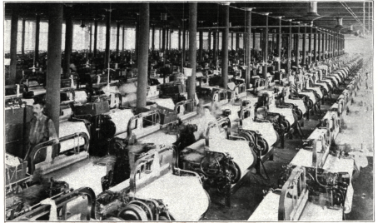
Cotton Exports
Notes:
By 1802, the cotton/textile industry made up between 4 and 5 percent of Britain’s national income. By 1812, 100,000 spinners and 250,000 weavers were working in the industry. Production had grown to 8 percent and had overtaken the woolen industry. More than half the value of British home exports in 1830 consisted of cotton textiles.
The cotton industry originally developed in three main British districts: Manchester, the Midlands, and the Clyde Valley in Scotland. By the 1780s, the industry became more concentrated in Lancashire, where a large proportion of the population depended on cotton and textile production. Do you think this dependence might have presented any concerns for the people of Lancashire? What are some dangers of single-product economies?
Look at the tables again. In what years were the increases or decreases in manufacturing inconsistent? What factors might have accounted for these inconsistencies (e.g., bad harvests, political unrest)?

Slide 12
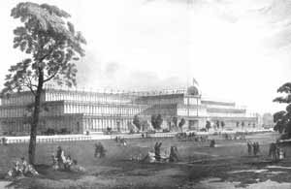
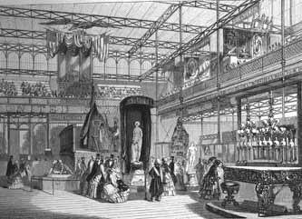
The Crystal Palace
The Great Exhibition of 1851 in London was mounted to symbolize Great Britain’s economic, industrial, and military superiority.
More than 6.2 million visitors
Notes:
The British government staged the Great Exhibition of 1851 to show off Britain’s economic, industrial, and military superiority. It was a truly international event, with more than 13,000 exhibits from all over the globe showcasing the achievements of the British Empire at home and in the colonies.
The British designed the exhibition grounds and buildings to impress the world and the more than 6.2 million visitors who came to the exhibition. The park surrounding the Crystal Palace, for example, contained an impressive set of fountains that used close to 12,000 jets.

Slide 13
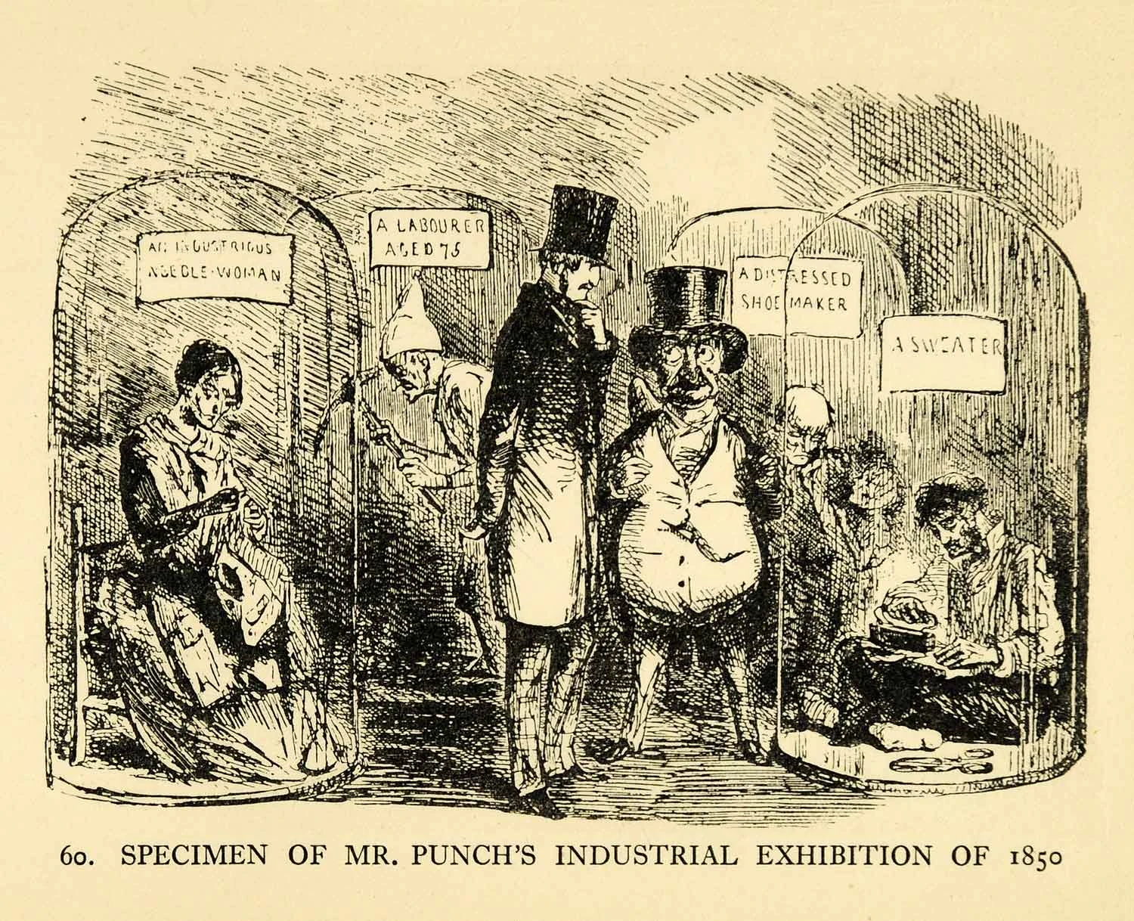

Slide 14
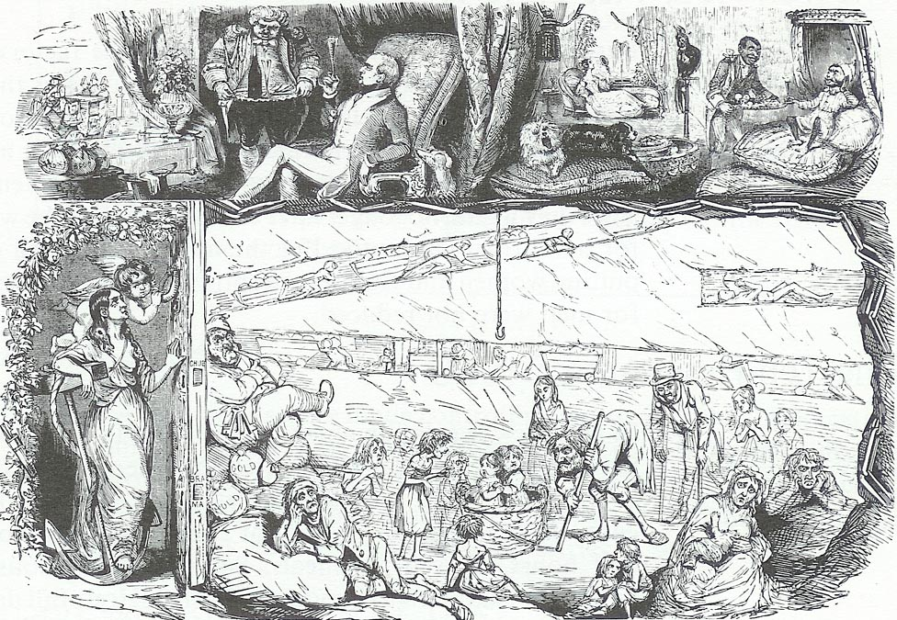

Slide 15
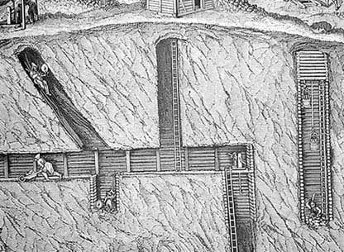
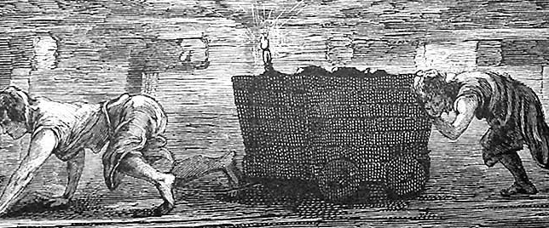
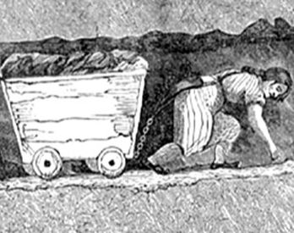
Labor Conditions
Laborers often worked in dangerous and hazardous conditions
Describe the images above, what kind of risks does this show?
Notes:
In the illustrations in this slide, workers are shown laboring in the shallow tunnels of late 18th-century mines. Notice that a woman is in the front in the lower picture. Female mine workers often suffered abuse at the hands of male workers.

Slide 16
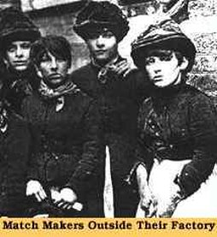
Women: The Labor Behind the Industry
Women had different jobs than men.
High poverty rates among both single and married women forced many to find work outside of their homes.
Work improved life for some women giving them extra money
Others encountered increased poverty, isolation, and dependence on employers for day to day sustenance.
Notes:
During the Industrial Revolution, division of labor occurred along gender lines. Women had different jobs than men, although they participated in many of the same industries during this period. High poverty rates among both single and married women forced many to find work outside their homes in domestic service, textile factories, piecework shops (where workers were paid by the piece), and coal mines.
Some women found that new urban and rural work opportunities improved their way of life and gave them some extra spending money. Others encountered increased poverty, isolation, and dependence on employers for day-to-day sustenance.

Slide 17
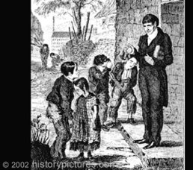
Child Labor: Unlimited Hours
Factories employed children, benefiting from their
Energy
small fingers *manipulate machinery
less pay
Extra money for home
19 hour days
Factory children attending Sunday School
Notes:
Factories employed many children, benefiting not just from their energy but also from their small fingers, which could manipulate tiny parts of machines more easily. Factories could also legally pay children less than adults, and parents were often eager to send their children to work and bring in more income for the family.
Children as young as four years old worked long, difficult days for very little pay. Children sometimes worked up to 19 hours a day with single breaks of one hour or less

Slide 18
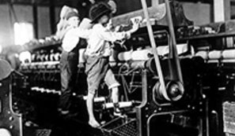
Child Labor: Dangers
Scavengers- picking up tiny pieces of loose cotton from inside machinery.
British mines work- “Trappers” opened underground doors to let “hurriers” pull through loaded wagons.
In the dark for 12 hours/day
Notes:
The smallest and youngest children in textile factories usually worked as scavengers. This very dangerous task involved picking up tiny pieces of loose cotton from under the machinery.
Working conditions in British mines were perhaps even worse. An 1842 Parliamentary Committee reporting on mines found that many children were working under intolerable circumstances. Children as young as four years old worked as “trappers,” opening underground doors to let “hurriers” (also children) pull through loaded wagons. Often working in the dark because they could not afford candles, children labored in these conditions up to 12 hours a day. The Parliamentary Committee further reported that miners beat the children for falling asleep on the job.

Slide 19
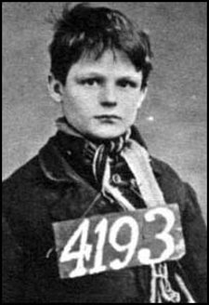
Child Labor: Punishment
Impossible to keep pace:
Malnourishment
Lack of sleep
Beatings for falling behind, talking, arriving late, falling asleep.
Runaways sent to prison
Notes:
Child laborers, most of whom came from severely impoverished backgrounds frequently found it impossible to keep up with the pace required in the factories—primarily because they were often malnourished and debilitated. Many children were beaten for falling behind. They were also beaten or docked pay for arriving to work late and for talking to other children. Apprentices who ran away from factories sometimes faced prison sentences.
Despite terrible working conditions, meager pay, and vicious punishments, family poverty forced many children to go to work.

Slide 20
Child Labor: Movement to Regulate
Factory owners argued that child labor was good for the economy and helped build children's character
Factory Act of 1833: limited child labor and the number of hours children could work in textile mills
9 years with certificate
9-13 yrs. could work 12 hrs.
No work at night
2 hours of school a day
Factory Inspections
Did not put an end to mistreatment:
Only applied to textile factories
Mines Act 1842
Restrictions on child mine labor
10+ yrs. to work
Notes:
In 1833, the British government passed the Factory Act to improve conditions for child laborers in textile factories. The act stipulated the following:
No child under nine years of age was permitted to work.
Employers had to have a medical or age certificate for each child laborer.
Children between the ages of nine and thirteen could not work more than nine hours a day.
Children between 13 and 18 could not work more than 12 hours a day.
Children could not work at night.
Each child had to receive at least two hours of school per day.
Four factory inspectors were appointed to enforce the law throughout the whole country.
Despite these conditions, the Factory Act did not put an immediate stop to mistreatment because it only applied to children working in textile mills, not coal mines or other types of factories.
The Mines Act of 1842 established restrictions on child mine labor, barring children under ten from working in the mines.

Slide 21
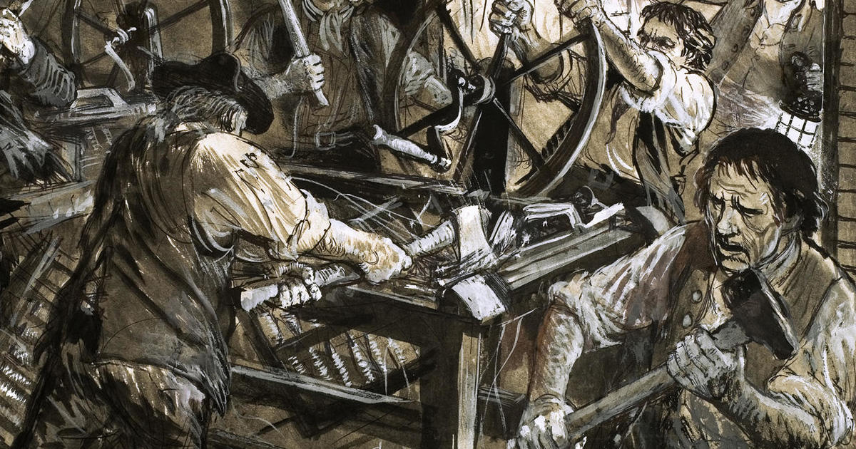
The Luddites
Low wages and employment of unapprenticed workmen outraged
Luddites
“Army of Redressers”
Broke into factories
Destroyed machines
200 machines destroyed in weeks
Special Police hired
“Luddite” now applies to anyone opposed to new technologies
Notes:
Many workers expressed outrage over low wages and the employment of unapprenticed workmen, who did not share the privileges and higher wages of apprenticed workmen. Some of these disgruntled workers, who later came to be called Luddites, broke into factories and destroyed machines. The Luddites referred to themselves as the “Army of Redressers”; their leader was “General Ned Ludd,” although there is little evidence to suggest that he was a real person. The impact of the Luddite movement, however, was felt through the destruction of equipment throughout the Midlands. In a matter of weeks, 200 machines were destroyed and special police units had to be hired to protect factories. The Prince Regent offered a reward (shown in this notice in this slide) to anyone "giving information on any person or persons wickedly breaking the frames.” Today, the term “Luddite” refers to a person who is opposed to new technology.

Slide 22
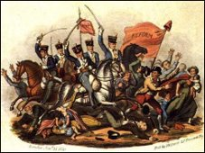
The Peterloo Massacre - 1819
50,000 met to agitate for universal suffrage (estimated differently)
Alarmed City magistrates
Ordered armed troops for control
Soldiers fired upon the crowd
11 died
400 wounded
Notes:
The most celebrated protest of the early 19th century was the “Peterloo Massacre” of 1819. On August 16, 1819, laborers advocating annual parliaments planned a meeting to agitate for universal suffrage. A crowd of about 50,000 gathered in St. Peter’s Fields to listen to several speakers. By early afternoon, the length and size of the meeting so alarmed city magistrates that they ordered armed troops in the Lancashire militia to arrest some of the organizers and disperse the crowd. The soldiers ended up charging and firing upon the crowd, however, killing 11 and wounding approximately 400 others.
Different sources reported different crowd sizes, but it was undoubtedly well-attended. Here are some of the estimates:
Thomas Tatton, Magistrate, testimony at Hunt's trial, March 1820: 30,000 people
William Hulton, Magistrate, testimony at Hunt's trial, March 1820: 50,000 people
Lord Castlereagh, speech in Parliament: 70,000 people
Samuel Bamford, Passages in the Life of a Radical: 80,000 people
John Tyas, The Times: 80,000 people
George Swift, letter to brother, August 1819: 130,000 people
Henry Huntspeech on September 18 1819: 150,000 people
Richard Carlile,The Republican: 150,000 people
James Wroe, Manchester Observer: 153,000 people

