Slide 1
The Scope of Congressional Power
Ch. 11 Sec. 1

Slide 2
Key Terms:
Expressed power
Implied powers
Inherent powers
Strict constructionist
Liberal constructionist
consensus

Slide 3
Congressional Power
1. Congress has only those powers delegated to it and not specifically denied to it by the Constitution.
The Constitution has given Congress expressed, implied, and inherent powers.

Slide 4
Congressional Power Cont.
Expressed: Powers specifically mentioned in the Constitution
Implied: Powers not specifically mentioned in the Constitution, but may be reasonably deduced from those that are
Inherent: Powers that are possessed by all national governments

Slide 5
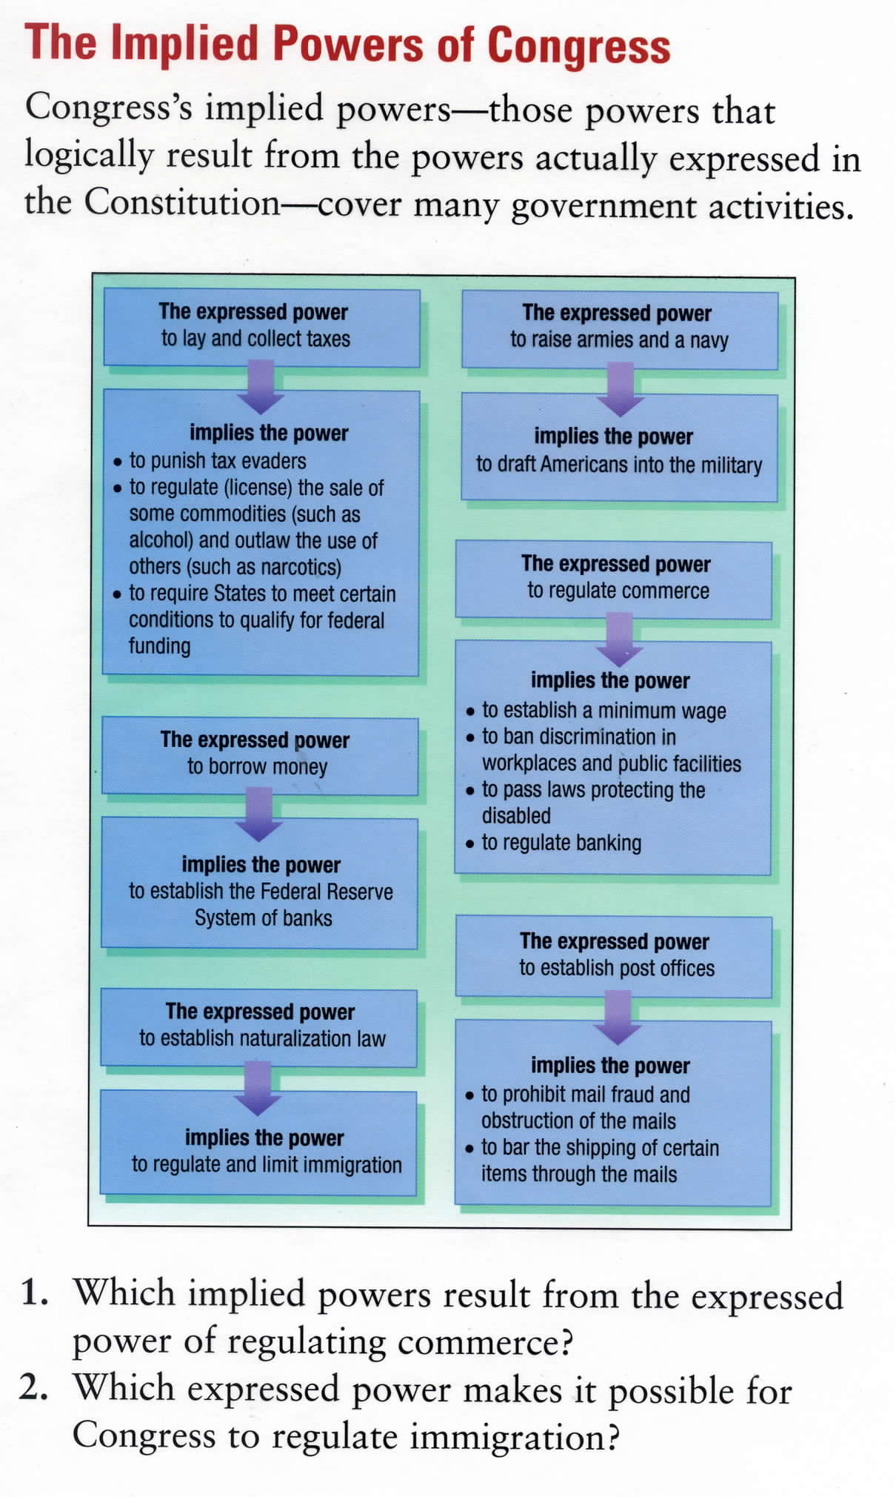

Slide 6
Strict vs. Liberal Construction
Strict constructionists
(led by Thomas Jefferson) believed Congress should exercise only its expressed powers and those implied powers absolutely necessary to carry out those expressed powers. The value of government most valued was State government.
T.J., States rights, anti-feds

Slide 7
Strict vs. Liberal Construction
Liberal constructionists
Believed that the Constitution must be interpreted broadly, with an eye toward change.
That belief has extended the powers of the Federal Government far beyond the plans of the original Framers of the Constitution.
A. Hamilton, Strong Fed. Govt.

Slide 8
Strict vs. Liberal Construction
RESULTS:
Liberal constructionists prevailed largely because wars and economic crises called for national action.
The consensus of the American public is that government should have the power to solve national problems.
Presidential influence

