Slide 1
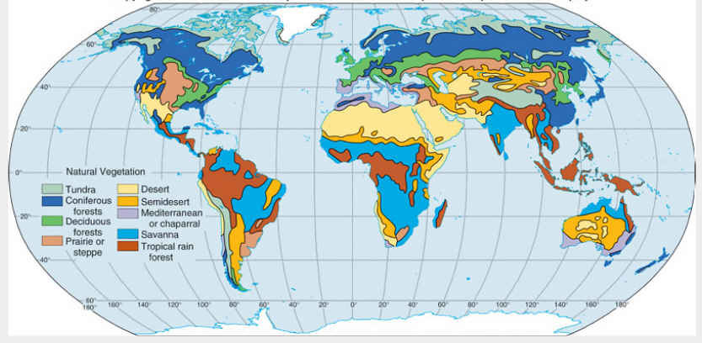
Vegetation Maps
Create at least SIX vegetation regions (see pg. 55 in your text).
Create a key to clarify colors
Title your map
You must use At LEAST four real vegetation types… the others can be unique to your island

Slide 2
Make sure that you look at your Physical Map when you create your vegetations regions. They should make sense together. For example, the desert vegetation should be located in your desert area, Icecaps are probably going to be found near your mountain tops, grass lands will be on your lower elevations, etc.

Slide 3
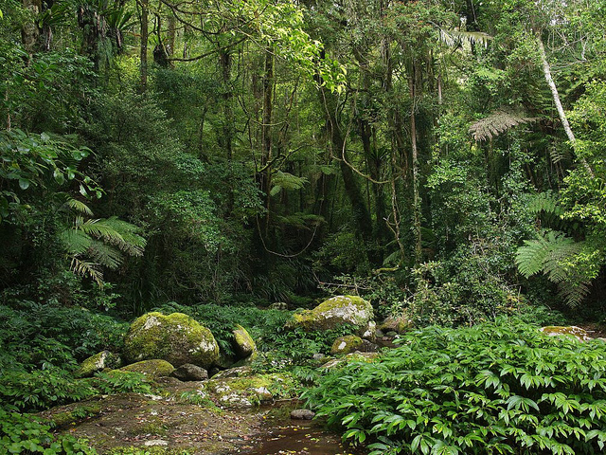
Hot, moist biome found near Earth's equator. Tropical rainforests receive from 60 to 160 inches of precipitation that is fairly evenly distributed throughout the year. Very dense.
Tropical Rain Forest

Slide 4
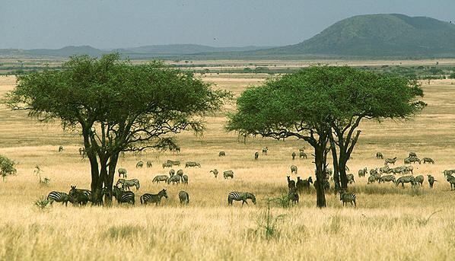
a mixed ecosystem characterized by the trees being sufficiently widely spaced so that the canopy does not close. The open canopy allows sufficient light to reach the ground to support a layer consisting primarily of grasses.
Tropical Grasslands/ Savanna

Slide 5
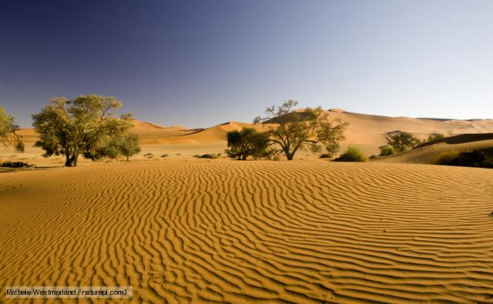
Desert Scrub/Waste Lands
Desert scrub vegetation occurs where summer rainfall is insufficient to support large trees or closed-canopy forests.

Slide 6
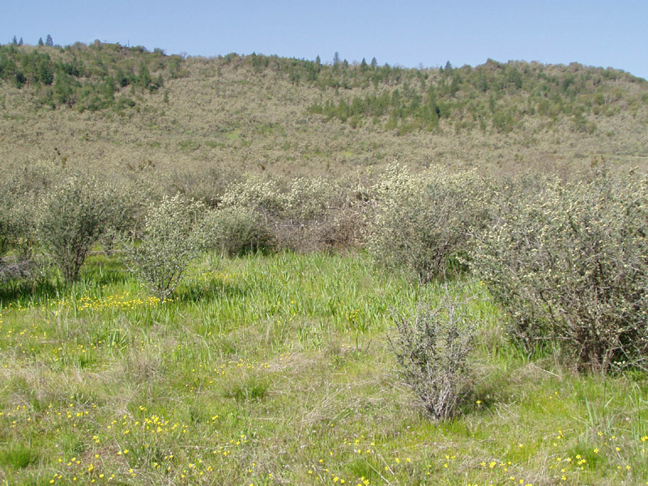
Chaparral, vegetation composed of broad-leaved evergreen shrubs, bushes, and small trees usually less than 2.5 m (about 8 feet) tall; together they often form dense thickets.
Chaparral (Not in Textbook)

Slide 7
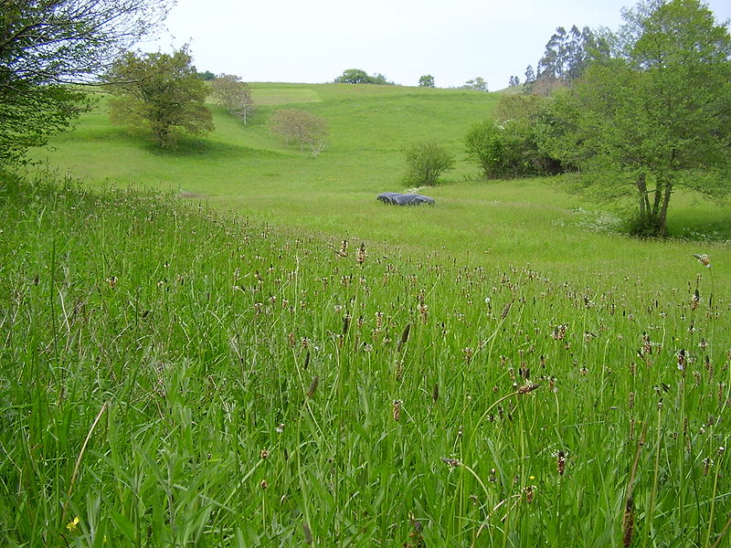
Temperate Grasslands
Temperate grasslands are characterized as having grasses as the dominant vegetation. Trees and large shrubs are absent.

Slide 8
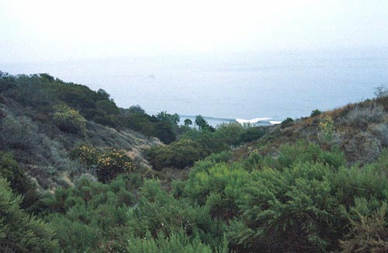
Chaparral is found in regions with a climate similar to that of the Mediterranean area, characterized by hot, dry summers and mild, wet winters.
Mediterranean Scrub

Slide 9
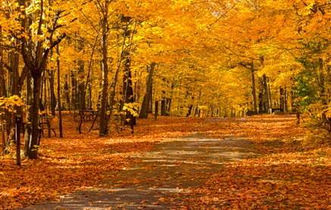
Temperate deciduous forests are most notable because they go through four seasons. Leaves change color in autumn, fall off in the winter, and grow back in the spring; this adaptation allows plants to survive cold winters.
Deciduous Forest

Slide 10
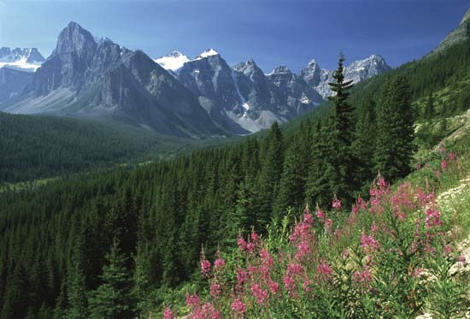
Coniferous Forest
Coniferous forests are made up mainly of cone-bearing or coniferous trees, such as spruces, hemlocks, pines and firs. The leaves of these trees are either small and needle-like or scale-like and most stay green all year around (evergreen). All are softwoods able to survive cold temperatures and acidic soil.

Slide 11
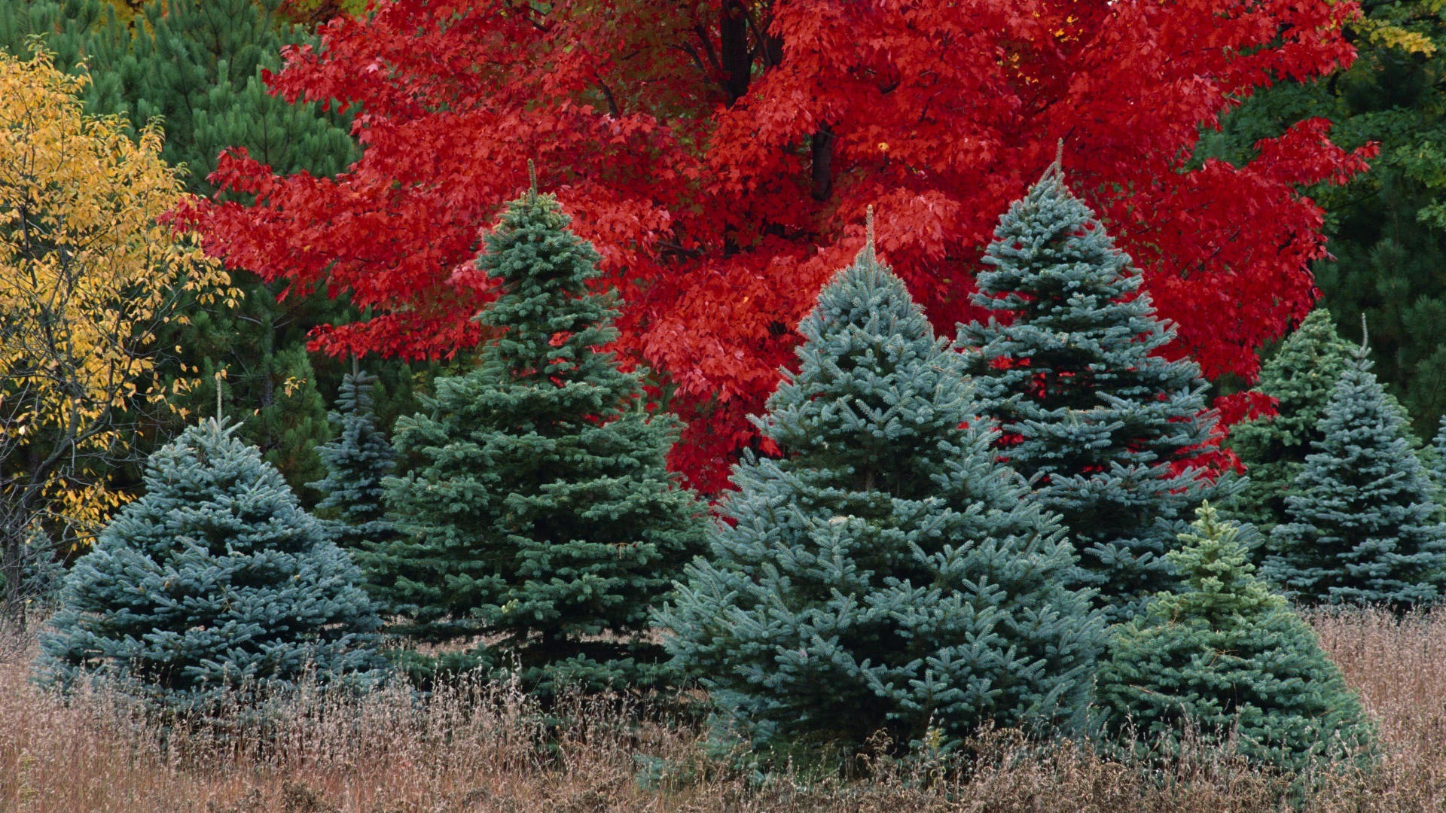
Mixed Coniferous and Deciduous forest

Slide 12
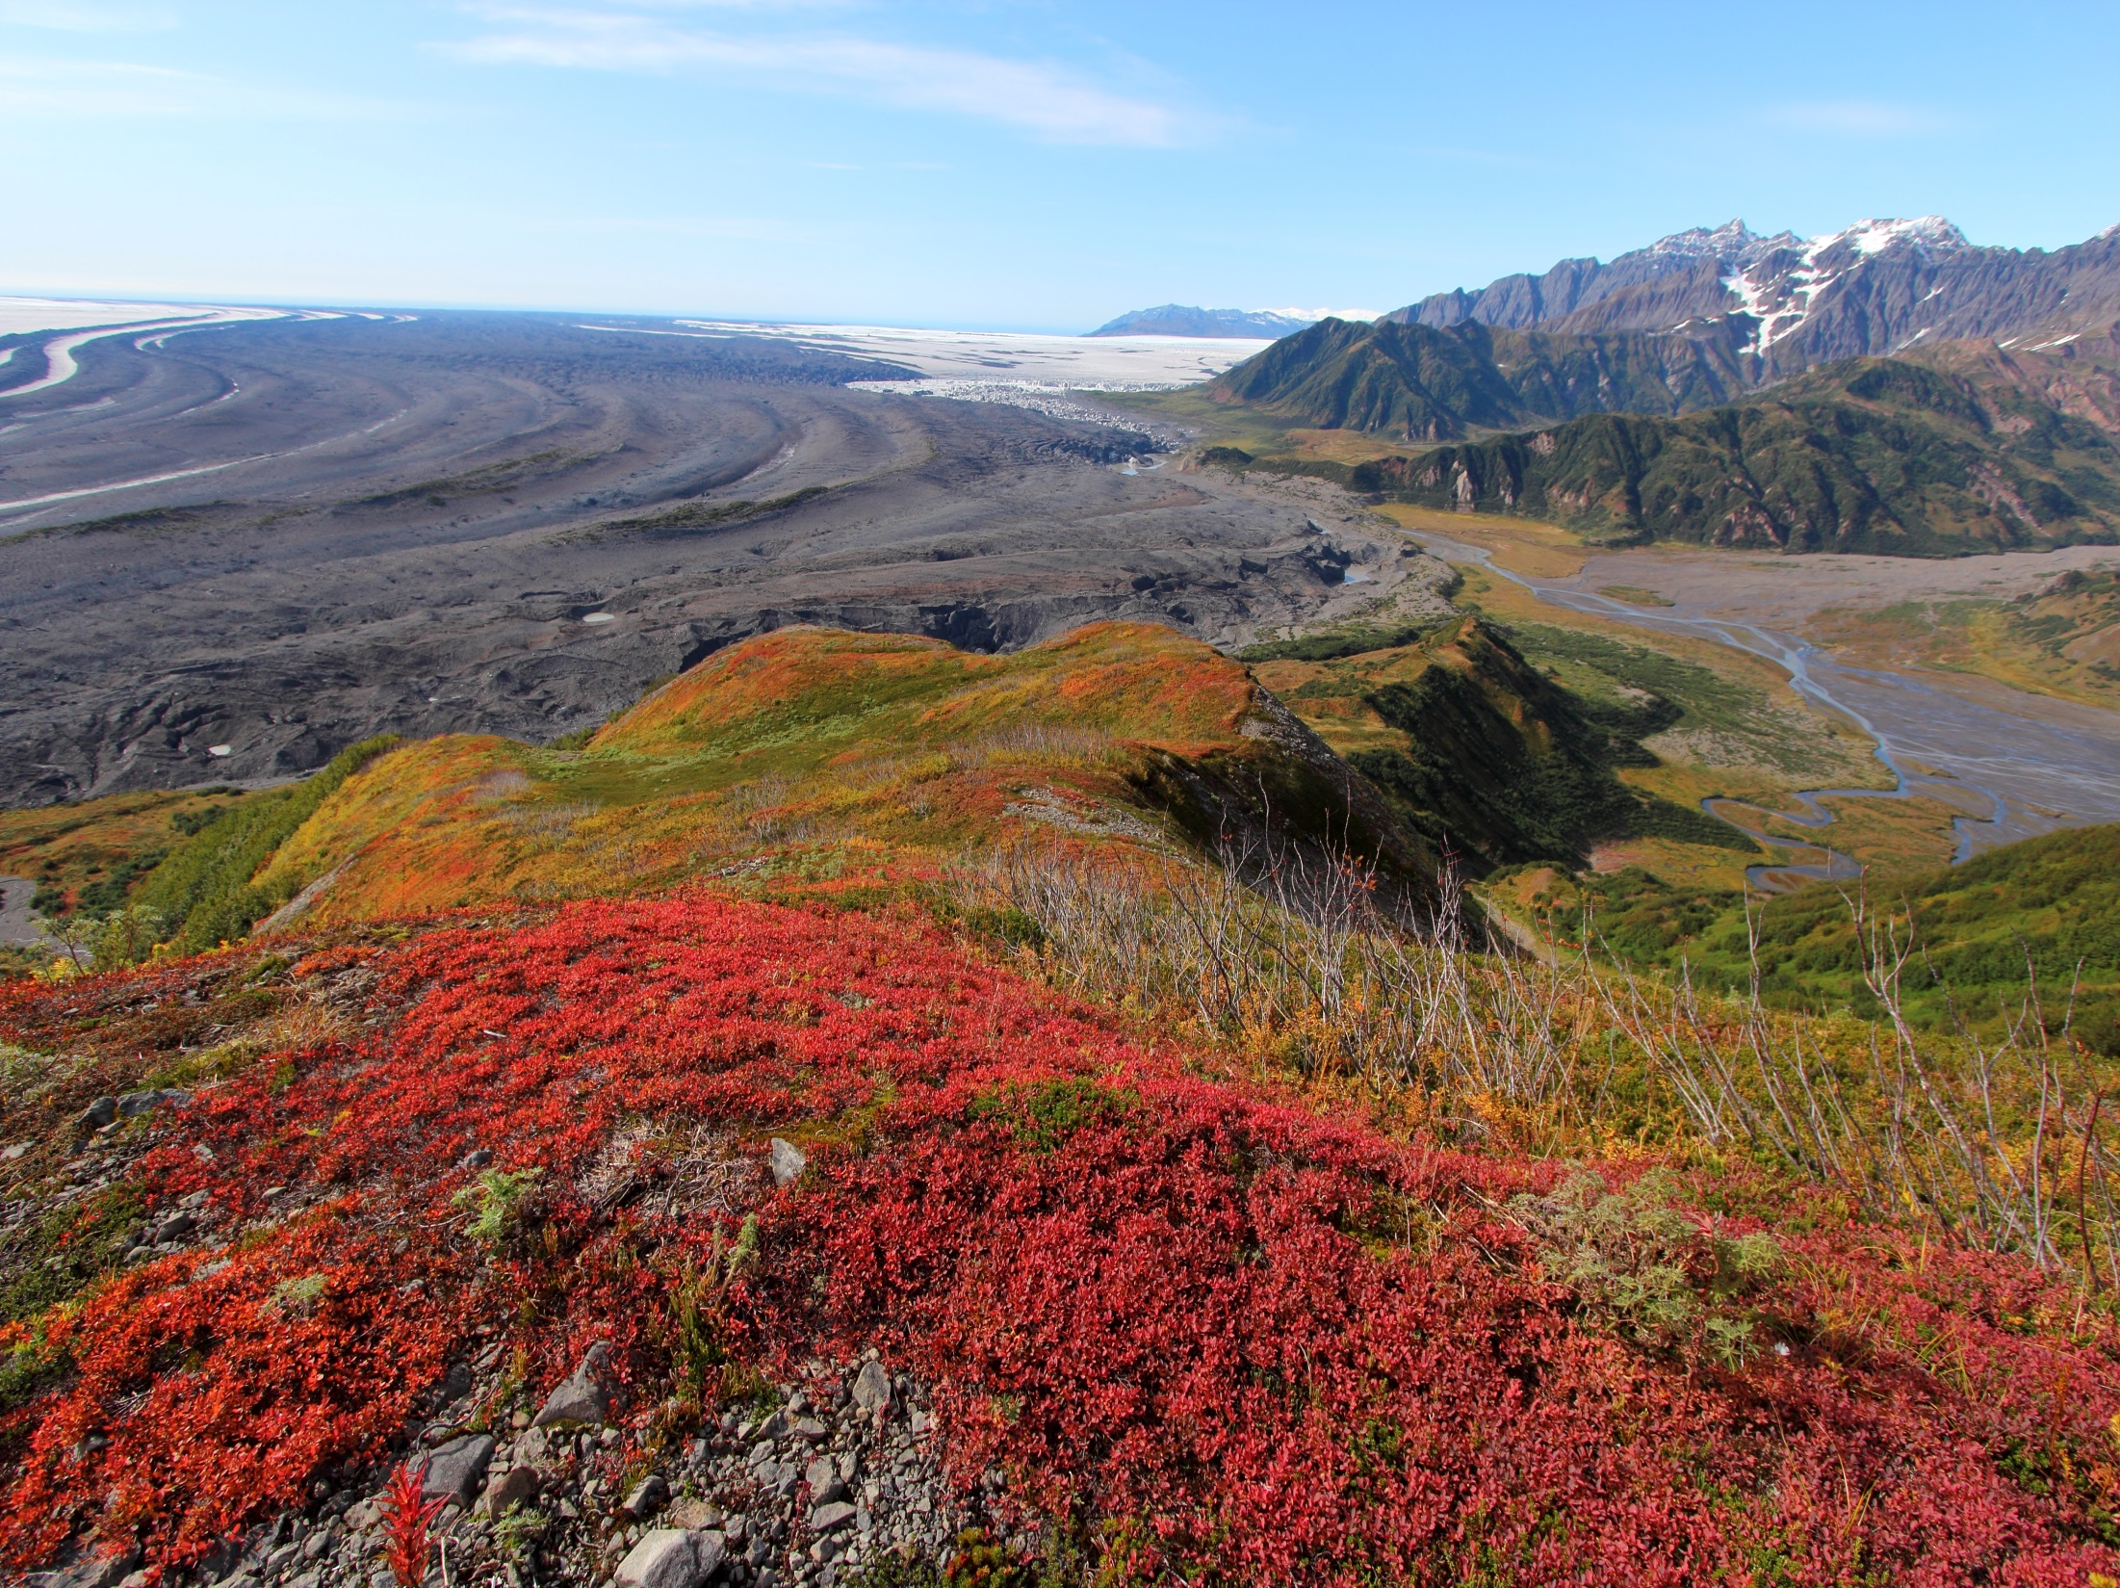
Tundra
The vegetation of tundra is low growing, and consists mainly of sedges, grasses, dwarf shrubs, wildflowers, mosses, and lichens.

Slide 13
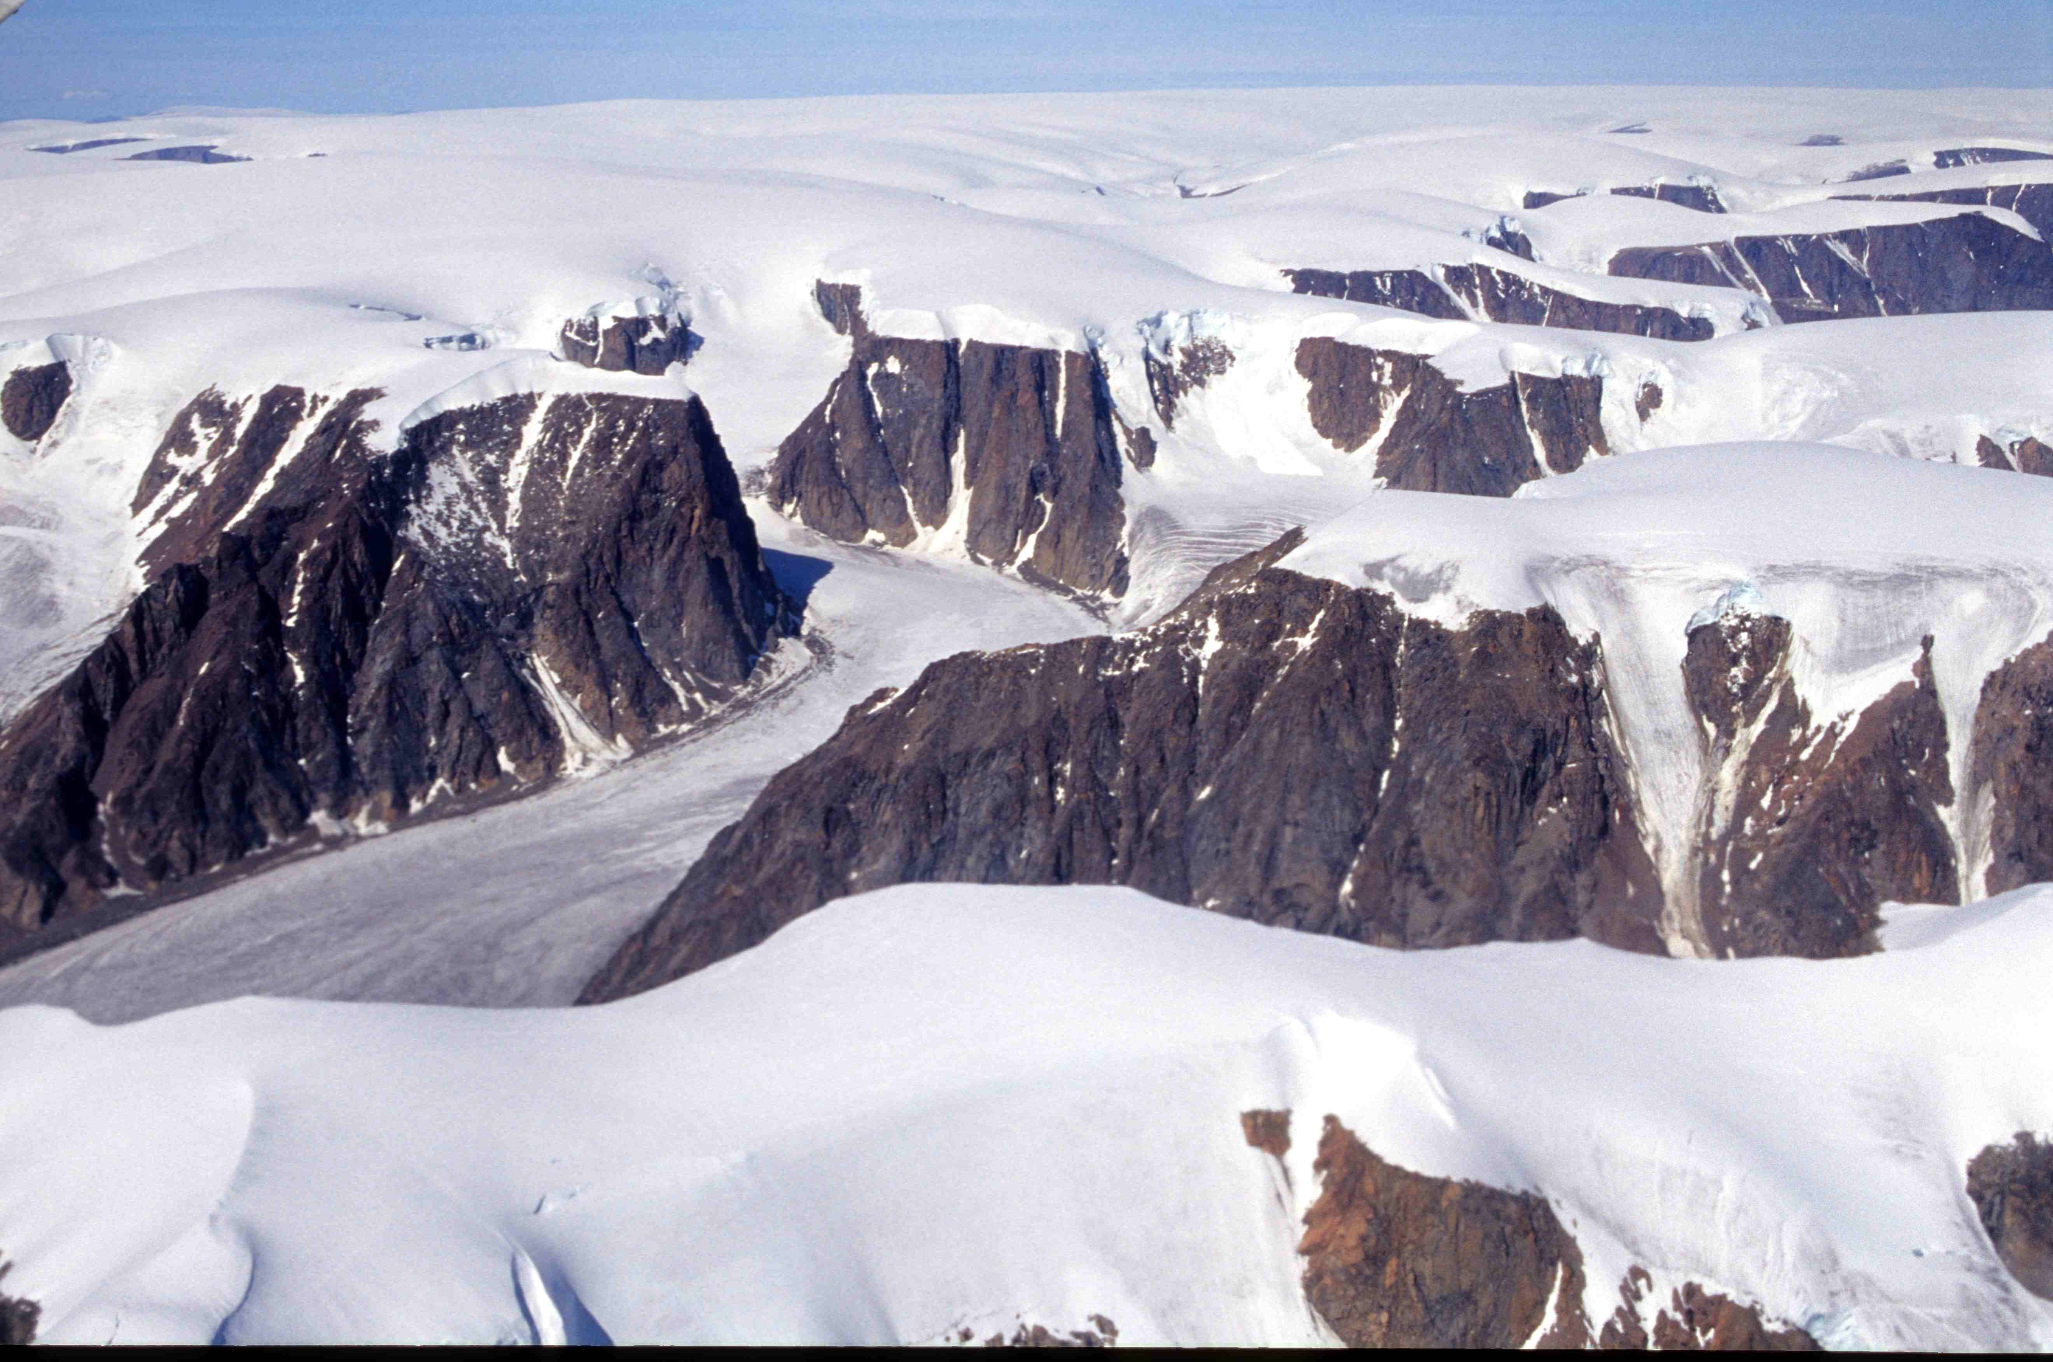
Icecap
The climate covers areas in or near the polar regions, such as Antarctica and Greenland, as well as the highest mountaintops. Such areas are covered by a permanent layer of ice and have no vegetation

Slide 14
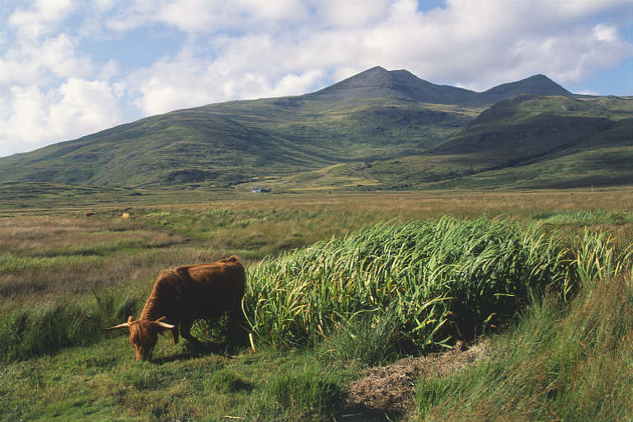
Highlands
Shrubs are generally confined to elevations immediately above the timberline or grow only in certain specially favorable localities at higher elevations where also they tend to become greatly dwarfed.

