Slide 1
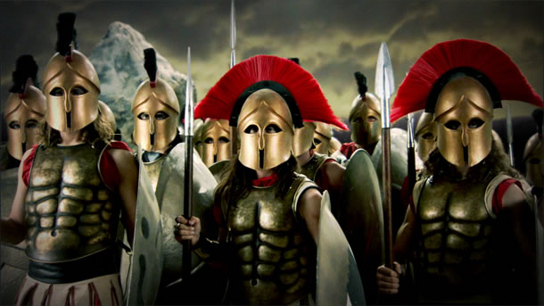
Battles BC: “Judgment Day at Marathon”
https://www.youtube.com/watch?v=kAWzK841EKo
Last Stand of the 300: “The Battle at Thermopylae”
https://www.youtube.com/watch?v=e_1d3ZasrTA

