Slide 1
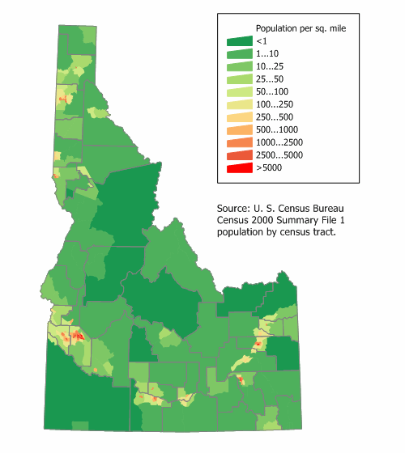
Population Density Map #9
Label:
a. land Area
b. population and
c. population density (People/Land area)
Title the Map
3. Label all of your cities location
with a dot (but don’t name them.)
Create a density key using
at least FIVE colors similar
to pg. 566 in both miles & Km
5. Shade your map.
You will need to guestimate this key based on your total population on the island

Slide 2
People/Sq MI
People/Sq km
People/Sq MI
People/Sq km
To get KM just divide by 1.61
20
12
50,000
31,056
10-19
6-11
25,000- 49,999
15,528-31,055
5-9
3-5
10,000-24,999
6,211-15,527
0-4
0-2
1 – 9,999
1-6,210
Uninhabited
Uninhabited
Uninhabited
Uninhabited
Low Population 5,000 or less
High Population 1,000,000 plus
Make up your own scale somewhere in-between the top examples ople… We are just guestimating. OR you can look up a real population density for any country Finally Pg. 108 really does work well.

