Slide 1
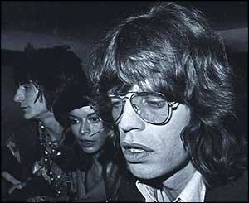
What does this have to do with the “Paleolithic” and “Neolithic” ages?

Slide 2
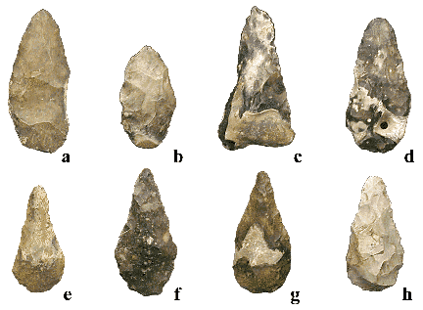
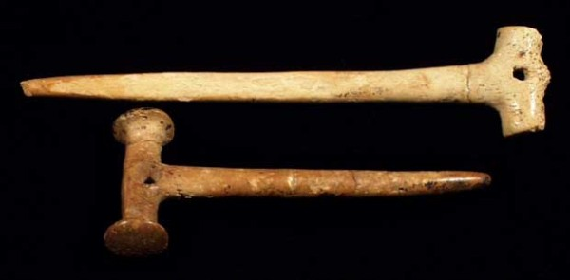
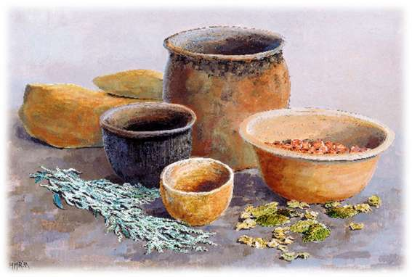
Paleolithic v/s Neolithic
Prehistory Timeline
What about these??

Slide 3
Please Create and Complete This Chart in Your Notebook
Factors of: | Paleolithic | Neolithic
Definition
Housing
Food/Living
Technology
Social Organization

Slide 4
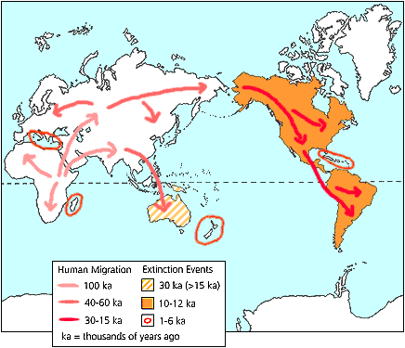
The Homer Simpson migration theory…
Follow the Donut
(food supply)

Slide 5
Definitions:
Paleolithic (Old Stone Age) The first age in which people lived (c. 2.3 million years ago – c.8,000b.c.) when they mostly hunted and gathered their food.
Neolithic (New Stone Age) The time period starting c. 8,000 bc when humans started to settle into farming villages and started producing their own food.

Slide 6
Neolithic (New Stone Age) The time period starting c. 8,000 b.c. when humans started to settle into farming villages and started producing their own food.

Slide 7
4 factors that you can use to tell them apart:
Housing
Means of Living (How they gather food)
Technology
Social Organization

Slide 8
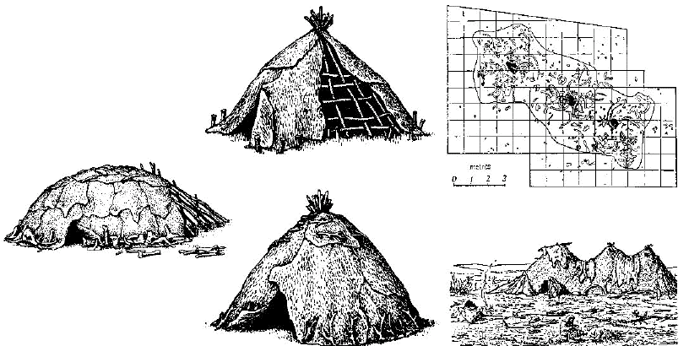
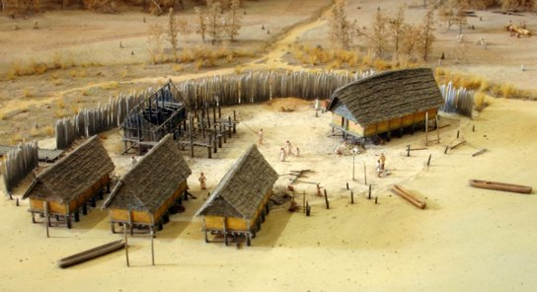
Housing
A House From Jarmo
Paleolithic:
Campsites, Tents, Caves and Huts
Temporary and Mobile
Neolithic:
Houses constructed of stone, mud, or wood.
More permanent

Slide 9
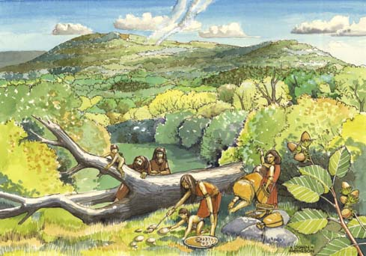
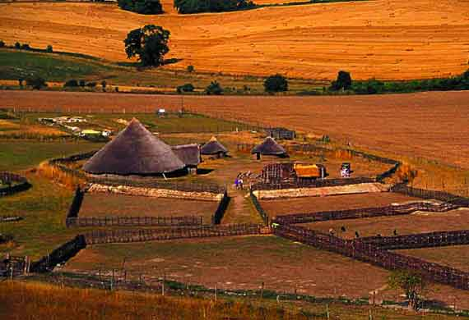
Means of Living (How they get food)
Paleolithic:
Hunting and gathering
Nomadic (moved with the food)
Neolithic:
Farming and herding
Start of specialized workers

Slide 10
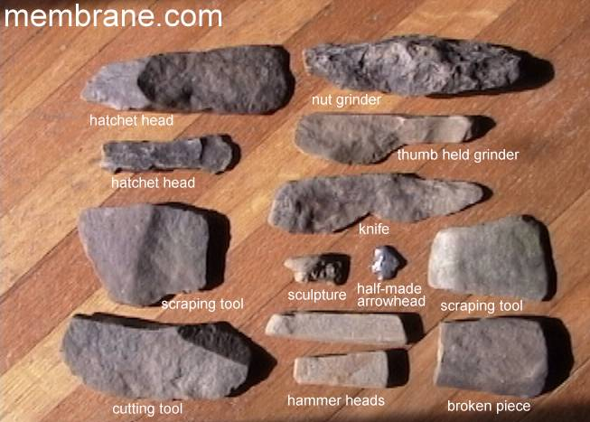
Technology:
Paleolithic:
Hunting and gathering tools:
Baskets, skins, bone and stone tools
Neolithic:
Farming tools:
Pottery, metal work, spinning/weaving, etc

Slide 11
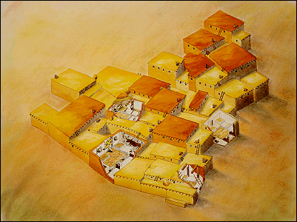
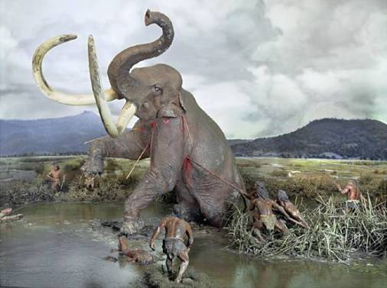
Social organization
Paleolithic:
Small Nomadic groups (25-40)
Society of equals, sharing resources
Neolithic:
Villages and small cities.
Private property

Slide 12
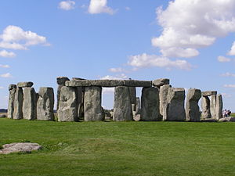
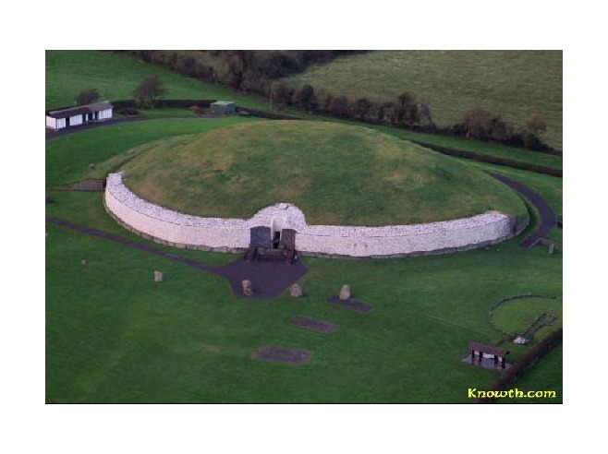
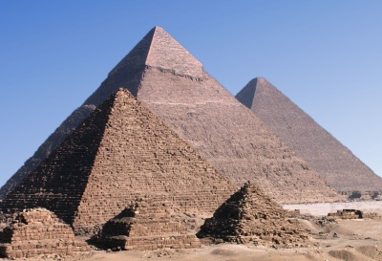
Great Neolithic Stone Monuments Which of these ancient monuments was built first?
Stonehenge in England
(3000 B.C. to 1600 B.C.)
Newgrange tomb in Ireland
(3200 B.C.)
Pyramids of Egypt
(2575 B.C. to 2465 B.C.)
Notes:
The answer is the Newgrange Tomb in Ireland. Remind students that B.C. dates are counted backward from 0, so 100 B.C. is “younger” historically than 1000 B.C.

Slide 13
Now that you see the difference between both the Paleolithic peoples and the Neolithic peoples let’s do and overview of how these groups developed to become a civilization that encompasses the five traits we discussed earlier.
Farmers/Herders domesticate plants and animals and settle in one area.
Paleolithic hunters and gathers

Slide 14
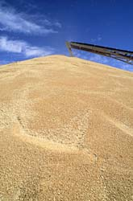
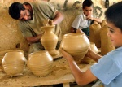
Specialized workers arise because people have enough food to start doing other types of work
Farmers produce a Surplus of Food and the population rises

Slide 15
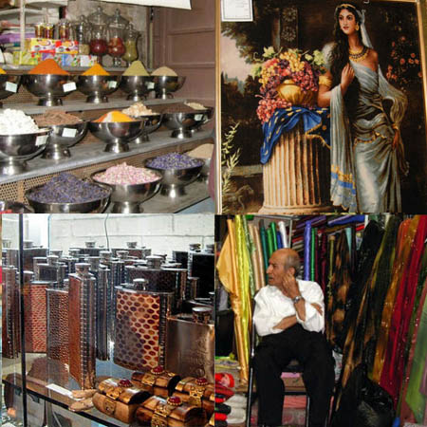
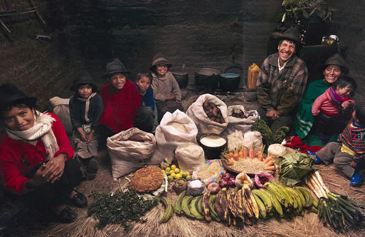
People start to produce more of everything and want items that they don’t make themselves
Trade develops

Slide 16
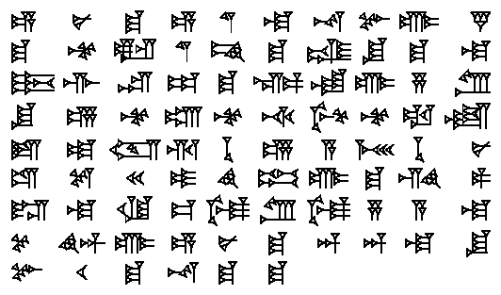
Exchange of ideas and culture. Civilizations start to borrow and exchange ideas… civilizations grow and adapt.
Writing develops to record trade transactions

Slide 17
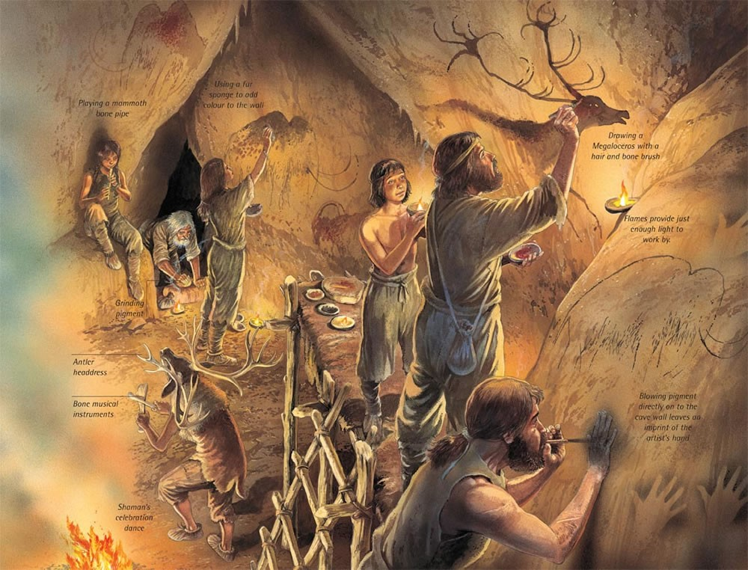
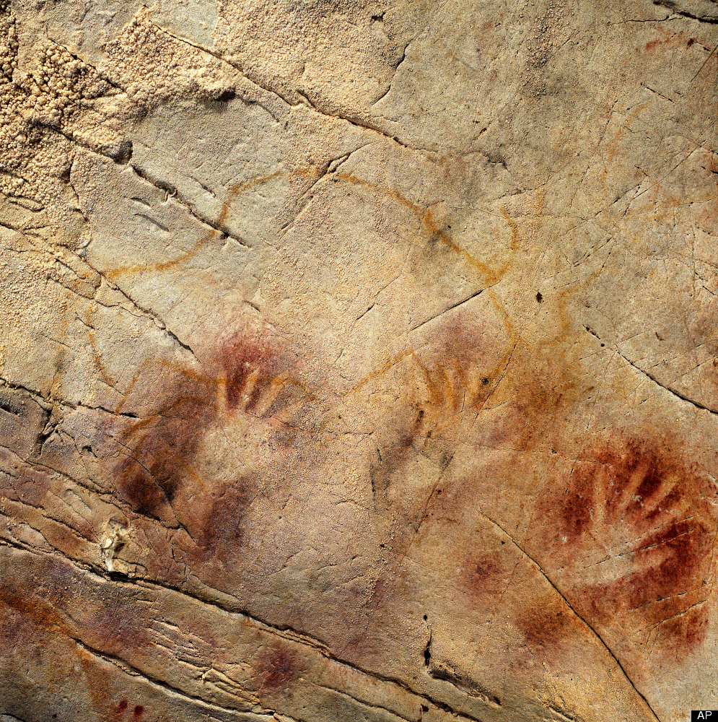
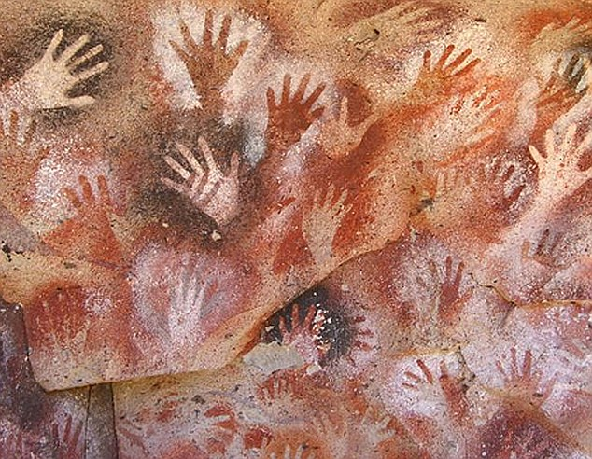
What do these hands tell us about the ancient peoples/groups who made them?

Slide 18
Sites to Explore
Tour Lascaux Cave
Stone Age Cave Paintings from Lascaux France
Visit Chauvet Cave
The Iceman's Last Meal
Buffalo Eddy - Washington and Idaho
"We're Nomadic" from Flocabulary

