Slide 1
5 Traits of a Civilization
EVERY MAJOR CIVILIZATION HAS DEVELOPED THROUGH 5 KEY COMPONENTS. EACH COMPONENT HAS A SIGNIFICANT IMPACT ON THE GROWTH AND PERSEVERENCE OF THE CIVILIZATION.

Slide 2
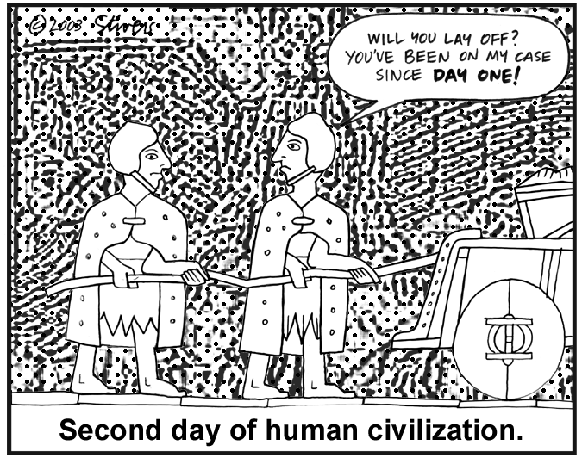

Slide 3
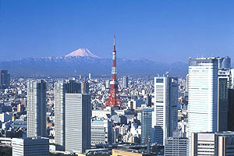
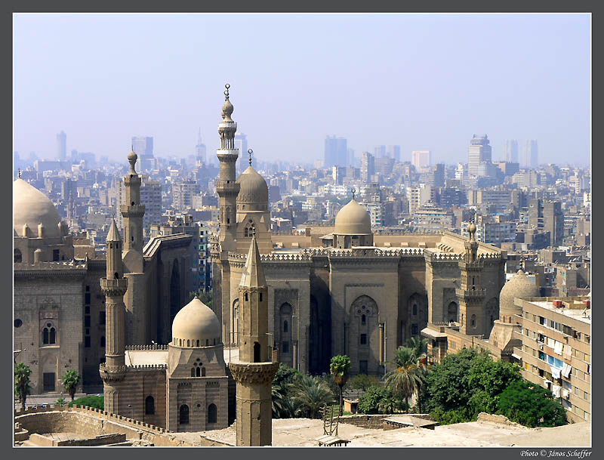
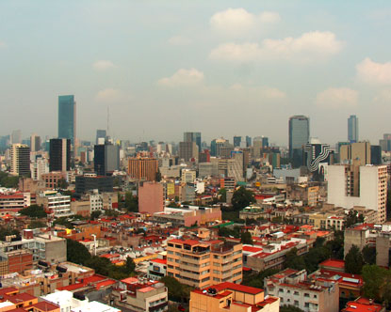
1. A CIVILIZATION MUST HAVE A CITY OR CENTER OF TRADE
Tokyo, Japan
Cairo, Egypt
Mexico City, Mexico

Slide 4
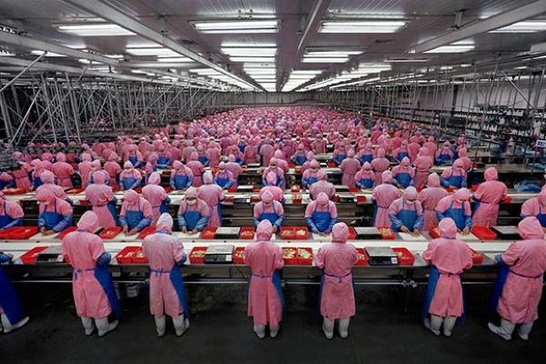
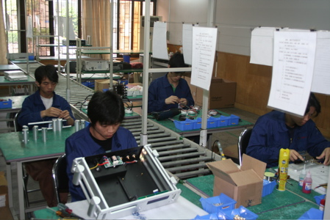
2. A CIVILIZATION MUST HAVE SPECIALIZED WORKERS ENGAGED IN THE MAKING OF PRODUCTS FOR TRADING OR SELLING
Chinese Assembly Line Workers
S. Korean Assembly Line Workers

Slide 5
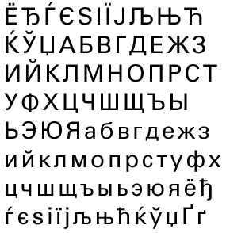
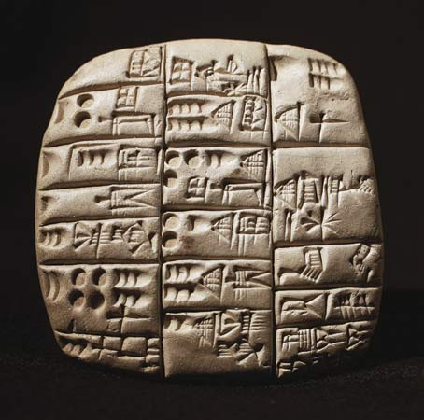
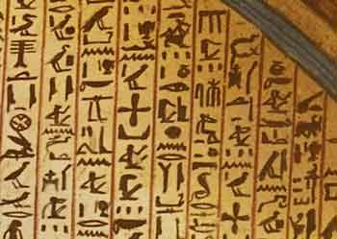
3. A civilization needs to have some sort of writing system for communications about trade, laws, etc.
Cyrillic Alphabet (latin)
Cuneiform writing
Egyptian Hieroglyphics

Slide 6
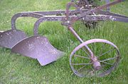
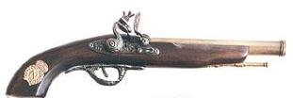
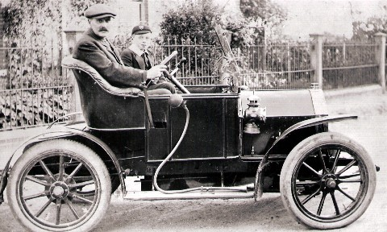
4. A civilization must have some type of technology which is advanced for their time period.
Gun
Plow
Computer
Automobile

Slide 7
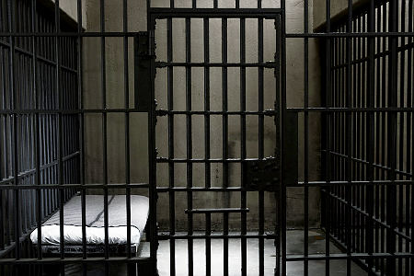
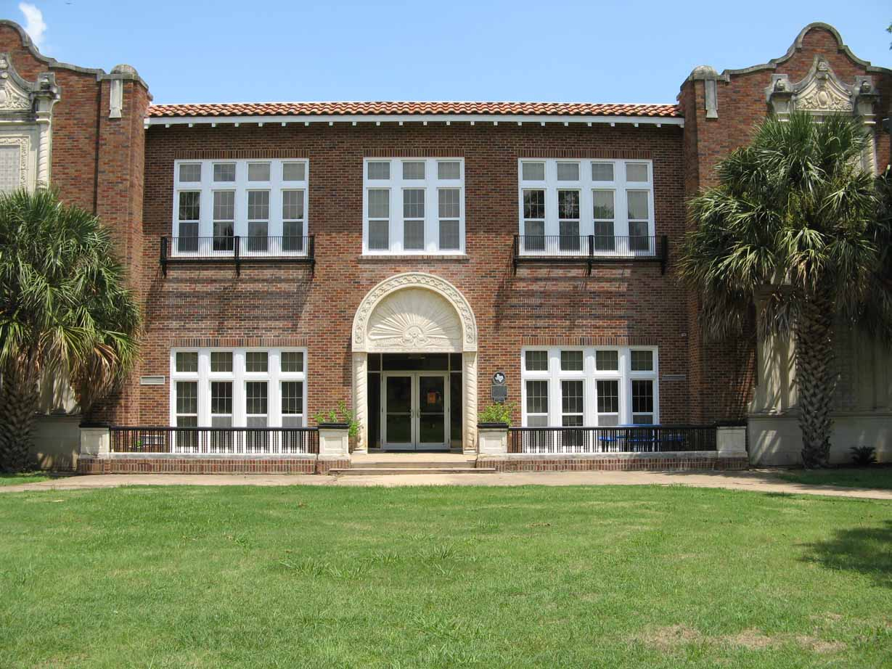
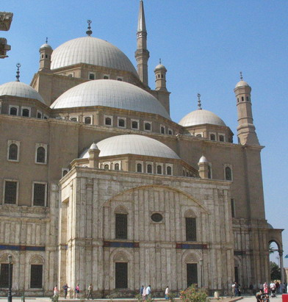
5. A Civilization must have complex institutions such as governments, schools, religion, etc.
Prisons
Government
Schools
Places of Worship

Slide 8
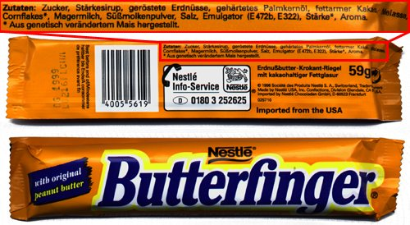
SO... Can you prove the U.S.A. is a civilization using just one wrapper???

