Slide 3
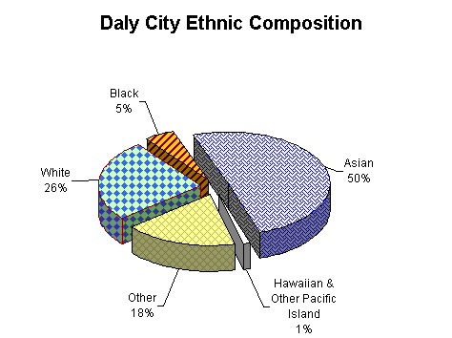
Ethnic Pie Charts
Must include at least four different Ethnicities
Must add up to 100% and have total populations
Must list Population
Must be labeled & colored neatly
Must include at least three REAL ethnic groups
Must be appropriate
(NO DISCRIMINATION!)

Slide 4
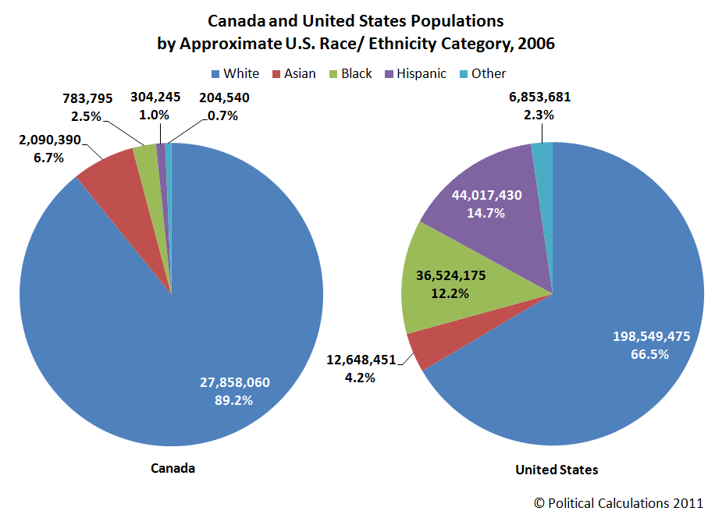

Slide 5
