Slide 1
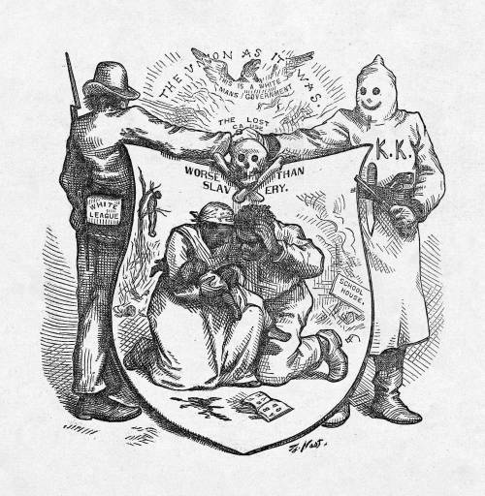
The Collapse of Reconstruction
Section 12.3

Slide 2
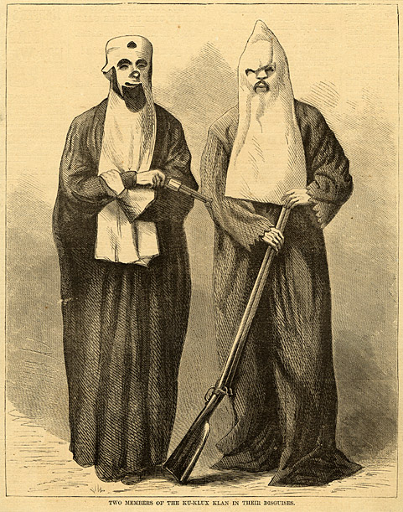
Opposition to Reconstruction
Ku Klux Klan
Founded as a Confederate veterans’ group
Turned into a terrorist organization
Goal: Restore white supremacy in the South

Slide 3
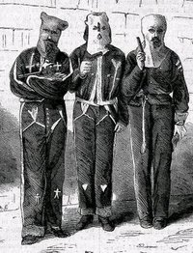
Opposition to Reconstruction
Ku Klux Klan (continued)
Tactics
Used intimidation and violence to keep African Americans from voting
Intimidate whites who supported African Americans
Attempted to reinstate Democratic political power in the South

Slide 4
Opposition to Reconstruction
Enforcement Act:
Federal supervision of elections in South
Use federal troops where KKK is active
Declared unconstitutional in 1872

Slide 5
Opposition to Reconstruction
Amnesty Act
Gave the right to vote and to hold office back to former Confederate generals and officials.
Severely weakened Republican power.

Slide 6
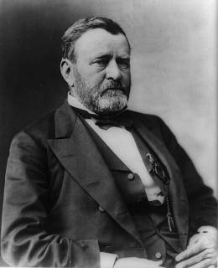
Scandals and Crises Hurt Republicans
Grant’s Presidency
Grant is politically inexperienced
Many of his appointees are dishonest and corrupt
Three of his appointees were proven to have taken bribes
Liberal Republicans opposed Grant
Weakened unity and power of Republicans

Slide 7
Economic Turmoil
Panic of 1873
Created by over-investments
Railroad companies
89 of 364 declare bankruptcy
18,000 business fail in 2 years and unemployment rose to 14%
5 year economic depression
Less concern with racism in south

Slide 8
Democrats “Redeem” the South
Redemption: Democrats regain control of state legislatures in the South
Election of 1876
Rutherford B. Hayes (Republican) loses popular vote but Republicans in the Senate award him the electoral votes needed for a victory.
184/165 (20 disputed votes)

Slide 9
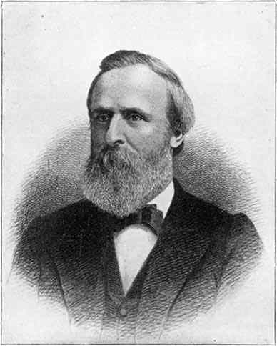
Democrats “Redeem” the South
Compromise of 1877
Democrats in the House of Representatives must approve Hayes in exchange for an end of federal supervision.

Slide 10
