Slide 1
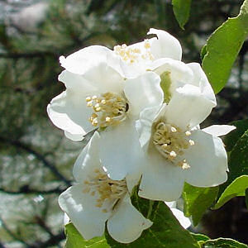
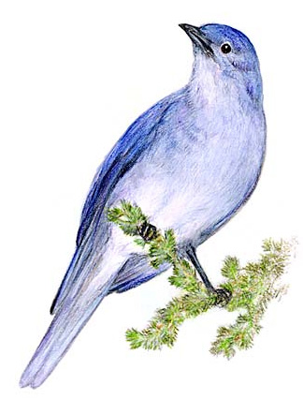
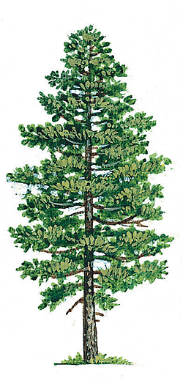
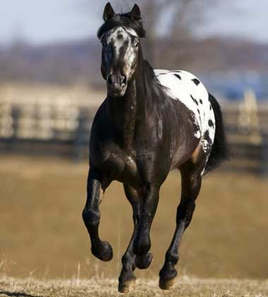
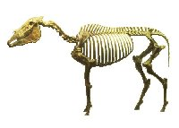
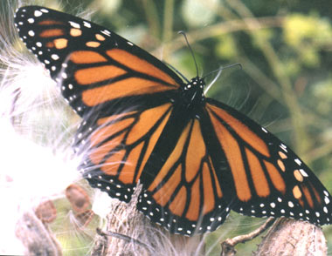
Island Symbols
Notes:
Idaho symbols: Seal, Flower: Syringa, Bird: Mountain Bluebird, Gem: Star Garnet, Fossil: Hagerman Horse Fossil, butterfly: monarch, tree: Western White Pine, horse: appaloosa, Fish: Cutthroat Trout, Song: Here we have Idaho, Vegetable: Potato, Nickname: Gem State, Motto: Esto Perpetua, State Dance: Square dance, State Fruit: Huckleberry

Slide 2
Island Symbols
Write down underlined words!
Must create 5 symbols and
Explain what they stand for
Examples: Island tree, animal, fossil, food, color, flower, drink, song, etc.
Each item needs to have a picture and a short description of what it is. Place them on a blank sheet of printer paper.
Items should related to the theme.

