Slide 1
Questions: Write these down and answer them as we go through this PPT .
Define History.
What are Artifacts? Examples?
Define Bias.
Define Interpretation.
Define Primary Source.
Define Secondary Source.
What is Archeology?
What is an Anthropologist?
Why are grid systems used? Explain.
Answer Prompt ☺:

Slide 2
Archeology 101

Slide 3
What is History?
The branch of knowledge dealing
with past events. (Webster’s)
How do we know about historic events?
Artifacts such as writing, drawings,
oral traditions, etc.
What is an Artifact?
Anything made or used by humans.

Slide 4
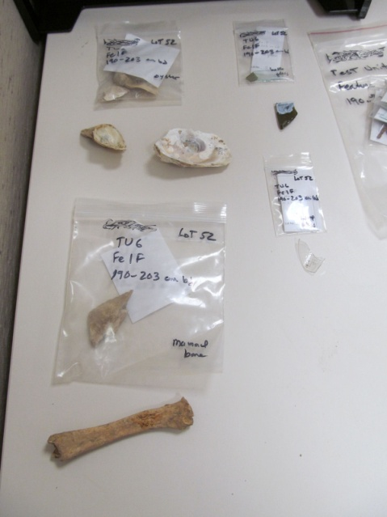
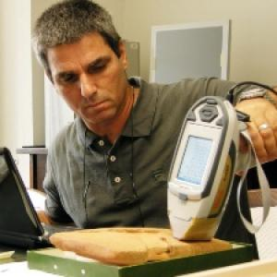
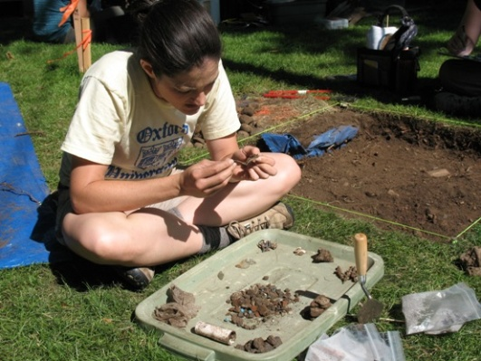
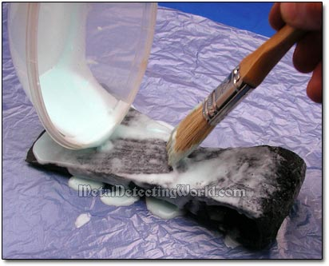
Artifacts
When artifacts are found they are...
Cleaned
Labeled
Sorted
Analyzed by professionals

Slide 5
How is history made??
Perspective/Bias: Your point of view based upon your likes and/or dislikes.
Interpretation: How you make meaning out of something.
Primary Source: Something created by someone who was directly involved in the event.
Secondary Source: Something created by someone who was NOT directly involved in an event… An interpretation using your personal biases.

Slide 6
Question what you read and hear!!! Everything is someone’s interpretation of what they believed happened.

Slide 7
Archeology vs. Anthropology
Archeology: the scientific study of material remains (as fossil relics, artifacts, and monuments) of past human life and activities.
Anthropology: the science of human beings; especially : the study of human beings and their ancestors through time and space and in relation to physical character, environmental and social relations, and culture.
~Merriam-Webster Dictionary
What does that mean??

Slide 8
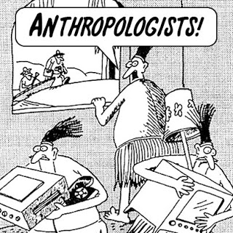
Archeology vs. Anthropology
Archeologists do the digging and discover artifacts from the past.
Anthropologists take those findings and interpret them to create stories about the people who lived back then.

Slide 9
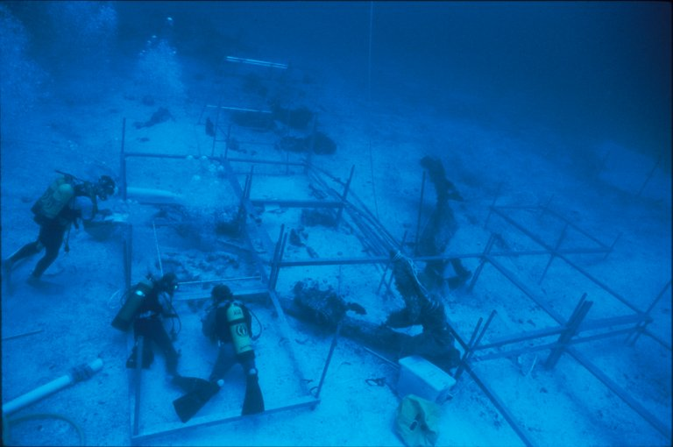
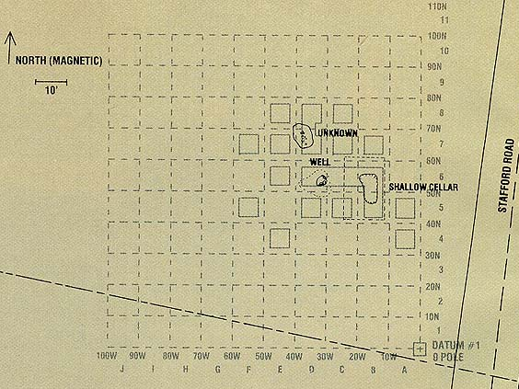
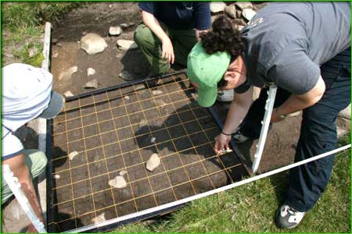
Grid System
Archeologists carefully grid out their site and a map of the site
Allows Archeologists to record exactly where each artifact was found
Normally 5 meter squares

Slide 10
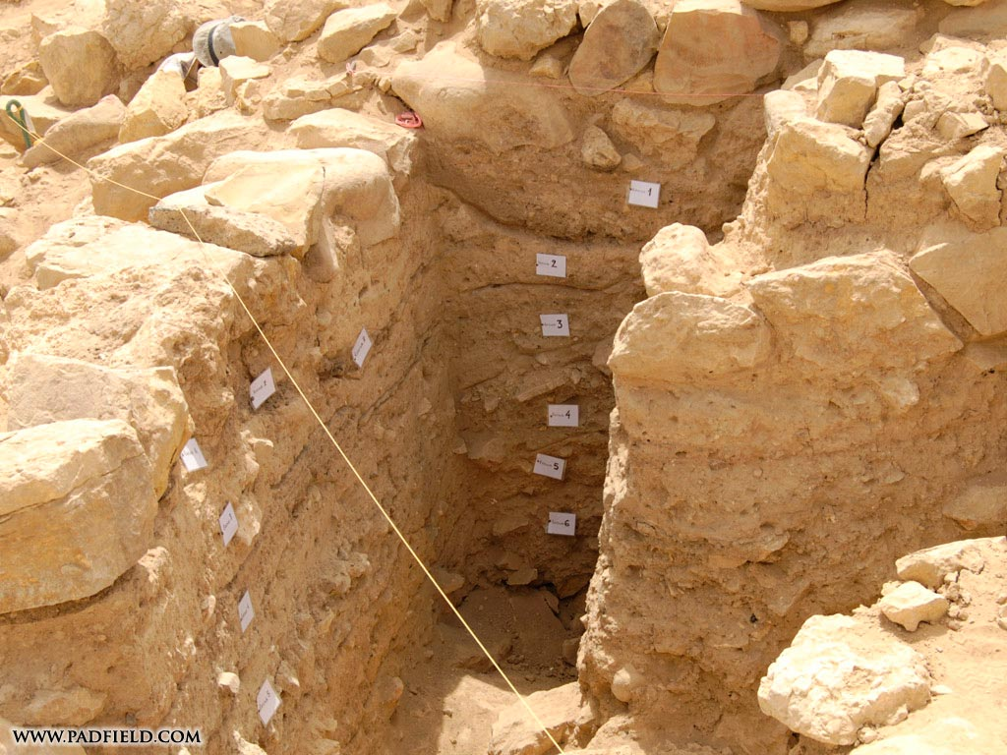
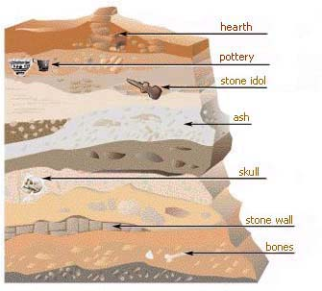
Layers – What They Tell Us
Over time, layers of strata are formed and pile on top of each other.
So each layer represents a different time period
Another reason the grid system is so important… archeologists have to keep track of which layer and therefore which time period each artifact comes from.

Slide 11
Think of History like Lasagna ☺
Notice the Layers or Stratas … each layer tells it own story about the history of that area

Slide 12
Reflect for a moment, then write a brief paragraph explaining what this statement means and how it relates to World History.
“There’s your side of the story, my side of the story, and somewhere in the middle is the truth.”

