Slide 1
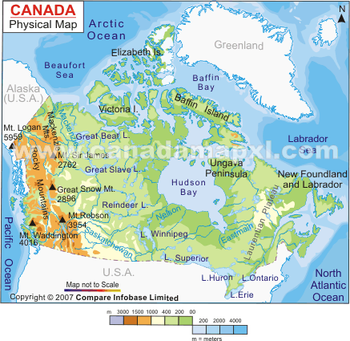
Physical Map
1. Title your map
Label at least 10 physical features on your island such as mountains, rivers, lakes, deserts, oceans, bays, etc.
Label and Color neatly
Calculate land Area onto the map
See pg. 34 for other physical features. Also see pg. 14 for a sample
Physical Map

