Slide 1
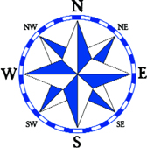
47N
Stop Sign Island
Draw a compass rose with cardinal and intermediate directions.
Add a title.
Label the lines of latitude and longitude appropriately based on where you chose to put your island on the planet
126 W
116 W
Draw a scale bar EXACTLY 2 inches long and mark at 0,1,2 inches BUT DON’T Label it YET.
Draw your Islands OUTLINE ONLY!
Write your full name AND period on the back.
40N

Slide 2
47N
Stop Sign Island
SAMPLE
126 W
116 W
Make it perfect!
This will be photocopied
40N

