Slide 1
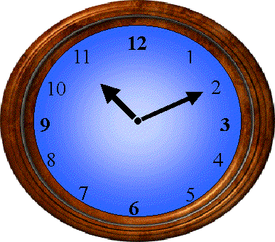
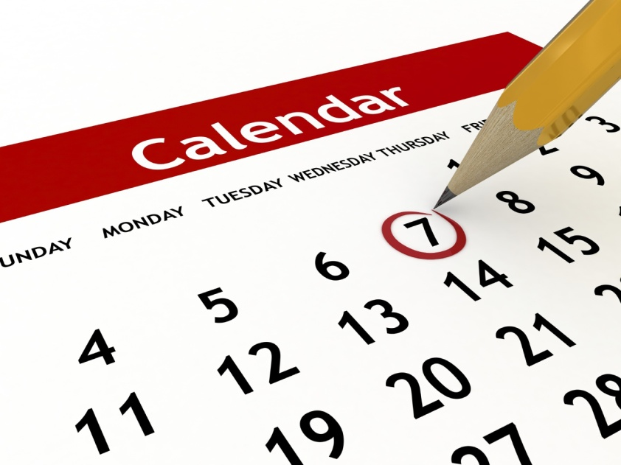
Time, Calendars, and Timelines of World History

Slide 2
Question: Why do we need time???
Answer: We need time to GET A DATE! ☺
Billy: Hey, you wanna go out with me sometime?
Sally: Sure, when?
Billy: Uhhhhh….. How about when the sun is up in the sky?
Sally: Where in the sky?
Billy: Man … I wish we had an exact time.
Billy: Hey, you wanna go out with me sometime?
Sally: Sure, when?
Billy: Uhhhhh….. How about 6:00pm this Friday Night?
Sally: That sounds perfect!
Billy: Man … I am glad that we have exact time.
Without Exact time
With Exact time

Slide 3
Time Breakdown
Millennia =
1,000 years
Century =
100 years
Decade =
10 years
Year =
365 ¼ days
Days =
24 hours

Slide 4
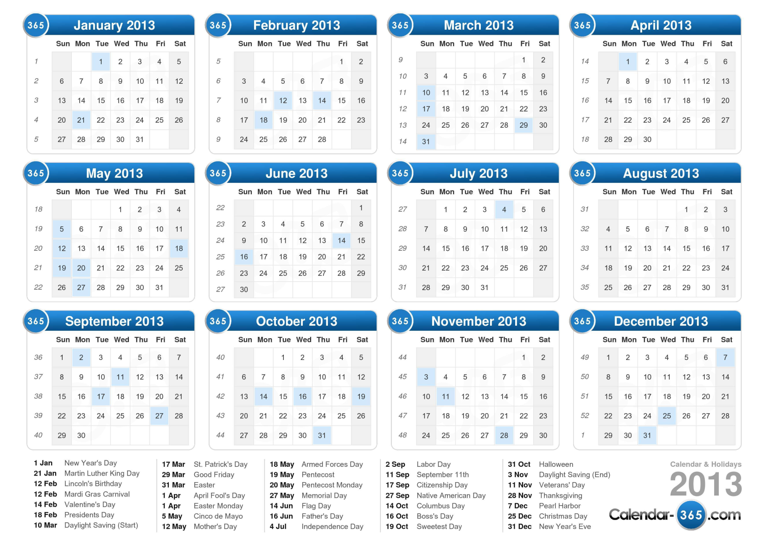
Once we have specific times and dates we can plot those on a calendar.
Our calendar: A.K.A: Gregorian calendar or Western calendar or Christian calendar
This is the most common global calendar recognized by the United Nations and the Universal Postal Union.
Called the Gregorian calendar because it was approved in the late 1500’s by Pope Gregory XIII (13th)
BUT WE ARE NOT ALONE!!!!!!!!!!!!!

Slide 5
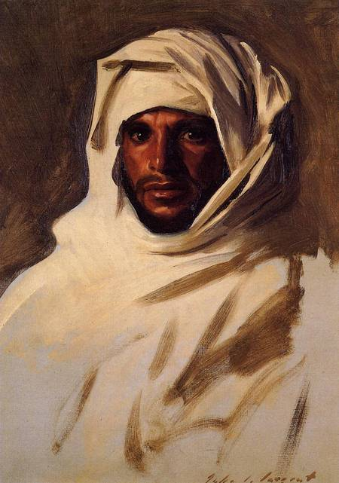
Muslim Calendar: The Year: 1437
Some other calendars from around the world!
The Muslim calendar starts in 622 AD when Mohammed left the city of Mecca. The years are about 10 days shorter because they use a different lunar calendar
So, today is the year 1440 AH or Anno Hegira which means “in the year of Hegira.”

Slide 6
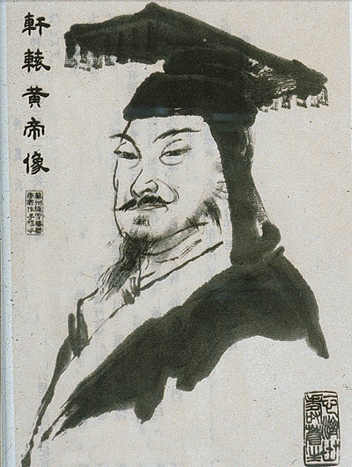
Chinese Calendar: The year: 4715
Although the Chinese Calendar traditionally does not use numbered years, outside China its years are often numbered from the reign of the Yellow Emperor Huangdi.
But at least three different years numbered 1 are now used by various Chinese calendars, making the year 2019 – the “Chinese Year” 4717, 4716 or 4656

Slide 7
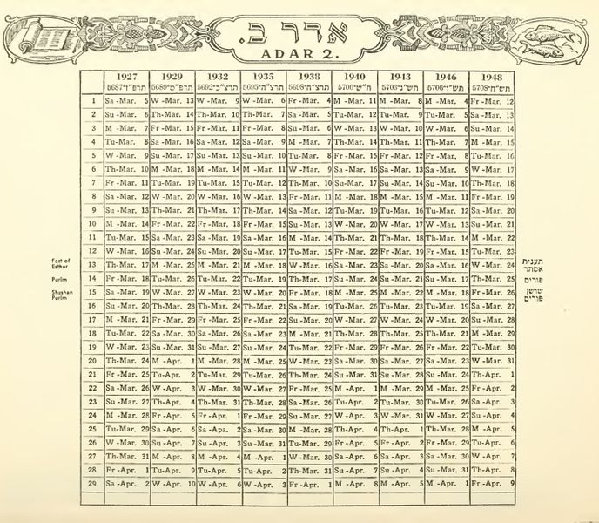
Jewish Calendar:
The Jewish calendar is generally said to have been set down by the Sanhedrin president Hillel II in approximately C.E. 359. The original details of his calendar are, however, uncertain.
The Jewish calendar is used for religious purposes by Jews all over the world, and it is the official calendar of Israel.
If it is Wednesday, 4 September 2019 on the Gregorian = Then it is 2nd of Elul, 5779 Hebrew

Slide 8
Question 1: Explain the challenge of not having a unified global calendar, what problems does that create?
TIME TO THINK☺
Question 2: Why would certain groups and people prefer to keep their own calendars and not switch to a global calendar?

Slide 9
History of the Gregorian Calendar: A work in progress
Based on the Sky: The moon, sun and stars
Year = Sun (once every 365 ¼ days) Leap Year is every 4th year
Months = Moons (every 29 days)
Weeks = Sun + Moon + 5 stars that don’t twinkle (planets)
Days = The rising and setting of the sun and the moon.
Hours = Only came about in the 14th Century AD (1300’s) when European towns mounted large clocks in the town square and they chimed out 24 times a day.
Minutes = Invention of trains and industry in mid to late 1800’s AD. Early clocks had no minute hands.

Slide 10
Now, what is the best way to display dates and events over a long period of time???
Yep …. A Timeline!
But what is a timeline?
Webster’s Dictionary: a table listing important events for successive years within a particular historical period.
WHAT?????? If you are still confused then see the example on the next slide!

Slide 11
Timeline Example:
The history of video games and gaming consoles.
What do you notice?
Unorganized data is confusing to sort through!

Slide 12
We use timelines to organize data over a period of time!
Notice: The use of colors, pictures, bolded items, titles, and legibility!

Slide 13
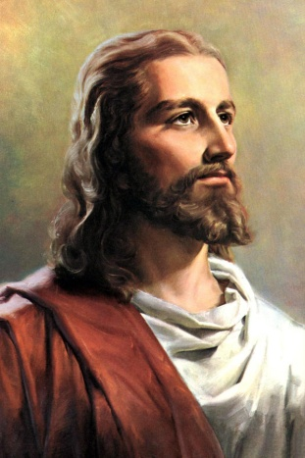
Answer: We use BC and AD!
Question: How do we organize timelines???
Also called the Christian calendar because it starts with the approximate birth of Jesus; a 0 marks that date and divides BC and AD.
BC or BCE
0
AD or CE
BC = Before Christ
BCE = Before the Common Era (used for BC sometimes)
AD = Anno Domini (latin): translated means “in the year of our lord”
CE = Common Era (used for AD sometimes)
When you see a date like c1500 BC, the “c” means circa or about

Slide 14
Rules of the Timeline: (History Math) ☺
KEEP IT SIMPLE: If it happened before Jesus was born then it was Before Christ (BC), if it happened after Christ was born it is AD (In the year of our lord).
Same Side of Timeline: Subtract
How many years are between 100 AD and 25 AD?
Answer: 100 AD – 25 AD = 75 years
How many years are between 200 BC and 100 BC?
Answer: 200 BC – 100 BC = 100 years
Opposite Sides of Timeline: Add
How many years are between 100 AD and 100 BC?
Answer: 100 AD + 100 BC = 200 years
How many years are between 65 AD and 10,000 BC?
Answer: 65 AD and 10,000 BC = 10,065

Slide 15
Final Practice:
Today is 2019 AD. How many years ago was 1000 BC?
Answer: 3,019 years
Today is 2019 AD. How many years ago was 5 AD?
Answer: 2,014 years
REMEMBER:
Same Side of Timeline: Subtract
Opposite Side of Timeline: Add

Slide 16
Your Timeline Task ☺:
Step 1: Organize all the dates provided to you in your envelope.
Step 2: Use the provided timeline to organize your dates.
Step 3: Write the dates and the events on the timeline.
Step 4: Using your global knowledge and/or your textbook and/or the World History Atlases, create a colored key that shows where in the world each event took place (example: any items in red occurred in Asia).
Step 5: Make sure you have a color for each of the following regions of the world: The Americas, Europe, Asia, Middle East, Africa, and Oceania/Australia.
Step 6: Using your global knowledge and/or your textbook and/or the World History Atlases you must add five additional dates to your timeline from 8000 BC – 1400 AD. These are items that you feel are extremely important to world history. Place a star by those events and be prepared to share those events and dates with your classmates, These cannot be the same date as required for Step 7.
Step 7: Using your timeline, write down five important events that occurred during your lifetime.
Step 8: Make sure your name, period, and date are on all of your sheets of paper and turn your timeline into the inbox.

Slide 17
Timeline Questions
What did you notice about the timeline?
Why do the dates become more specific in more modern times?
Why do the dates bunch up around 0?
Why do the time intervals change after 0?
Why did you decide on the dates you picked for steps 6 and 7?

Slide 18
Student Sample

