Slide 1
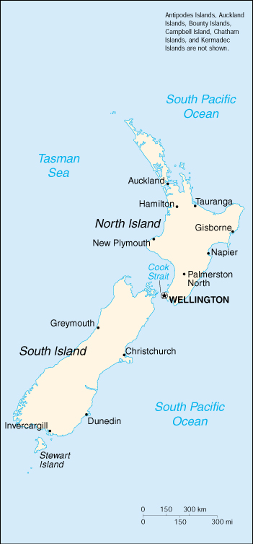
Political Map
35° S
1. Label at least four states, four cities, & a national capital
Add a key & Map Title
Color each state with a colored pencil.
See page 26 for a sample
46° S
179 ° W
167 ° W

Slide 2
125 ° w
Sample Political Map
100 ° W
N
15 ° S
W
E
S
Maple Bar
▪ Syrup City
◙ Duncan
Chocolate
▪Cocoville
Glazed
▪Sugar city
Cream Filled
▪Custard Town
See pg A 5 for a sample of a political map
Key
▪ = City
◙ = Capital
25 ° S

