Slide 1
Moderate Stage (French Revolution)
1789-1792

Slide 2
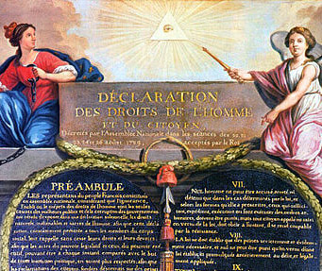
National Assembly (August 1789)
First Actions:
Abolition of Privilege:
Clergy & Nobility can now be TAXED!
Declaration of the Rights of Man and Citizen:
Declared that all men are “born and remain free and equal in rights”
Stated that people have Natural Rights
Notes:
Abolition of Privileges – On August 4, 1789, the National Assembly abolished all special privileges that the clergy and nobility had, thus both groups could be taxed.
Declaration of the Rights of Man – Inspired by the American Declaration of Independence, it declared that all men are “born and remain free and equal in rights.” It said that people have natural rights such as “liberty, property, security, and resistance to oppression.” It declared that all French people are equal before the law.

Slide 3
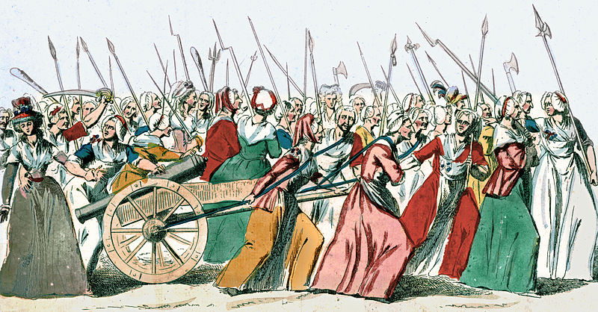
Women’s March on Versailles (October 1789)
Question:
What was the third CAUSE of the revolution that had NOT been addressed yet?
Food Shortage:
Got worse
Parisian women marched to Versailles
Demanded and forced Louis XVI to move to Paris
Question:
Why do you think the Parisian women wanted Louis XVI to move to Paris?
Notes:
Food Shortage – Hunger continued to plague France. The French people demanded through protest and force solutions to the problems France faced
Women’s March on Versailles – In October 1789, the food shortage had grown so bad that Paris women march to see Louis XVI in Versailles to demand food. The women heard the Queen, Marie Antoinette respond to their pleas for food by saying, “Let them eat cake.” This was just rumor and was not true, but it still angered the women in Paris and motivated them to march to Versailles. The women demanded for Louis XVI to return to Paris and Louis XVI complied.

Slide 4
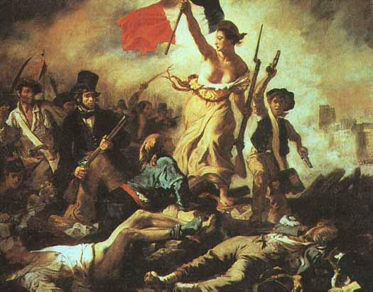
Constitution of 1791
National Assembly declared…
Constitutional Monarchy:
Voting to landowners
Formed Legislative Assembly which will:
Make laws
Collect taxes
Declare war & peace
Confiscated all Catholic Lands:
Intended to sell the lands to raise money
This angered Catholic peasants
Question:
Why might taking Catholic lands anger Catholic peasants?
Notes:
The National Assembly finished the constitution in 1791. It declared.
Constitutional monarchy. Along with the king would be the Legislative Assembly, which would make laws, collect taxes, and declare war and peace.
The Legislative Assembly would be elected by tax paying male citizens (only 50,000 of France).
Catholic Church lands were now under the control of the state and could be sold off to raise money; this angered the Catholic Church and peasant Catholics.

Slide 5
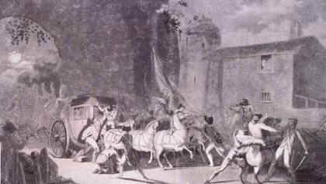
Run Away! Louis XVI (June 1791)
Louis XVI attempts to escape from France
Escape FAILS!
Captured in Varennes
Considered a traitor & placed under house arrest
France becomes a Republic
Louis XVI is dethroned
Notes:
In June 1791, Louis XVI and his family attempts to flee France, but their escape fails. He is found out and captured in Varennes and brought back to Paris.
Louis XVI is now considered a traitor to the revolution.
He is dethroned and France no longer has a king or a queen ruling the country. It has officially become a republic (a country where the power rests with the people and their elected representatives rather than a monarch).

Slide 6
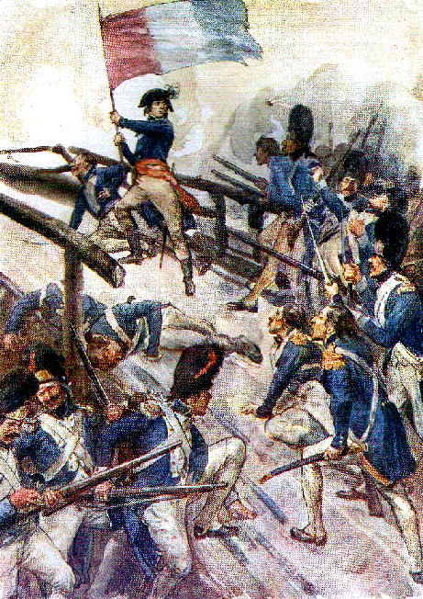
War (April 1792)
Declaration of Pilnitz (August 1791):
Prussia & Austria vow to protect the French Monarchy (Louis XVI)
Threat to the Revolution:
France declares WAR on Prussia & Austria (April 1792)
Duke of Brunswick (Prussia):
Declared that Paris would experience a “terrible revenge” if Louis XVI is harmed
Prussian Army moved closer to Paris
Question:
Why would France declare war on Austria & Prussia while it experiences a revolution?
How do you think the people of Paris responded as the Prussian Army got closer to Paris?
Notes:
Declaration of Pilnitz – In August 1791, Prussia and Austria stated through the Declaration of Pilnitz that they would protect the French monarchy.
This was considered a threat on the revolution.
April 1792, the Legislative Assembly, which was becoming more radical, declared war on Austria, Prussia, and Britain.
Duke of Brunswick – The war with Austria, Prussia, and Britain caused tension in Paris. The Duke of Brunswick declared that if Louis XVI and his family was harmed that he would exact a terrible revenge on the people of Paris. The Duke of Brunswick pushed westward toward Paris, which caused wide fear.

Slide 7
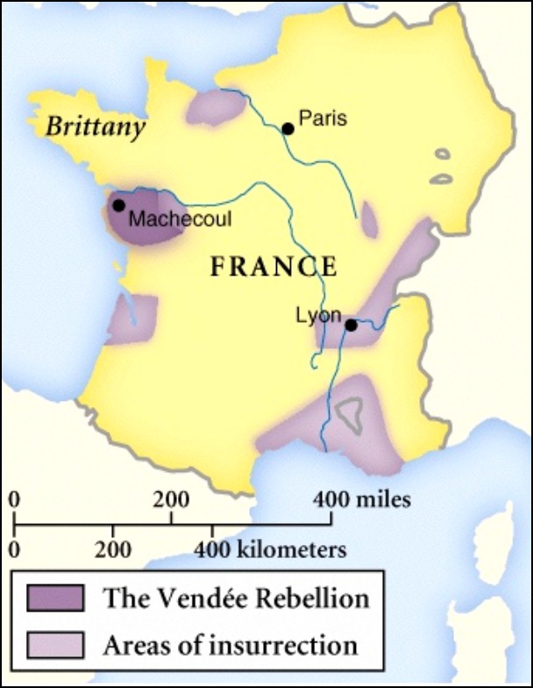
Counterrevolution
Some rural Peasants opposed the revolution
Disapproved of:
Taking Catholic lands
Abolishing Catholic traditions
Drafting peasants for war
Increased taxation
These Peasants allied with local nobles and fought against the revolution
Question:
What actions do you think the leaders of the revolution would take against the counterrevolution?
Notes:
Many peasants in western France protested against the changes made against the revolution. They were angered by the abolition of the Catholic tradition in France, conscription to fight in the war regional war, and taxation. They allied with local nobles and fought against the revolution.

Slide 8
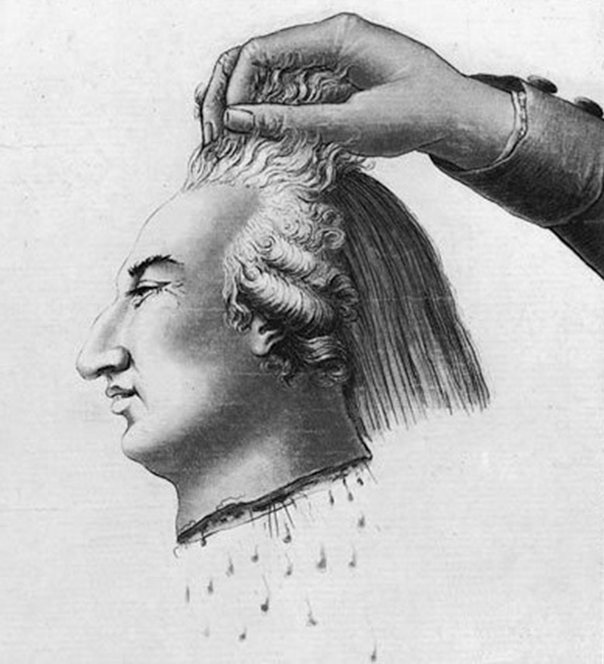
Execution of Louis XVI (January 1793)
Question:
As the Austrian & Prussian Army moved closer to Paris, and the counterrevolution occurred in rural France, how do you think the people felt about Louis XVI who attempted to leave France?
What do you think they will do to Louis XVI?
Louis XVI was seen as a traitor because he tried to flee
Revolutionaries feared that the invading forces AND the counterrevolution would restore Louis XVI as king
Louis XVI is found guilty of treason
Put to death by guillotine
Question:
Why kill the king?
Notes:
The tension from the invading forces (Prussia and Austria) and the counterrevolution caused the revolutionaries to put Louis XVI on trial for treason, because he tried to escape and was seen as a traitor trying to help and support Prussia and Austria. The revolutionaries also feared that Prussia and Austria would reinstate the monarchy if they defeated the French Army. Louis XVI was found guilty for treason.
He was executed in 1793 by the guillotine.

