Slide 1
The Enlightenment (The Age of Reason)
1685-1789

Slide 2
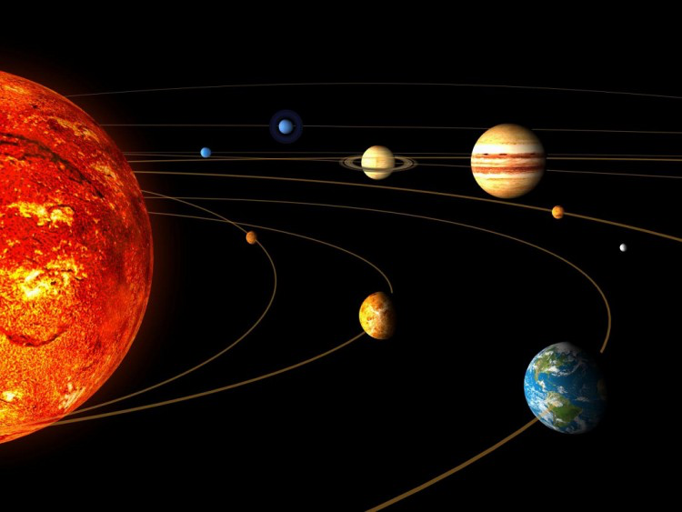
Causes of the Enlightenment
Scientific Revolution
Reason & Scientific Method
Isaac Newton – Explained the order of the universe
Abuse of Power – Absolutism
Religious tolerance revoked in France (1685)
Protestants fled France AND criticized Absolutism
England’s Constitutional Monarchy
An example of limited government
Notes:
Scientific Revolution and Isaac Newton’s Principia was one of the causes. Newton explained the order of the universe. If Newton could use reason to explain physics, then reason could be used in government as well.
Abuse of Power (Absolutism) – 1685, Louis XIV repealed the Edict of Nantes and started to persecute the Protestants in France again. This changed showed the far reaches government had under an Absolute Monarchy, and it caused many Protestants to flee France, and through writing, criticize France and Absolutism.
England’s Constitutional Monarchy – England was not an Absolute Monarchy, and it was an example to the other countries of Europe of what a limited government could look like.

Slide 3
Enlightenment Terms
**Take out your “Enlightenment Terms” worksheet to define the following terms.***
**NO NOTES NEED IN THIS PART**

Slide 4
State of Nature:
Enlightenment Terms:
A situation without laws, government, and other controls; anarchy.
Question:
What is an example of the state of nature?
Social Contract:
An agreement people make to cooperate with one another by giving up the state of nature and some individual rights in order to have protection and an organized society.
Question:
When would you give up your rights?

Slide 5
Enlightenment Terms:
Natural Rights:
Question:
What are some Natural Rights?
Rights that belong to humans from birth. For example, the rights to life, liberty, and property.
Checks and Balances:
Regulating and correcting different parts of a government through limiting and adjusting the power of each part to ensure that no part of a government becomes too powerful.
Question:
How do the checks and balance work in the United States government?

Slide 6
General Will
Enlightenment Terms:
The common interests of the people as a whole; what is believed to be best for society.
Question:
What is an example of general will?
Philosophe:
Intellectuals or philosophers during the Enlightenment; applied reason to the study of government. “Lovers of wisdom.”

Slide 7
English Philosophes
Back to our notes ☺

Slide 8
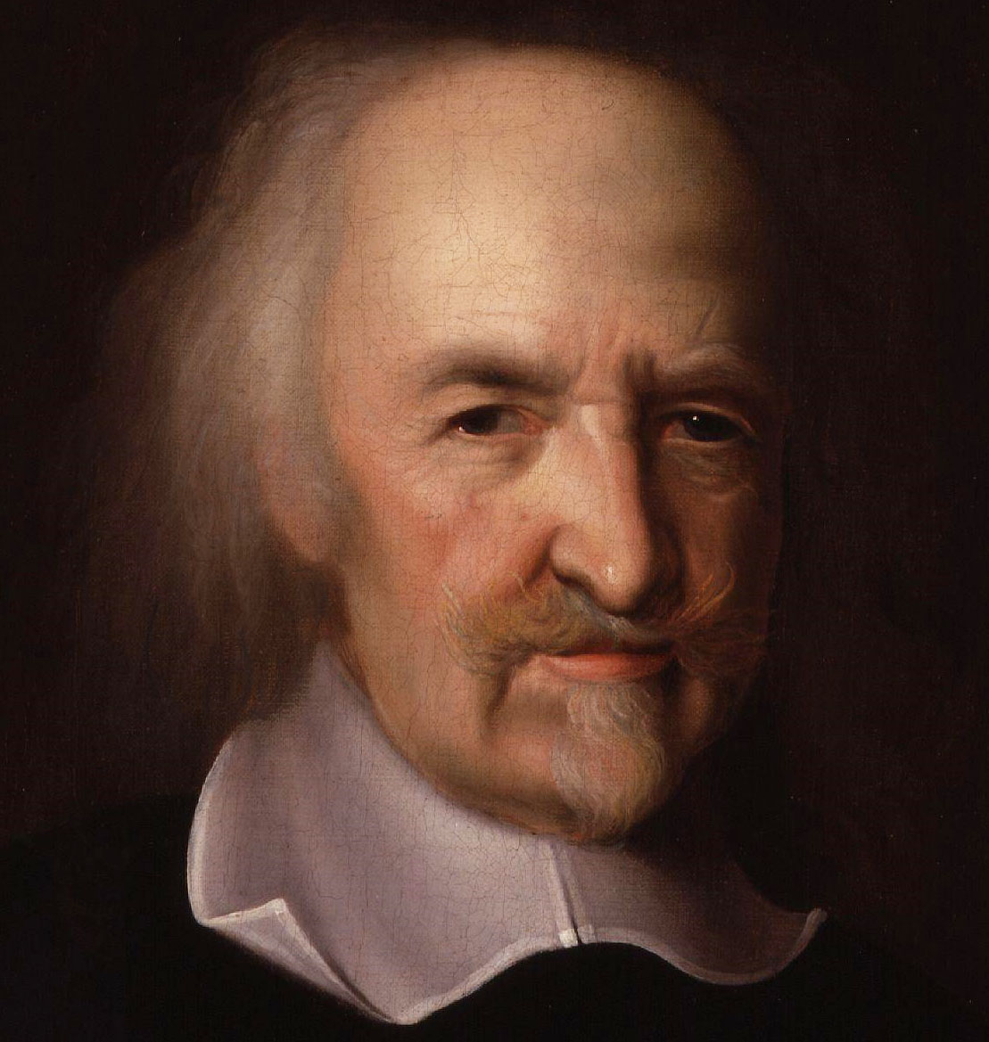
Thomas Hobbes (1588-1679)
Philosophe #1:
Believed people are naturally bad
State of Nature
War and chaos
“Continual fear and danger of violent death”
SOLUTION:
Social Contract
To obtain stability and order
Favored Absolute Monarchy
Question:
Why do you think he favored Absolute Monarchy?
Notes:
Thomas Hobbes (1588-1679) – English Philosopher. Believed that people are naturally bad, cruel, greedy, and selfish in the “state of nature.” Therefore people needed to create a “social contract” to obtain stability and order. Hobbes believed in a strong central government to obtain and maintain stability and order; he favored absolute monarchies.

Slide 9
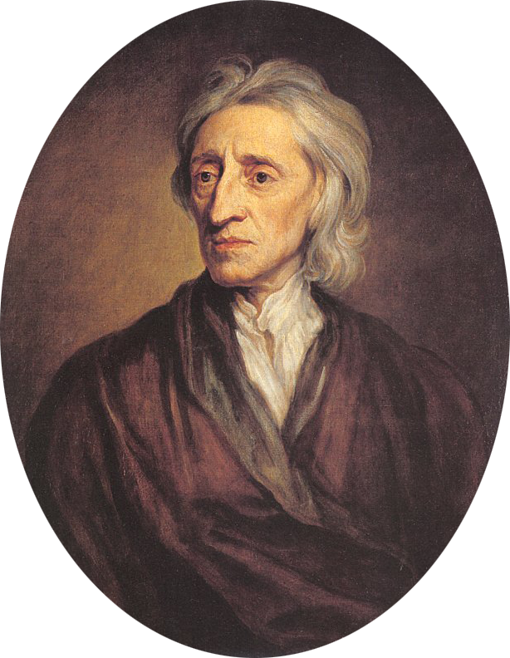
Philosophe #2:
John Locke (1632-1704)
Believed people are naturally reasonable and moral
Natural Rights
Everyone is born with the right to life, liberty, property
Consent of the Governed
People give the government the authority to rule
Government is required to protect natural rights
If natural rights are violated, people have the right to overthrow a government
Favored limited government power
Question:
When do YOU think it’s okay to overthrow a government?
Notes:
John Locke (1632-1704) – English Philosopher. Believed that people are naturally reasonable and moral, and that everyone is born with “natural rights” such as the right to life, liberty, and property. He said that people formed government to protect their natural rights, and that the best form of government was one with limited power; he rejected absolute monarchy. He believed that government has an obligation to the people it governs and that if fails its obligation or violates natural rights, then the people have the right to overthrow that government.
John Locke believed that government derived their power from the consent of the governed (the people of a country). A contract is made between the people and the government for the government to govern justly, protect property, and to ensure that liberties are protected. If a government violates this contract, then the people have the right to overthrow the government. He believed that a constitutional government was the best form of government because it protected rights.

Slide 10
Questions
What were the THREE causes of the Enlightenment?
What was Thomas Hobbes’s description of the State of Nature?
What solution did Thomas Hobbes have for humanity to separate themselves from the State of Nature?
What did John Locke believe everyone was born with?
According to John Locke, what do people have the right to do if a government does NOT protect natural rights?

Slide 11
The Enlightenment Continued: French Philosophes

Slide 12
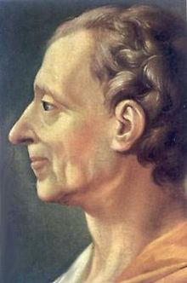
Montesquieu (1689-1755)
Philosophe #3:
Studied governments of the past & present
Admired the English Constitutional Monarchy because of its divided power
Checks and Balances
Best government divides power into 3 branches:
Legislature
Executive
Judicial
Question:
Should power be divided? Why?
Notes:
Montesquieu (Mon-tes-quu) (1689-1755) – French Philosopher. He studied the different governments of the past and present from around the world. He admired the English form of government because of its divisions of power. He believed that the best form of government that would protect the natural rights of its people was one that divided its power into three separate parts: the legislature, executive, and judicial. And that each part of the government would check the power of the other parts in order to limit the power of each. This is known as “checks and balances.”

Slide 13
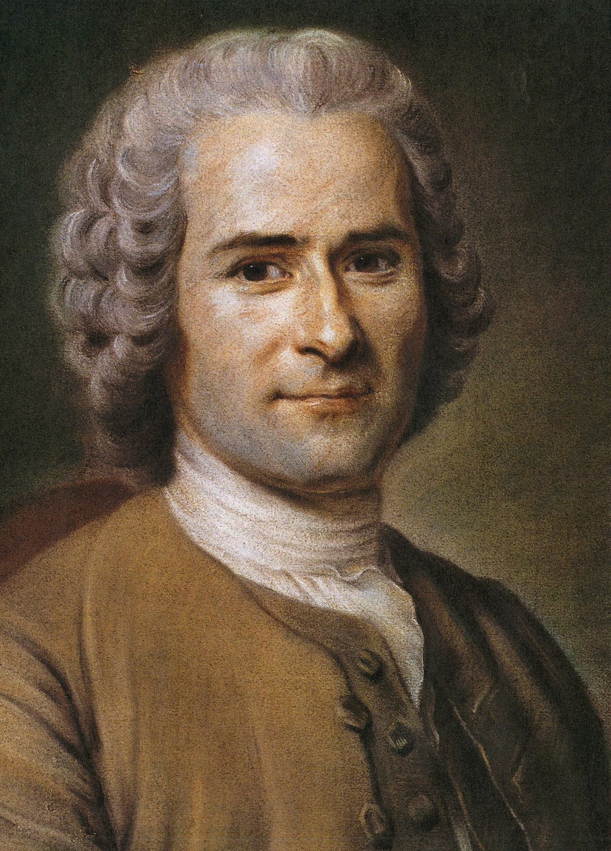
Jean-Jacques Rousseau (1712-1778)
Philosophe #4:
Believed people are naturally good
Evils of society is what corrupts society
Republicanism
Only elected government can place restrictions on the people
General Will
Good of the community more important than individual
Makes the laws
Social Contract – Constantly renewed to reflect the General Will
Question:
What do YOU think is more important: Community OR Individual? Why?
Why should the social contract reflect the General Will?
Notes:
Jean-Jacques Rousseau (1712-1778) – French Philosopher. Believed that people were naturally good in the state of nature, and that it was the evils of society like unequal distribution of property that corrupted society. He thought that government placed too many controls on its people and that only some were necessary, and it was only an elected government by the people that could place restrictions on the people. He believed in the “general will” and that the good of the community should be placed above that of the individual.
Rousseau, like Hobbes, believed in a social contract between the people and the government, but unlike Hobbes, Rousseau thought that the contract between the people and the government should constantly be renewed so that government always reflects the will of the people. He believed that the people should be in charge of the government and that the general will of the community should be what makes the laws of a country.

Slide 14
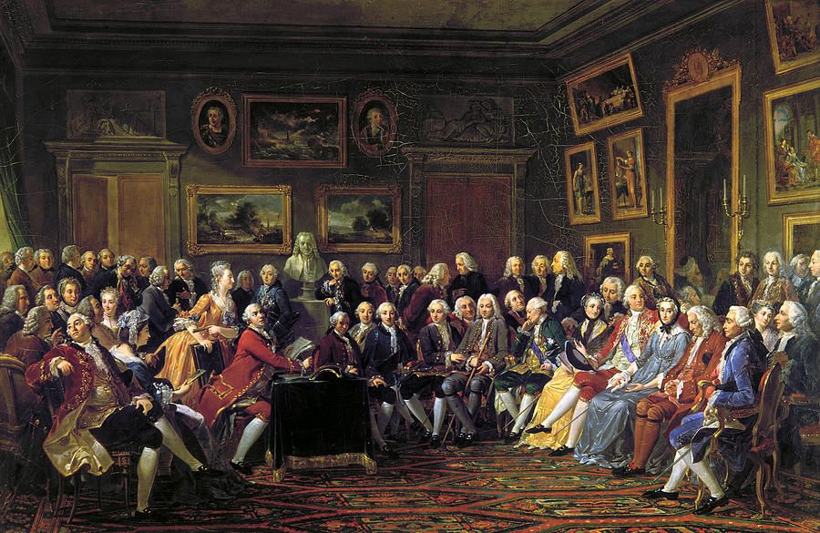
Enlightenment Spreads
The Encyclopédie
28 Volume Encyclopedia: Helped spread Enlightened thinking
Written by Denis Diderot
Salons
Informal social gatherings where Enlightened thinkers met and exchanged ideas
Madame Geoffrin hosted many
Notes:
The Encyclopédie helped spread the ideas of the Enlightenment throughout Europe and to the Americas.
Denis Diderot (1713-1784) – French writer. Created The Encyclopédie and published 28 volumes from 1751 to 1772. The Encyclopédie helped spread Enlightenment thinking throughout Europe and to the Americas.
Salons – Informal social gatherings in which Enlightened figures met and exchanged ideas.

Slide 15
Questions
Which Enlightenment thinker do you agree with most? Why?
Which Enlightenment thinker had the greatest impact on America? Provide textual evidence.
What is your opinion on the state of nature? Would you ever want to go back to a time without government? Why?
What effect can you foresee this movement having on governments around the world?

