Slide 1
Money & Funding
Who Has It, Who Needs It, and What Do They Want for It?

Slide 2
How Much Does it Cost to Run for President?
2000 Presidential Election ≈ $1.5 Billion
2016 Presidential Election ≈ $2.4 Billion (cash spent)
Trump’s “earned media attention” ≈ $5 Billion
Clinton’s “earned media attention” ≈ $3.24 Billion
For comparison, all 2016 Congressional Elections ≈ $4 Billion
Where does this money go?

Slide 3
Political Action Committees (PACs) & Super PACs
PAC’s are the “political arms of the special interest groups”
https://www.youtube.com/watch?v=Bis-LB-wEVA

Slide 4
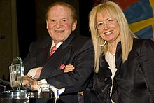
Sources of Funding
Individuals
Wealthy Individuals
Candidates
PACs
Temporary Organizations (groups who fund-raise)
Public Subsidiaries
The Adelson's donated over $113 Million to Republican candidates in the 2018 Midterm-Elections.

Slide 5
Why Do People Give?
They believe in a candidate or cause which that candidate supports.
1
They want access to government
2
This may come in the form of: Special Recommendations, Fame, Legal Assistance, Appointments, etc.

Slide 6
The Law
1907 – Unlawful for banks or corporations to contribute to Federal campaigns
Since then:
FECA – Federal Election Campaign Act 1971
FECA Amendments – 1974 & 1976
Bipartisan Campaign Reform Act 2002
FEC – Federal Elections Commission 1974, Began Operating in 1975
Buckley vs. Valeo 1976 – “Money is Speech”
Citizens United v. Federal Election Commission 2010
Free speech of First Amendment, money=speech

Slide 7
Types of Money
Hard Money
Contributions made directly to a candidate
Regulated by the Federal Government
Soft Money
Money that is not directly given to a candidate but instead used in support of that person.
Little to no regulation

Slide 8
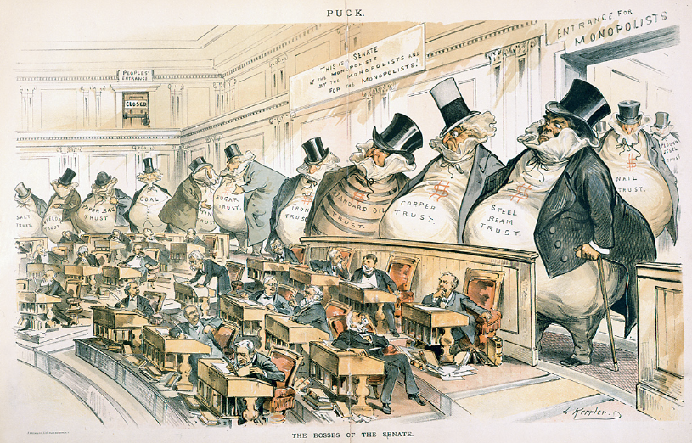
Write a paragraph(ish) on the back of your notes describing the political cartoon below:

