Slide 1
Presidential Succession & The Vice President
13.2

Slide 2
Presidential Succession Act 1947
VP
25th Amendment (1967)
Speaker of the House (H)
President Pro Tempore (S)
Secretary of State (Exec.)
Each of other 13 heads of the cabinet departments

Slide 3
Presidential Disability
Vice Pres. Becomes President if:
The President informs Congress, in writing, “that he is unable to discharge the powers and duties of office,”
or
The Vice President and a majority of the members of the Cabinet inform Congress, in writing, that the President is so incapacitated.
President resumes powers and duties when he informs congress of readiness
Congress has 21 days to decide

Slide 4
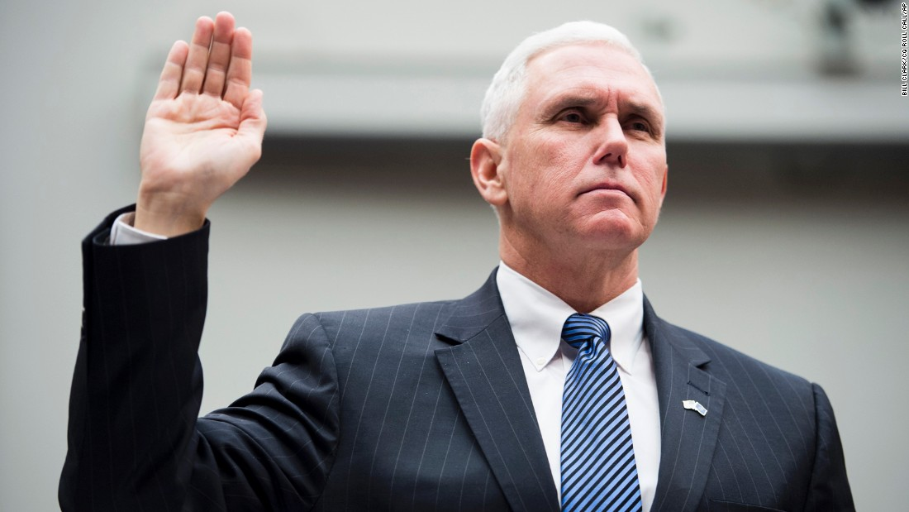
VP’s roles
1. Presides over the Senate
2. Decides question of Presidential disability
3. Balances the ticket
* Only a heartbeat away from the most powerful office in the world

