Slide 1
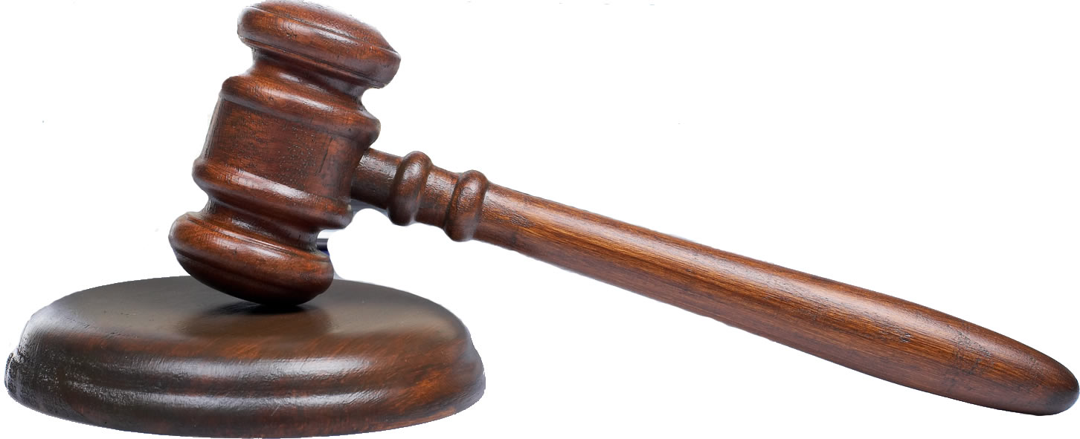
Why do we create laws? Why do we need laws?

Slide 2
Creation of your Rules for your Island
Must create no less than 10 laws
They must not use a specific students name to be excluded or put down.
They must fit your islands theme
They must protect your islands inhabitants and make for a productive society
Must be fair to all!

Slide 3
Your Tasks Today
Task)
Create 10 laws for your island
Must be school appropriate and fair to all
Type or neatly hand write these laws

