Slide 1
How Do We Vote
Chapter 7.2

Slide 2
Who handles elections?
Federal Government:
Date & Times for Congressional and Presidential Elections
Regulates Federal Campaign Financing
States:
Types of Ballots Used
Precincts (Voting Districts)
When & Where of Local and State Elections

Slide 3
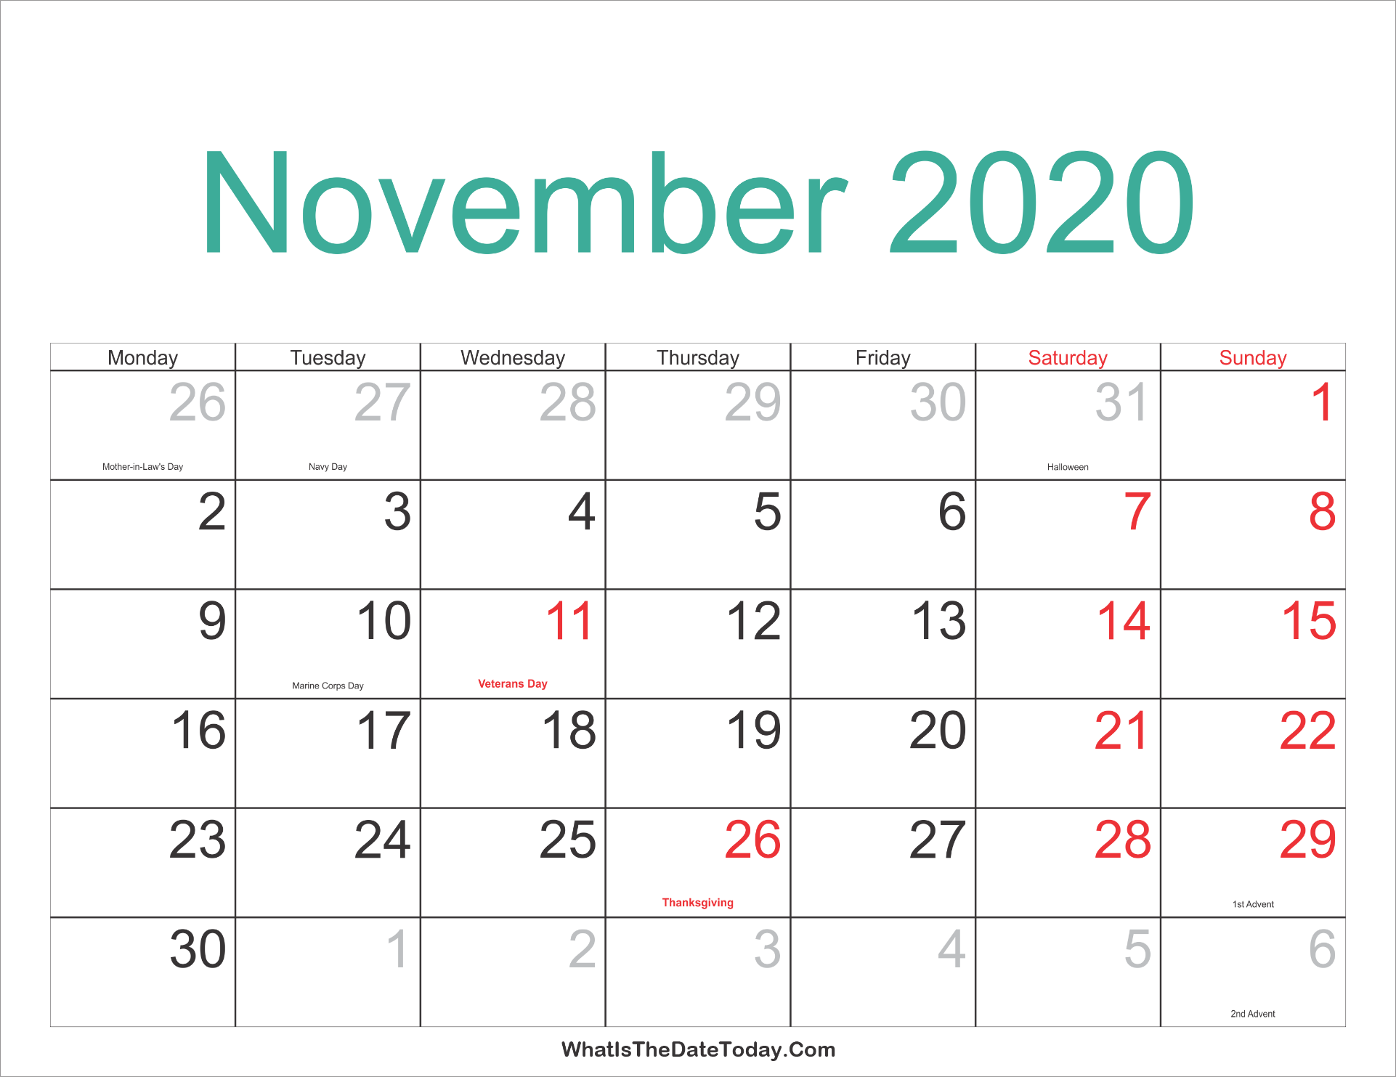
Why then?
Federal Elections are always held on the second Tuesday after the first Monday in November.
Why?
Even though States are not required to hold their elections on that day, many do. What are some considerations in this?
- Tradition
- Cost
- Coattail Effect
- Party ID

Slide 4
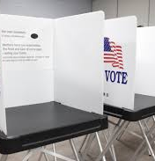
Why Here?
States and localities decide where elections will take place and how precincts are split up.
Each precinct usually holds 500-1000 eligible voters.
These are divided up by the County Clerk or the County Board of Elections. They also fix poll locations, pick precinct board members.
- All votes are reported to them.

Slide 5
The Ballot
Ballots are, “a device by which a voter registers a choice in an election”
Ballots and voting are now kept secret.
People used to vote “viva voce” (by voice)
Problems: allowed for intimidation, vote buying, and corruption.

Slide 6
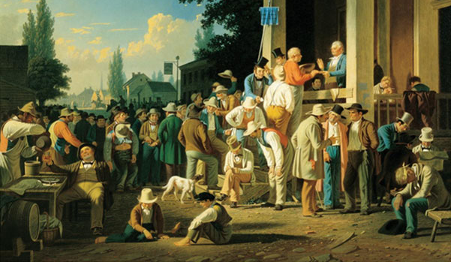
History of the Ballot
Viva Voce – In person, out loud
Paper Slips – Prepared by voters
Party Slips – Prepared and distributed by parties
Australian Ballot – Publicly funded, lists all candidates, given at polls, and marked in secret.
* Two types: Party-column and Office-group

Slide 7
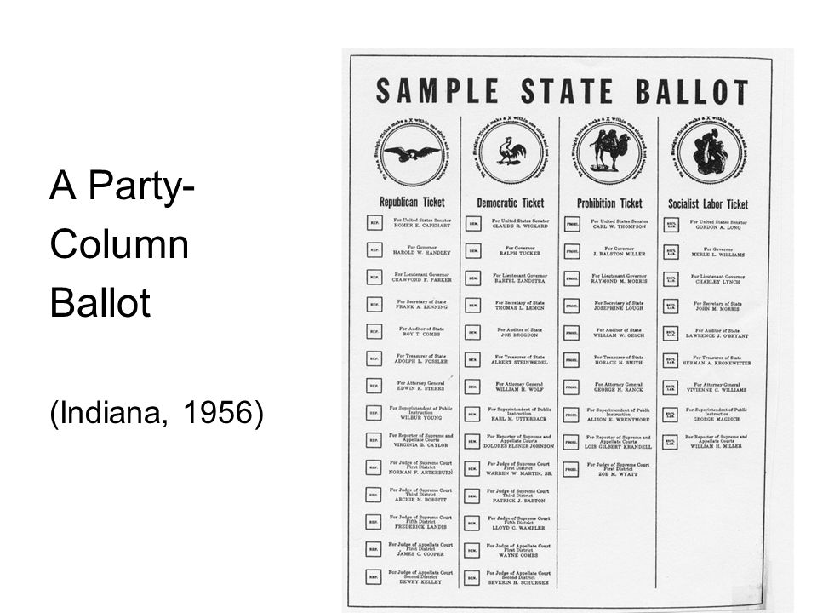

Slide 8
The Bedsheet Ballot
This is a term often used to describe large ballots with many different offices and candidates.
Benefits: More options for voters -> more democratic
Detriments: Voter fatigue, uninformed voters
Some suggests we should elect those who make policy and appoint those who administer policy.
Thoughts?

Slide 9
Current Options
Paper
Touchscreen
Mail-in
Online
Voting Machine

