Slide 1
Colonial Resistance: The Beginning of The Revolution

Slide 2
French and Indian War
French and Indian War Audio-2:40
Aftermath
England has huge war debt
Wants colonies to help pay
Sugar Act of 1764
Negative reaction to the tax
“No taxation without representation” / unsuccessful protests
Stamp Act on 1765- Tax on all printed materials
Boycott of the stamps, and of British goods
Repealed in 1766

Slide 3
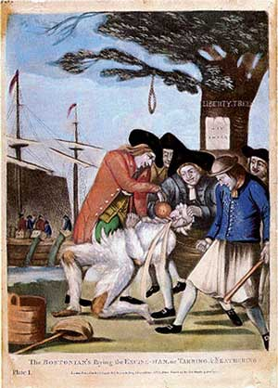
Sons of Liberty, 1765
Formed in Boston as a response to the Stamp Act.
Led by Samuel Adams
Used intimidation in the form of tarring and feathering tax collectors.

Slide 4
Townshend Acts
Parliament created a new set of taxes called the Townshend Acts
Leads to a new Boycott
British send in troops (4K)
Soldiers compete for jobs in Boston
March 5th 1770
Workers confront 9 British Soldiers.
Snow, ice, rocks and taunts fly
Someone yells “fire!” and shots ring out

Slide 5
The Boston Massacre
When shooting stopped, 5 colonists were dead.
Sam Adams, Paul Revere seize moment with propaganda
10K march at funeral
British troops are withdrawn
Townshend Acts repealed
Relative calm follows

Slide 6
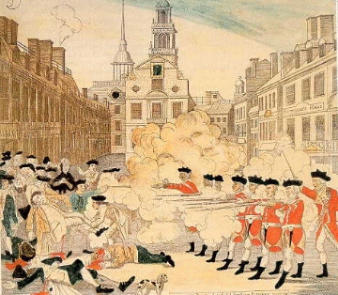

Slide 7
The real story behind the drawing
The British soldiers are shown standing in a straight line shooting their rifles in a regular volley, actually both groups are cussing at one another.
The event occurred around nine o'clock on a cold winter night.
Notice too the absence of snow and ice on the street, Crispus Attucks, a black man is lying on the ground closest to the British soldiers but is shown to be white.
The print of the Boston Massacre was released three times by separate men. Paul Revere was one of those men. All the men benefited financially from the drawing.

Slide 8
Samuel Adams
Harvard educated politician from Massachusetts
Politically savvy, starts committees of correspondence, Sons of Liberty
Involved in burning a Royal Navy boat & The Boston Tea Party

Slide 9
Boston Tea Party, 1773
Sons of Liberty, dressed as Indians, dumped 342 tea crates into Boston Harbor
“The die is now cast. The colonies must either submit or triumph.” - George III
Listen to track- 2:20

Slide 11
British Respond
Parliament passed Coercive Acts
Port Bill- closed Boston Harbor until tea was paid for
Massachusetts charter nullified
General Gage sent to Boston with 4K soldiers
Quartering Act- right to demand food and shelter
Colonists refer to these as Intolerable Acts
Arrange First Continental Congress
The Revolution had begun, only needed the shooting to begin…

Slide 12
“Shot Heard ‘Round the World”
Audio 2:20-4:50

