Slide 1
Political Parties
5.1 and 5.2

Slide 2
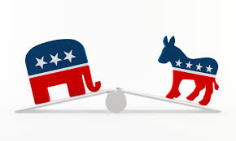
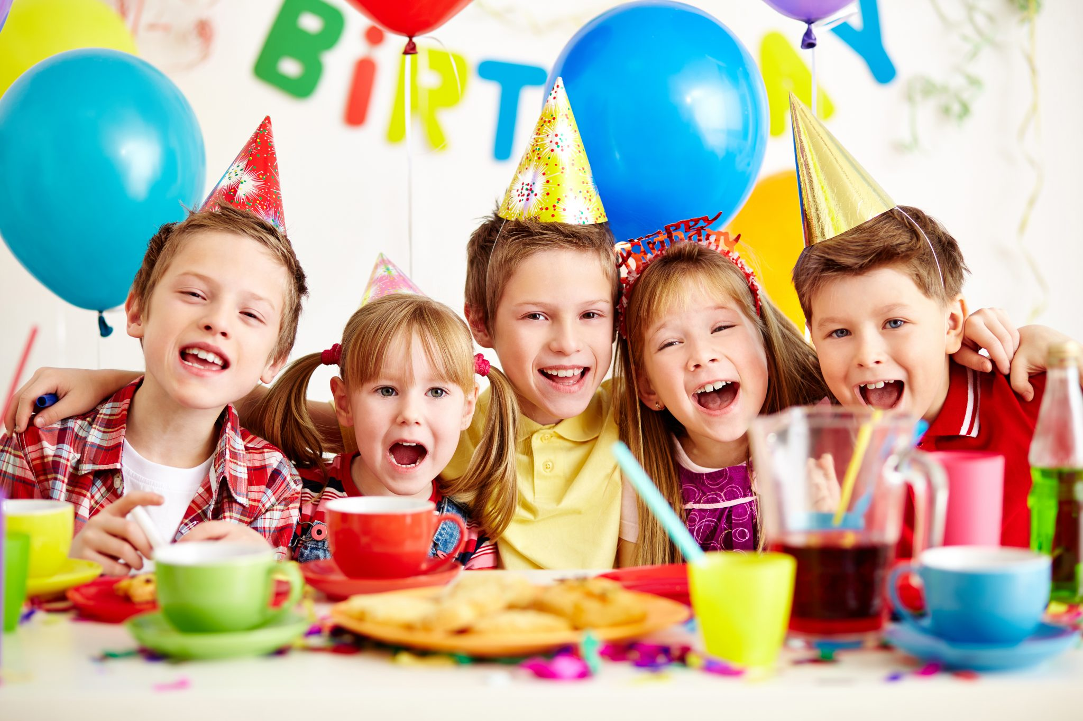
Political Party
A party is a group of people who try to control government by winning elections and holding public office.
What can they do?
Nominate candidates
Inform and inspire supporters
Encourage good behavior among members
Govern once in office
Perform oversight on government actions

Slide 3
3 elements in a political party
The party organization is the party professionals who run the party at all levels by contributing time, money, and skill.
The party in government includes the candidates and officeholders who serve at all levels of government.
The party in the electorate are the millions of voters who identify strongly with a particular party and support its policies.

Slide 4
What do parties do?
Parties express the will of the people in government.
Parties nominate qualified political candidates.
Parties inform the public and try to shape public opinion.

Slide 5
Party Roles:
Parties act as a “bonding agent” to encourage accountability among their candidates and office holders.
Parties play a key roles in governing at all levels.
Legislatures are organized along party lines and parties shape the electoral process.
Partisanship guides many legislative votes and appointments to public office.
Parties provide channels of communication between the branches of government.

Slide 6
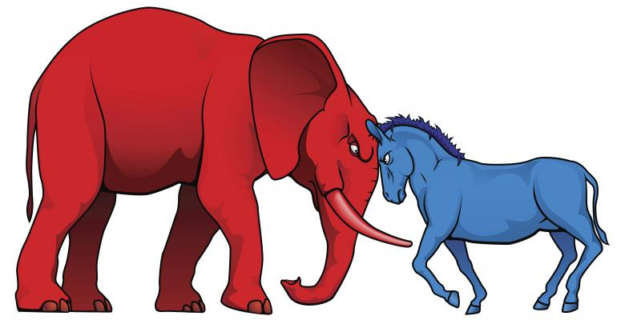
Ch. 5 Sec. 2 2 Party System

Slide 7
2 Party System
The Republican and Democratic parties dominate American politics.
Only the candidates from the two major parties have a real chance to win most elections.
The Framers opposed political parties.
They saw parties as “factions”
Washington

Slide 8
Washington’s Farewell address:
"However [political parties] may now and then answer popular ends, they are likely in the course of time and things, to become potent engines, by which cunning, ambitious, and unprincipled men will be enabled to subvert the power of the people and to seize for themselves the reins of government, destroying afterwards the very engines which have lifted them to unjust dominion.“
Time to think: Why is Washington weary of political parties?

Slide 9
Tradition
Once established, parties became part of tradition.
The nature of the election process supports the two-party system. How?
Nearly all American elections take place in single-member districts--only the one candidate who wins the largest number of votes gets elected to office.
This works against third-party candidates, who have little chance of finishing in the top two.

Slide 10
Cont.
The two major parties write election rules that discourage non-major parties.
For example, it is very difficult for a third party candidate to get on the ballot in all 50 states.

Slide 11
Ideological Consensus
Americans tend to share a broad ideological consensus.
While Americans don’t agree on every issue, they do support the same basic freedoms.
Strongly divisive issues have tended not to last for generations.

Slide 12
Building Consensus
Both major parties try to be moderate and build consensus.
Both parties tend to have a few major areas of policy differences while being rather similar in other areas.
The similarities between parties arises because both parties are after a majority of voters in any given election. Both parties must compete for the many voters in the middle of the political spectrum.

Slide 13
Political Spectrum
Radical | Favors extreme change to create an altered or entirely new social system.
Liberal | Believes that government must take action to change economic, political, and ideological policies thought to be unfair.
Moderate | Holds beliefs that fall between liberal and conservative views, usually including some of each.
Conservative | Seeks to keep in place the economic, political, and social structures of society.
Reactionary | Favors extreme change to restore society to an earlier, more conservative state.

Slide 14
Multiparty Systems
Multiparty systems are used by many democracies.
They have several major and many smaller parties.
Each party is based on a particular interest.
Multiparty systems tend to represent a more diverse group of citizens.
Supporters admire this feature, arguing that it gives voters many more choices among candidates and policies.
Less stable

Slide 15
One-Party System
Only one political party exists, offering no real choice.
Some U.S. states and districts are “modified one-party systems.”
In these places, one party repeatedly wins most of the elections and dominates government.

