Slide 1
Write down these questions and answer them during the presentation.
Why is it called the Rosetta Stone? And who discovered it?
What languages was it written in?
Who is Thomas Young?
Who is Jean Francois Champollion?
In your own words … What was the true importance of finding the Rosetta Stone?

Slide 2
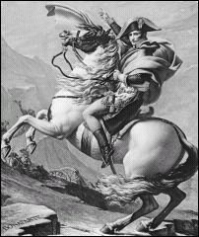
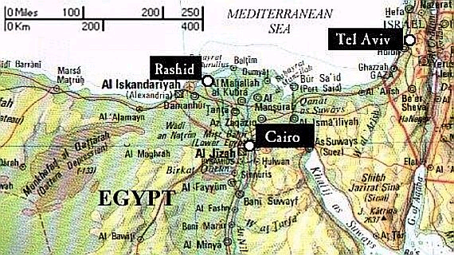
Finding the Stone: 1799
Found in the city of Rosetta
Napoleon Bonaparte
Weight: 1,700 lbs and almost 4 feet tall
It sat 15 years without anyone knowing it’s value or what it meant

Slide 3
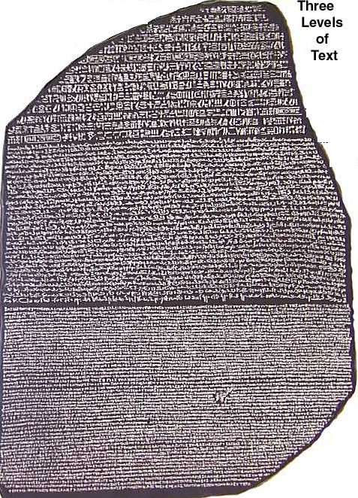
Egyptian Hieroglyphics
One of five times “Ptolemy” is written
Egyptian Demotic Script (Common language)
Greek

Slide 4
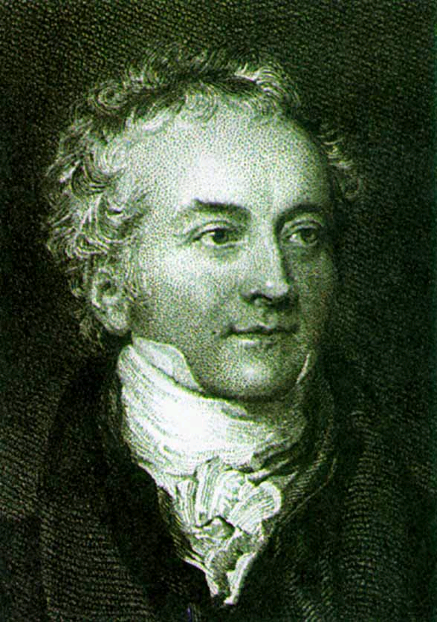
Thomas Young deciphers the first word in 1818
“Ptolemy”
A Greek-Egyptian Family Name
A Cartouche= Names

Slide 5
Jean Francois Champollion
Champollion is given credit for deciphering the Rosetta Stone
1821 – Created an Ancient Hieroglyphic alphabet
A Stone of Many Language
Hieroglyphics
Demotic
Greek

Slide 6
Egyptian Hieroglyphics
Definition: A complex writing system of pictures and sounds.
2,000 hieroglyphic characters
Cartouche = names

Slide 7
Modern Day Symbols for words

Slide 8
Different styles of hieroglyphics?
There are a lot of different styles that correspond with different time periods. Remember they had c.3,000 years of documented history … languages evolve!
The Evolution of English
Old English or Anglo-Saxon (circa 450-1066 AD)
Middle English
(circa 1066-1450 AD)
Late- Mid English(Shakespeare)
(circa 1450- 1750 AD)
Modern English
(circa 1750- Today AD)

Slide 9
The modern day standard for learning a new language is a stolen idea from the rock that unlocked the mysteries of Egypt.
A Modern Day Connection

Slide 10
Activity
Directions: Create 1 cartouche (oval shapes containing Hieroglyphics), using your hieroglyphic key to help you construct your own cartouche.
Cartouche Directions:
Step 1: Create a cartouche using hieroglyphics on the following: Your First and Last Name.
Step 2: On the Cartouche explain what the symbols represent (i.e. what letters do your symbols represent)
Step 3: Lastly, answer the questions attached.
Pts Possible: 30 pts (Make sure to attach this sheet with your final Cartouche
_____/10 pts for neatness and color
_____/10 pts for Accuracy and the explanation
_____/10 pts for the questions on the back (use complete sentences)
Due Date: ___________________at start of class

Slide 11
Questions

