Slide 1
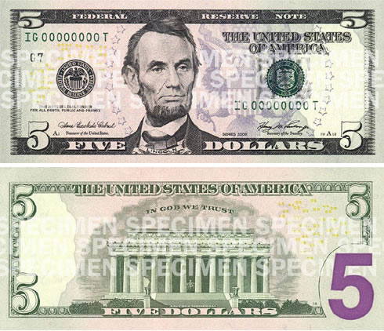
Currency
Create the front and back of one of your currencies
Must be colored and stick to theme
List the other denominations ($1, $5, $10, $20, ETC)
Create an exchange rate for your bill. Example $1 USD = 3.57 New Israeli Shekels.

