Slide 1
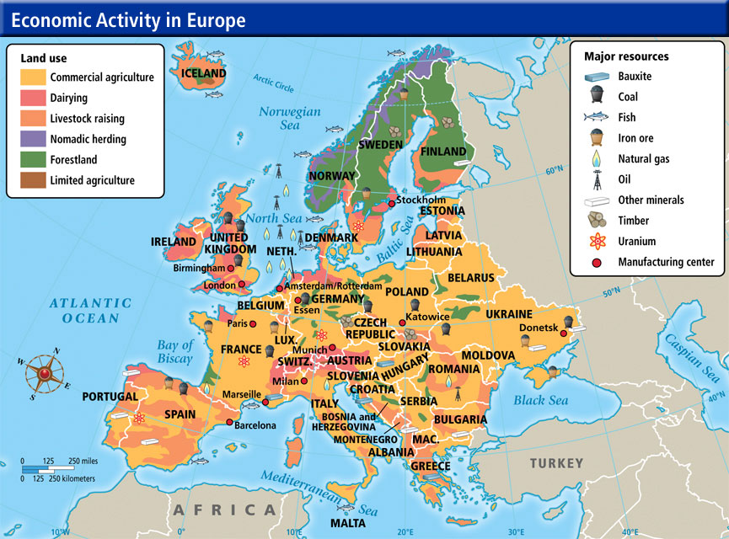
Add a Title
Label at least FOUR land use areas
Label at least SIX specific resources
Label at least ONE power generation plant to show how your island is powered

Slide 2
