Slide 1
The Roaring Twenties
Ch. 20 and 21

Slide 2
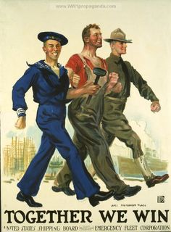
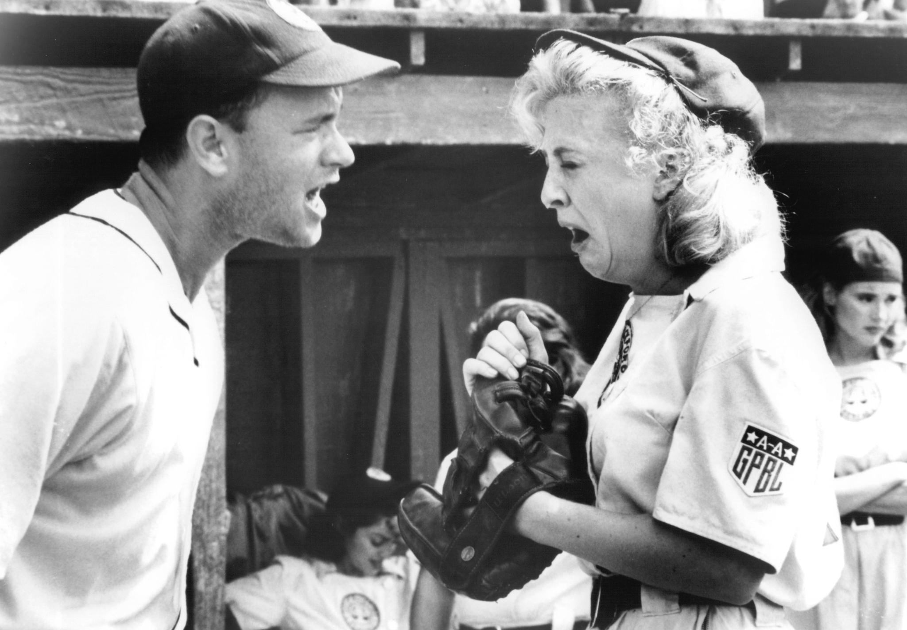
Pre-Twenties WWI: 1914-1919
Results from first World War:
Stimulated sectors of the economy
Changed industrial labor
Launched women into workforce
Accelerated migration of African Americans to northern industrial cities.
Loss of innocence = “Lost Generation”

Slide 3
Aftermath of War
Versailles Treaty was centered on revenge rather than stabilizing democracy in Germany.
Demilitarization
War reparations ($33 Billion)
Loss of territory (oil rich land for 15 years)
Leaves Germany in desperate situation which opens the door for Nazis
League of Nations was created to prevent another world war
Congress wants to retain their constitutional powers…U.S. doesn’t join!

Slide 4
Prohibition
The 18th Amendment outlawed the production and selling of alcohol.
Many thought alcohol was cause of social problems in America
Ushered in decade of organized crime
Bootleggers, gangs, and police
Established underground bars known as “speakeasies”
Twice as many Speakeasies in N.Y.C. as there were bars pre-prohibition.

Slide 5
Economy
Decade of the Twenties opened in tight recession
Federal Reserve’s tightening of credit
Decline in exports due to tariff wars
Began to rebound in 1922 in response to:
Housing
Consumer goods—Automobiles, electric appliances, radio

Slide 6
Construction
Construction doubled between 1919-1926
Produced 900 K houses a year…more than twice the previous decade
Why?
Affordability of automobiles spurs suburbs (possibilities)
Balloon mortgages make ownership a possibility (owning for all)
Technology in houses improve: (more desirable)
Indoor plumbing, hot and cold water, modern bathrooms, gas or electric ranges

Slide 7
Automobile Industry
Takes off due to:
Improvements—electric switch, closed steel bodies with windows, price.
Fordism—assembly-line production makes the automobile affordable
From 1912-1924 price halved to $294
New companies offer diversity:
Different colors, add-on equipment, new models and styles, buy on credit
Federal Road Bill: federal subsidies for roads

Slide 8
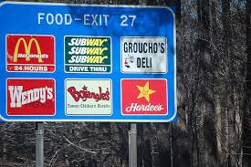
Auto Industry cont.
Car production boosts economy through:
Steel, paint, textile, electric, and tire industries
Also impacts oil industry as well as road construction and new businesses: dealerships, gas stations, repairs, parts, diners, hotels, fast food chains

Slide 9
Appliances and Mass Media
Electrification of the country. By end of decade, 70% of houses have it!
Spawned new inventions: irons, fans, vacuum cleaners, toasters, stoves, washing machines, sewing machines, refrigerators.
Radio
Began to broadcast recorded music, news, sporting events such as Babe Ruth
Became the medium of mass communication
By 1930 half of American homes owned them

Slide 10
Flaws in the Economy
American Business is booming, but…
Walmart vs Mom and Pop Shop
Corporate concentration of industries takes away from small businesses
1/3 of families earn less than $2,000 (decent standard living)
1/5 of families earn less than $1,000
Felt heavily by labor and agriculture industry, why?
Began to experiment with mass production techniques

Slide 11
Agriculture
After WWI prices spiraled downward
farmers declare bankruptcy
Small farms acquired by agribusiness
Increase profits by adopting industrial methods of production
Overproduction = lower returns
Farmers leave the land for cities

Slide 12
City Life
In 1920, for first time in U.S. history
More people live in cities than in rural areas
Multiple races and cultures mix to form new American Identity

Slide 13
City Life
Culture of the city
“Talkies,” Radios, live shows, Corner music, and art all add to the excitement of the city
New dance crazes
Advertisements
Art & Literature
Fashion
Photography

Slide 14
Jazz/African Americans
Jazz brought to white audiences from migrating African Americans
Popular with writers, artists, women, and college students
Produces innovations in art, self-expression, and identity
During twenties 1 million African Americans move north.
40% of 12 million live in northern cities
Brought about new awareness for need of civil rights and cultural identity
Harlem Renaissance

Slide 15
Women
New opportunities for women in 1920’s: A changing climate
New voice: 19th Amendment
New fields of work: health care, teachers, librarians, social workers
Health care improvements
New Look:
Flappers: Hair, smoking, drinking, independent
New kind of home: New technologies change a wife’s work at home

Slide 16
Immigration
1924 Congress passes National Origins Act
Established restrictions on immigration
Reduced quota for admission of countries (Eastern Europeans, Asia)
Fueled by racism and desire to keep traditional make-up of America
Lowered the annual immigration quota from 356,000-164,000

Slide 17
Stock Market Crash of 1929
In twenties stock prices quadruple in value
Investors borrow to buy more stocks. In 1929, value crashes
Dramatic event that left many of the rich feeling less rich, and wiped-out the savings of many of the middle class
Americans become wary of investing in stocks, and in banks
Did not cause the economic Great Depression, but aided it

