Slide 1
Introduction to U.S. Government
Dail

Slide 2
Introduction: Our Goals
Understanding the context of where we are and how we got here (our history and place in history)
“The only thing we learn from history is that we don’t learn from history.” –Ron Paul
Learn structure of government and process of politics.
Learn why government does what it does.
Promoting discussion
Promoting improved civic literacy and engagement.
Civics: the connection one feels with the larger society.
Where are we/where are we going?

Slide 3
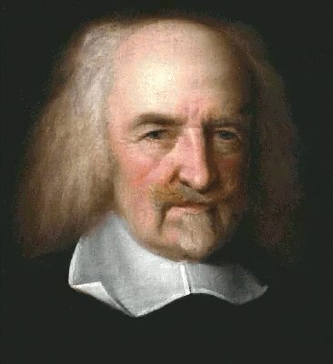
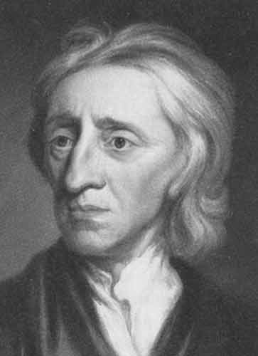
What would life be like without Government?
Thomas Hobbes: “The life of man, solitary, poor, nasty, brutish, and short.”
John Locke: “In the state of nature men mostly kept their promises and honored their obligations, and, though insecure, it was mostly peaceful, good, and pleasant.”

Slide 4
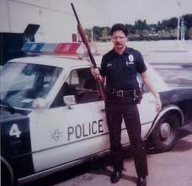
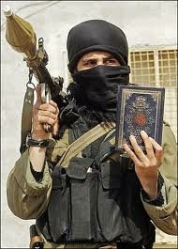
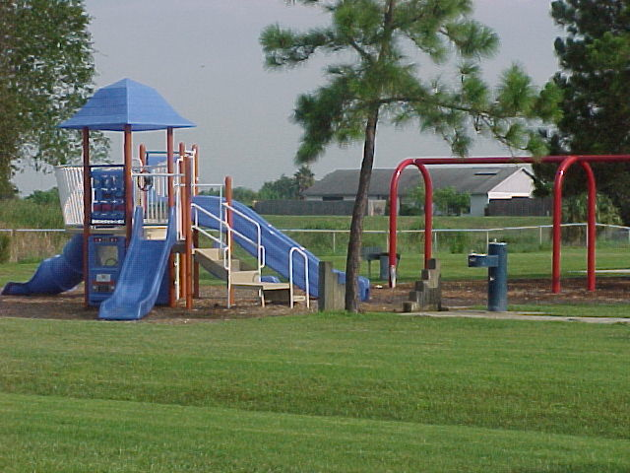
What is the Purpose of Government?
Since dawn of social interaction, there has been government.
Government provides:
Security/defense (protection from external threats)
Order (protection from internal threats)
Structures (e.g. police force, courts, education, public works)
Economic stability and prosperity.

Slide 5
How does government effect you?
It does today: school
Later: taxes, benefits, other countries angry by our foreign policy.
What does government provide?
Regulates windshield wiper speed and length.
Provides subsidies for students to go to college.
Should the government be less invasive or more involved in regulation and services?

Slide 6
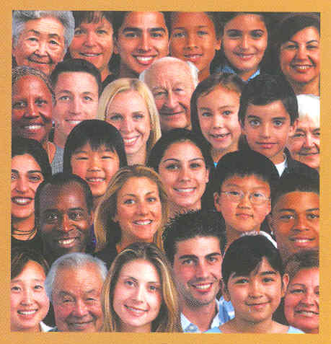
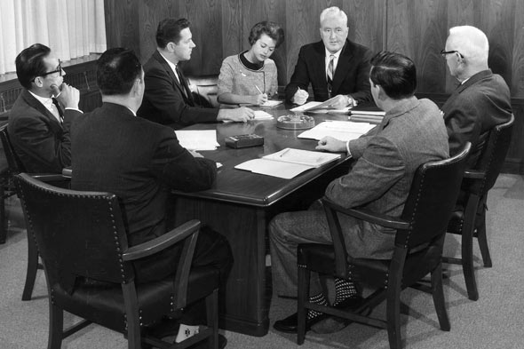
What types of governments are there? (AKA words on test)
Ideology: is a set of basic beliefs about life, culture, government, or society.
Ideologies on government deal with power
Who has the power?:
Fascism (Autocracy): Government where the power to rule is in the hands of a single individual.
Oligarchy: Government where the power to rule is in the hands of a small group of people.
Democracy: Government where the people hold the ultimate political power.

Slide 7
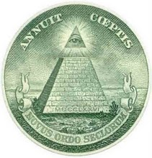
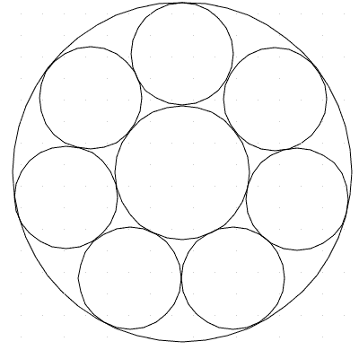
Where is the Power?
Unitary System: Government where the power to rule is in the hands of a national government.
Confederacy: Government that is a loose collection of independent states.
Federalism: is a system of government that divides the powers geographically between the national government and regional government.

Slide 8
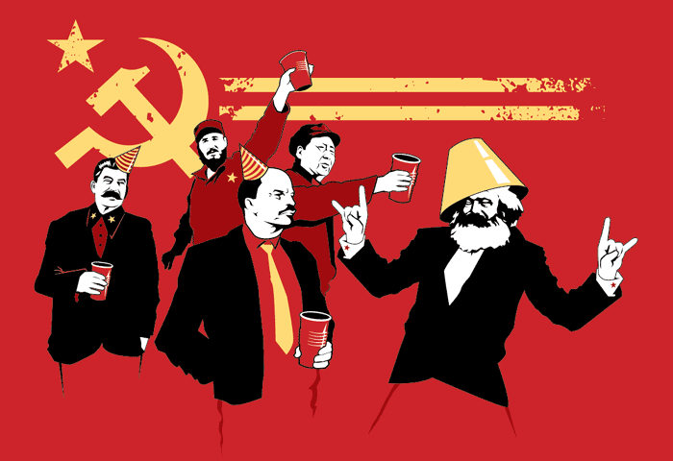
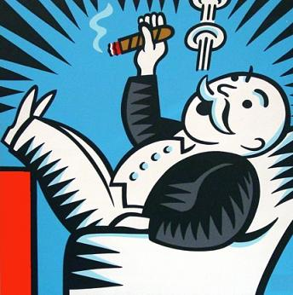
Where does the power go? Economic Systems
Socialism: The economic system in which government owns the basic means of production and provides numerous social services in return
Capitalism: The economic system that relies on private ownership, free choice, and competition for a profit
Communism: The economic system where the government controls most or all of the means of production and discourages private ownership of property

Slide 9
Where do your rights come from?
First off: What are some rights that you have as an American citizen?

Slide 10
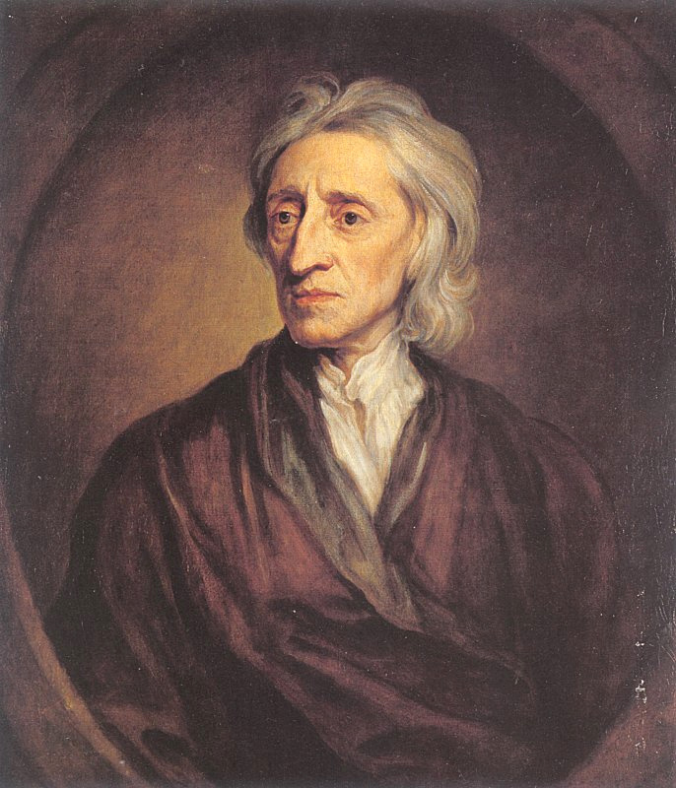
John Locke
Wrote “Two Treatise of American Government in 1690.
The founding father of our founding fathers.
Here are some excerpts:

Slide 11
Excerpt 1: State of Nature
To understand political power, we must consider the condition in which nature puts all men. It is a state of perfect freedom to do as they wish and dispose of themselves and their possessions as they think fit, within the bounds of the laws of nature. They need not ask permission or the consent of any other man.
The state of nature is also a state of equality. No one has more power or authority than another. Since all human beings have the same advantages and the use of the same skills, they should be equal to each other. The state of nature has a law of nature to govern it. Reason is the law. It teaches that all men are equal and independent, and that no one ought to harm another in his life, liberty, or possessions. All men are made by one all-powerful and wise Maker. They are all servants of one Master who sent them into the world to do His business. He has put men naturally into a state of independence, and they remain in it until they choose to become members of a political society.
1. What is the “state of nature”?
3. How does “man,” or humankind, live in the State of Nature?
Is this true?
2. What is the “Law of Nature”?

Slide 12
Ex. 2. Social Contract Theory
If a man in the state of nature is free, if he is absolute lord of his own person and possessions, why will he give up his freedom? Why will he put himself under the control of any person or institution? The obvious answer is that the rights in the state of nature are constantly exposed to the attacks of others. Since every man is equal and since most men do not concern themselves with equity and justice, the enjoyment of rights in the state of nature is unsafe and insecure. Hence each man joins in society with others to preserve life, liberty, and property.
4. According to Locke, why would “man” want to join others and enter a society when he is his own master over his property and possessions?

Slide 13
Ex. 3. Life, Liberty, and ???
Since men hope to preserve their property by establishing a government, they will not want that government to destroy this objective. When legislators (lawmakers) try to destroy or take away the property of the people, or try to reduce them to slavery, they put themselves into a state of war with the people who can then refuse to obey the laws. When legislators try to gain or give someone else absolute power over lives, liberties, and property of the people, they abuse the power which the people had put into their hands. It is then the privilege of the people to establish a new legislature to provide for their safety and security. These principles also hold true for the executive who helps to make laws and carry them out.
5. What does Locke say man has the right to do when the government tries to pass unfair laws or tries to destroy or take away the property of the people?
6. Why might this passage appeal to colonists?
7. Has our current government “tried to destroy or take away property of the people or reduce them to slavery?”

Slide 14
Ex. 5: A Declaration of Independence (So to speak)
However, it will be said that this philosophy may lead to frequent rebellion. To which I answer, such revolutions are not caused by every little mismanagement in public affairs. But if a long train of abuses, lies, and tricks make a government's bad intentions visible to the people, they cannot help seeing where they are going. It is no wonder that they will then rouse themselves, and try to put the rule into hands, which will secure to them the purpose for which government was originally organized.
8. Why does Locke argue that political revolutions are necessary? What type of revolution do you think he is talking about?
9. How does this passage relate to how the colonists felt about how the British ruled the colonies?

