Slide 1
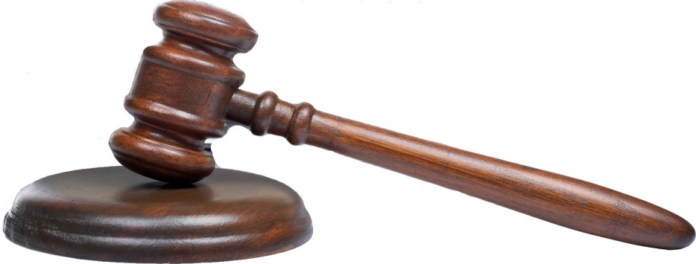
Island Flag: Due Friday
Island Laws: Due Friday
First and Last Name always on your papers please!

Slide 2
Flag and Motto

Slide 3
Why do people create flags and mottos?

Slide 4
What colors stand for on flags
BLACK : Black often represents determination,
ethnic heritage, and/or defeating one's
enemies.
BLUE Blue often represents freedom, vigilance,
perseverance, justice, prosperity, peace,
and/or patriotism.
GREEN Green can symbolize the Earth, agriculture,
fertility, and/or the Muslim religion.
YELLOW (GOLD) Yellow often represents the sun,
wealth, and/or justice.
WHITE White often represents peace, purity,
mountain snow, and/or innocence.
A simple white flag represents surrender.
RED Red often represents courage, revolution,
hardiness, blood, and/or valor.

Slide 5
Use colors and shapes to represent your Island

Slide 6
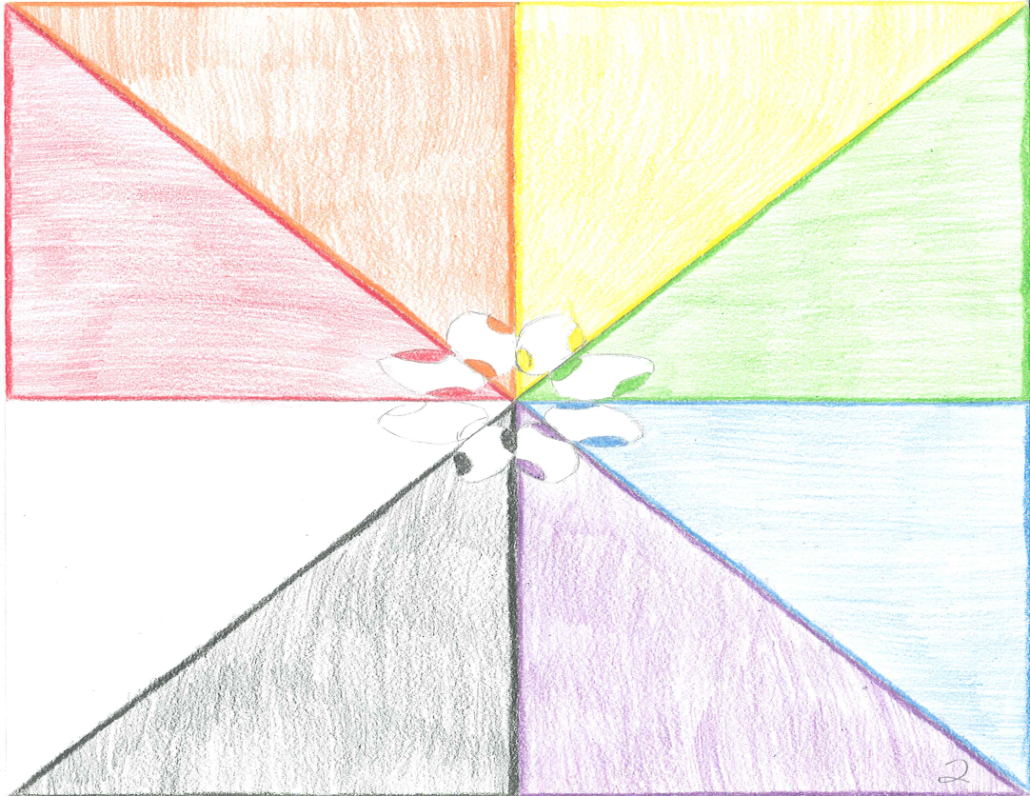
Island Flag Sample: Yoshi Island (2013)

Slide 7
Motto’s
Write out an inspirational line to represent your country.
Examples:
“In God we Trust”
“United we Stand, Divided we Fall”
Etc.

Slide 8
Your Tasks Today
Task 1)
Make a Flag for your island
Must have at least three colors
Write the explanation of the colors on the back of your flag
Create an island Motto – Write it on the back of your flag

