Slide 1
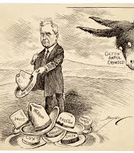
The Nomination Process Chapter 7.1

Slide 2
Nominating the Candidates
Primary job of the major political parties
This job is the main reason the two parties are decentralized.
Incredibly important part of the election process.
In fact, in Single Party Districts, there is more contention in the primary elections than in the general elections.
There are 5 ways to nominate a candidate:
Self-Announcement
Caucus
Convention
Petition
Primary

Slide 3
The Originals
Self-Announcement
Oldest form in American Politics
If someone wants to run, they say so!
Typically used when a candidate is not selected by a major party or is dissatisfied with them
Still used in rural and local elections
Caucus
Late Colonial Period–1820s
Solved Transportation & Communication Issues
Elitist & Undemocratic - “King Caucus”
Still used today at local level, but they hardly resemble the original form

Slide 4
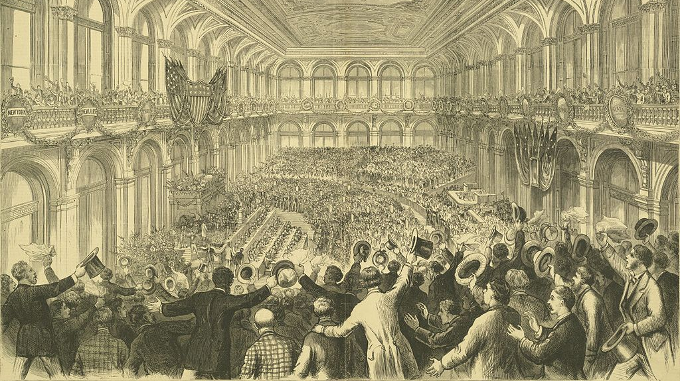
Conventions
Image: 1876 Democratic National Convention
Took the place of Caucusing
Used for the major party’s Presidential Elections starting in 1831
Tiered System
Local Members
County Delegates
State Delegates
National Delegates
Easily corrupted from the ground up

Slide 5
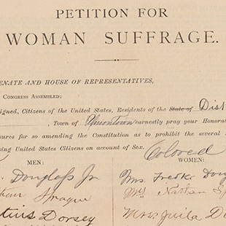
Petitions
Requires a predetermined number of eligible voter signatures.
Numbers vary widely between states and offices sought
Usually seen at the local level for non-partisan candidates
E.g. judges, school officials, & municipal officials
Petitions are more commonly used for Propositions, Recalls, and Referendums

Slide 6
Primary Elections
Definition: Within-party elections for nominees
Replaced Conventions by 1910s
Typically state-controlled
2 Main Types: Closed or Open
Other options:
Non-Partisan
Runoff

Slide 7
Closed
Pros:
Prevents “raiding”
Creates responsive candidates
Committed voters
Cons:
Compromises voter privacy
Excludes Independents
Open
Pros:
Protects voter privacy
Includes Independents
Cons:
Allows for “raiding”
Undercuts concepts of “party loyalty” and “responsibility”
Primary Options

Slide 8
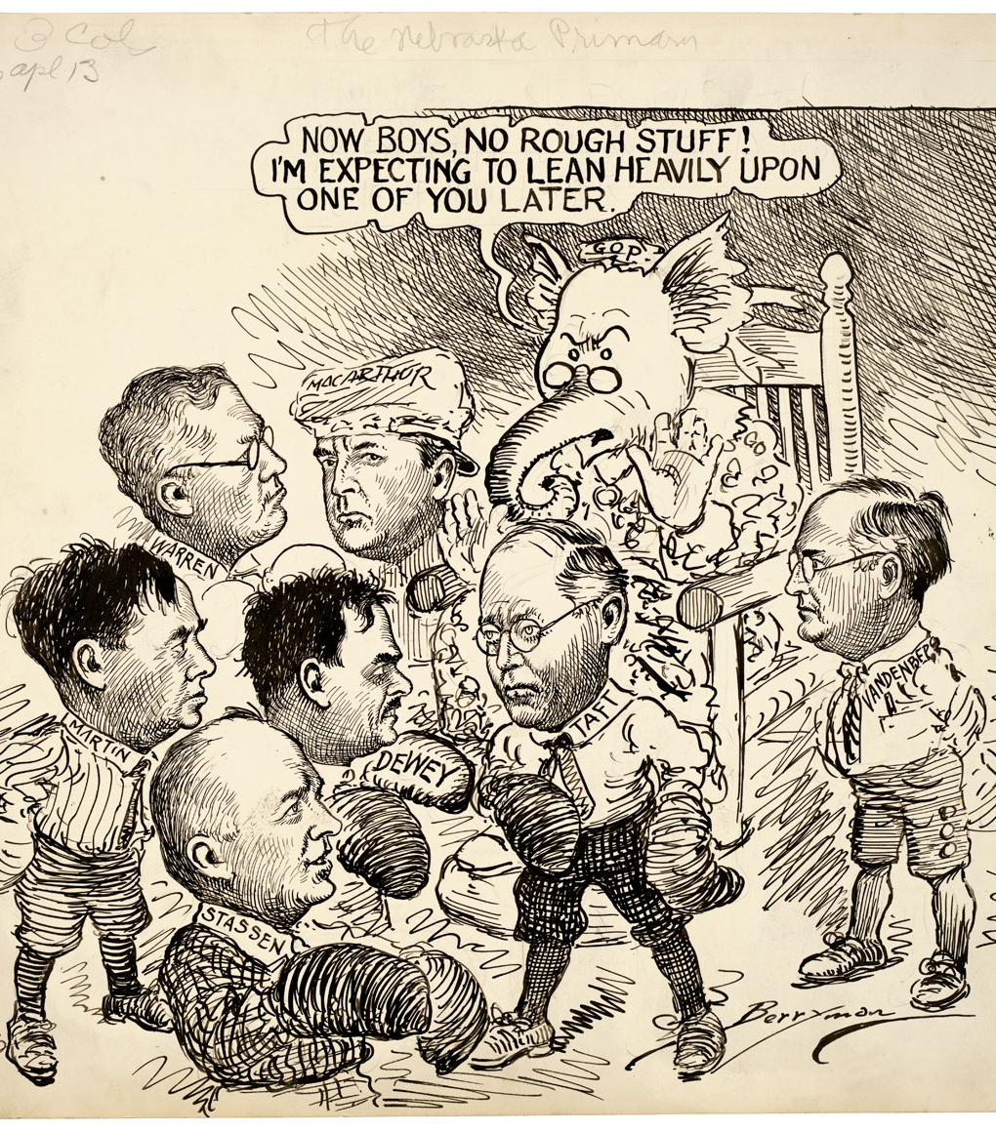
The Problem with Primaries
Voter Turnout
Typically less than ½ of General Elections
Funding
Primaries are costly and many potential candidates cannot afford both primary and general election campaigns
Permanent Scars
Intra-party battles can be so wounding that the party members remain divided for the general election.
Extremism
Bell Curve vs. Camel Back

