Slide 1
Chapter 12: Congress in Action
Section 1

Slide 2
The Major function of Congress is to make the nation’s laws
“It is very easy to defeat a bill in congress. It is much more difficult to pass one.”
- John F. Kennedy

Slide 3
Opening Day
Congress begins a new term every two years, on January 3 of odd years.
The House faces three difficulties on that opening day:
They currently have no sworn members
They have no rules
There is no organization
The Senate is a lot less hectic, why?
They are a continuous body so they only have to swear in 33 or 34 people compared to 435 in the house

Slide 4
After Opening Day
After the senate hears from the house, a joint committee is formed to “wait upon the President”
Inform him that a quorum of each House is assembled
Ready to receive any communication he/she has

Slide 5
The State of the Union
Addressed to a joint session of Congress a few weeks after it is organized.
Describes
The general state of national affairs,
the planned policies of his or her administration
Requesting that Congress pass specific pieces of legislation.
Who attends?
Members from both houses, cabinet, Justices of the Supreme Court, dignitaries

Slide 6
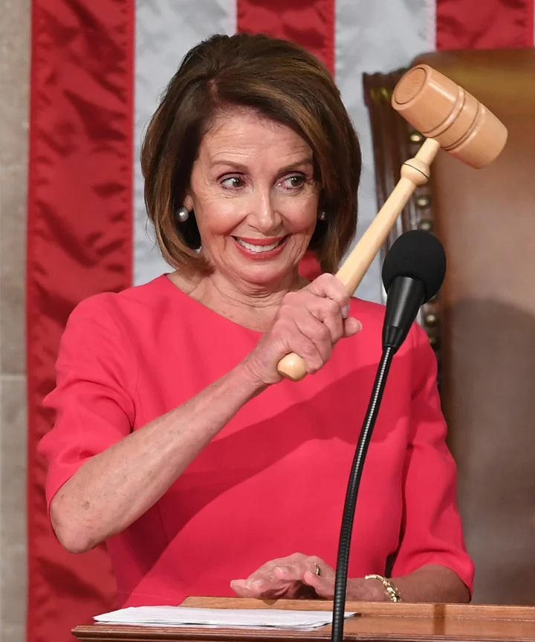
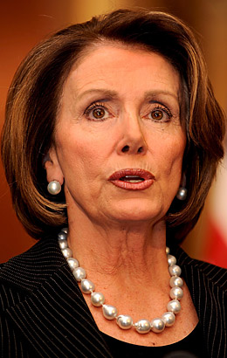
Speaker of the House
Presiding officer of the House and the leader of its majority party.
Nancy Pelosi (Dem.)
Duties:
Presides and keeps order.
Applies rules
Refers bills to committees,
Puts motions to a vote.
Votes to break a tie

Slide 7
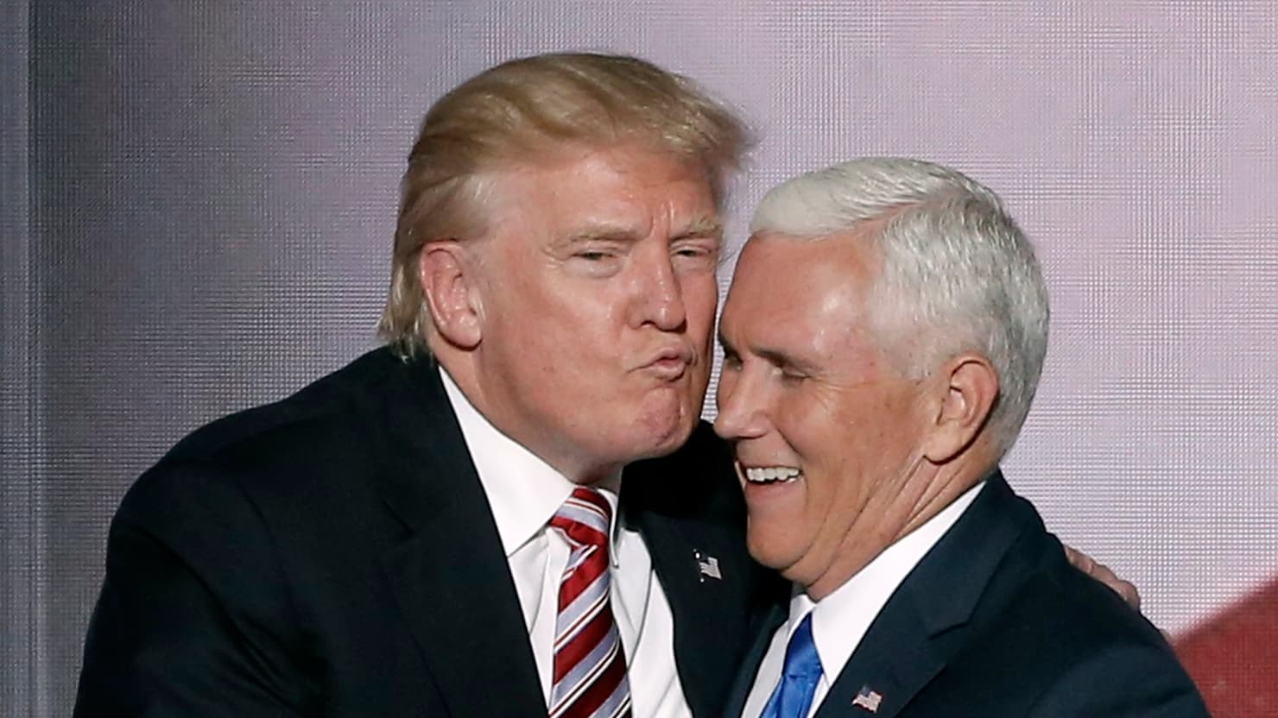
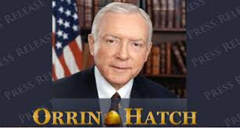
President of the Senate
Vice President Mike Pence
can recognize members, put questions to a vote, but cannot take part in debates and votes only to break a tie.
The President pro tempore Orrin Hatch- majority party elected to serve as Senate leader in the Vice President’s absence.

Slide 8
Floor Leaders
The floor leaders are party officers in the House and Senate.
The majority leader represents the majority party in each house and controls the order of business on the floor.
The party whips are assistant floor leaders who help connect the party leadership with the rank-and-file members.

Slide 9
Committee Chairman
Committee chairs have a major say in what bills the committee considers, if public hearings will be held, and what witnesses will be called

Slide 10
The seniority rule
The seniority rule in an unwritten custom granting the most important posts in Congress, such as committee chairmen, to the party members with the longest service.
Critics say this rule ignores ability, discourages younger members, and limits fresh ideas.
Supporters say the rule ensures experienced leadership and is easy to apply without sparking debates.

