Slide 1
Causes of the French Revolution
1715-1789

Slide 2
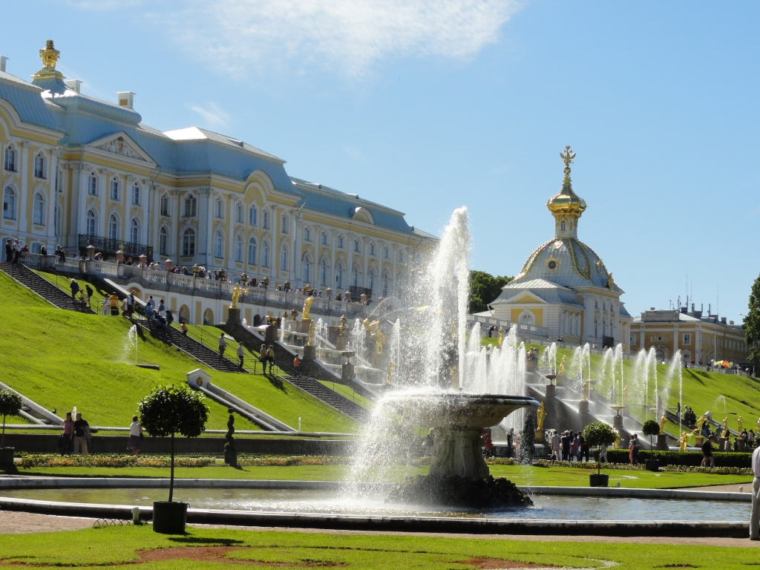
Deficit Spending
1st Cause:
France was in DEBT!
Deficit Spending – Spending more money than what is made
Wars (Seven Years War & the American Revolutionary War)
Excessive Spending (i.e. Palace of Versailles)
Clergy and Nobility did NOT pay taxes
Question:
What solutions would you have recommended France to do to decrease their debt?
Notes:
Debt – France was in debt and was taken part in “deficit spending” (spending more money than it takes in).
From extravagant royal buildings like the Palace of Versailles to wars like the Seven Years’ War (French and Indian War) and the American Revolution had all left France in debt.
France needed to cut spending, increase taxes, or both. The clergy and the nobility did not want to loss their privilege of not being taxed.
Economic Decline – France on the 1770’s experienced an economic decline similar to a depression which caused people like Urban Workers to loss their jobs and it caused the Nobility to increase their “manor” taxes on their peasants.

Slide 3
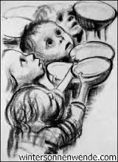
Food Shortage
2nd Cause:
Late 1780’s:
Bad harvests
Food prices increased
Hunger & Starvation spread throughout France
Question:
What would you do if there was a food shortage?
Notes:
In the late 1780’s, bad harvests caused there to be a lack of food and for the price of food to increase which caused hunger and starvation to occur in France.

Slide 4
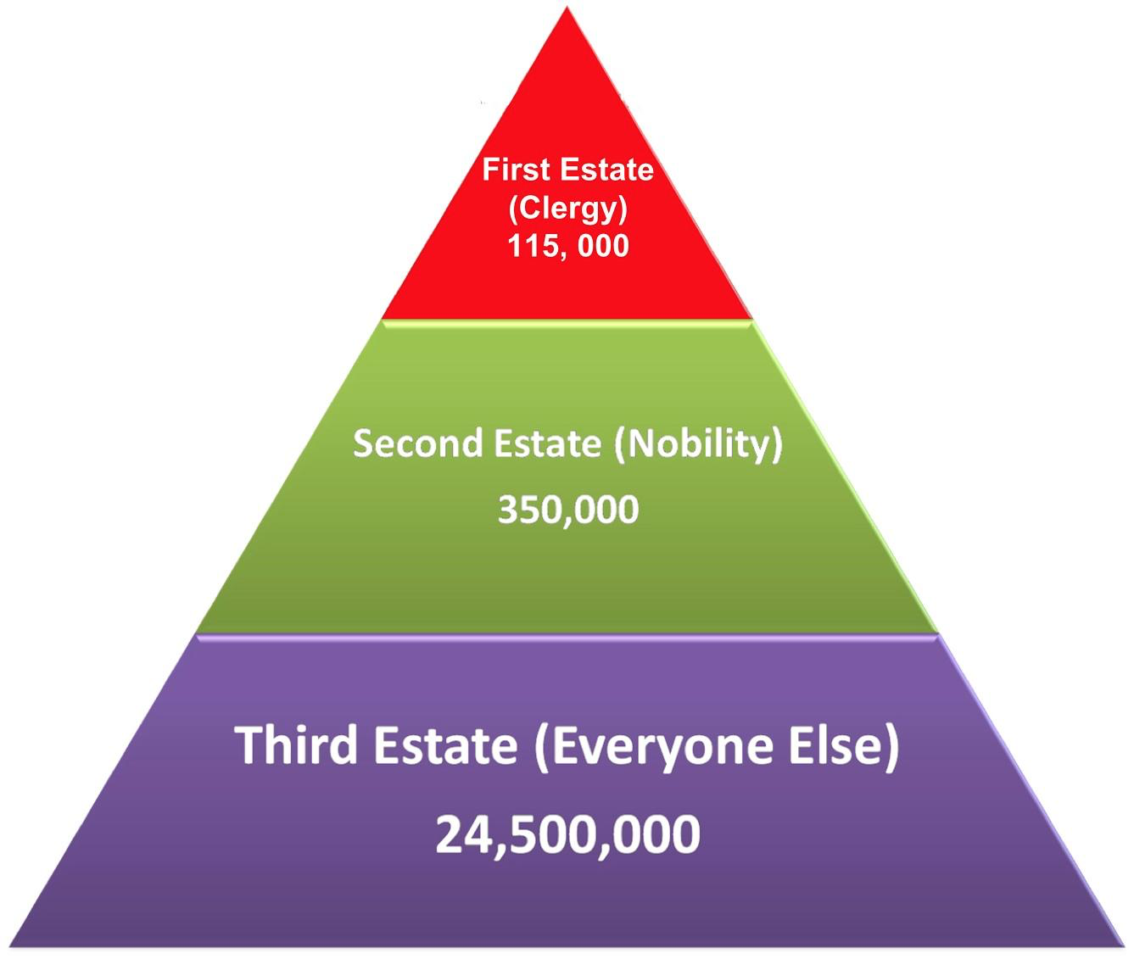
Inequality of the Estates
3rd Cause:

Slide 5
First Estate (Clergy)
Catholic priests, bishops, abbots
Owned 10% of the land
1% of the French population
Collected Tithes (Church Tax)
Paid NO Taxes
Notes:
The Clergy
The Catholic Church or the clergy (priests, bishops, and abbots).
They owned 10% of the land in Frances
Collected taxes through the tithes.
Paid no taxes to the state.
They only represented 1% of the population in France.

Slide 6
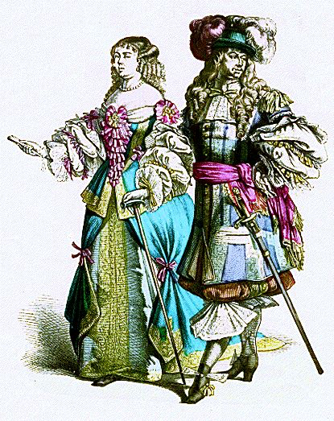
Second Estate (Nobility)
Knights, lords, aristocrats
Owned 20% of the land
2% of the French population
Heredity – Born into power
Privileged:
Top government JOBS reserved to ONLY them
Paid NO Taxes
Notes:
The nobility
The knights and lords of the Middle Ages.
During the Middle Ages, they once had their own armies and military power, but during the age of Absolutism under Louis XIV, the nobility’s military power diminished and they were given other privileges such as: top government, army, courts, and church jobs.
They also paid no taxes to the state.
Owned 20% of the land in France.
They only represented 2% of the population in France.

Slide 7
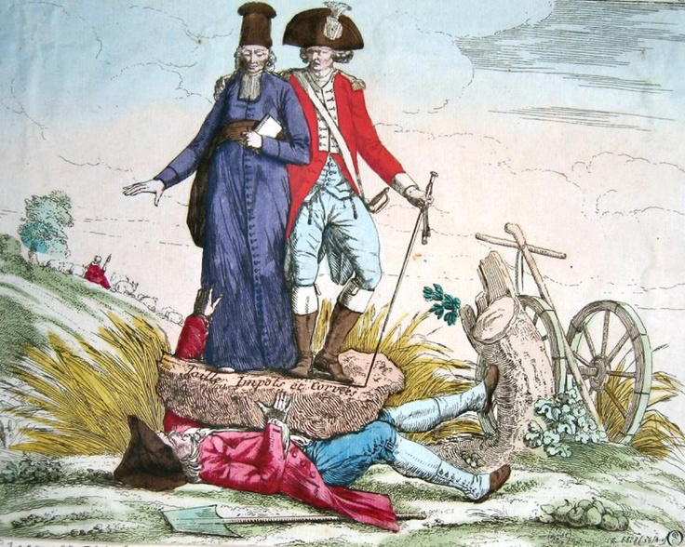
Third Estate (Commoners)
97% of the French population
PAID TAXES
Blocked from top government positions
Three groups:
Bourgeois – Newly rich bankers, merchants, professionals. Created a new class: the “Middle Class.”
Peasants – Rural farmers. 90% of the population.
Urban Workers – City dwellers. Poorest group. Suffered unemployment.
Question:
What character represents the “Third Estate” in the picture above?
What do you think the rock represents?
Notes:
The commoners who were made up of the bourgeoisie, peasants, and urban workers.
Paid all of the taxes.
Blocked from gaining top positions in the government.
Represented 98% of the population in France.
Owned only 70% of the land.
Bourgeoisie:
The new middle class.
Included prosperous bankers, merchants, manufacturers, and professionals (lawyers, doctors, journalists, professors, and skilled artisans).
New class in French society that had NOT been a part of France in the Middle Ages.
Its emergence upset the status quo because they sought top positions in the government, military, courts, and the church that were only reserved for the nobility.
Peasants:
90% of the French population.
Rural farmers.
Urban Workers:
Apprentices, journeymen, and industry workers.
The poorest group of people in France.
Suffered from unemployment.

Slide 8
3rd Cause:
Inequality of the Estates
(First & Second Estate Privileges)
What were the privileges/inequalities?
Can you think of any others?
Taxes!
First & Second Estates paid NO taxes
Third Estate paid ALL of the taxes
Jobs!
Top government, army, judicial, Church jobs were reserved to ONLY the Second Estate
Land!
First & Second Estates (3% of the population) owned 30% of the land
Money!
First & Second Estates were wealthier than most of the Third Estate (except the bourgeois)

