Slide 1
The Principles of the Constitution
Ch.3 Sec.1

Slide 2
Six principles of the Constitution
  Popular Sovereignty
  Limited Government
  Separation of Powers
  Checks and Balances
  Judicial Review
  Federalism

Slide 3
Popular Sovereignty
The people are the only source for all governmental power.
  leaders elected by the people to represent the people.

Slide 4
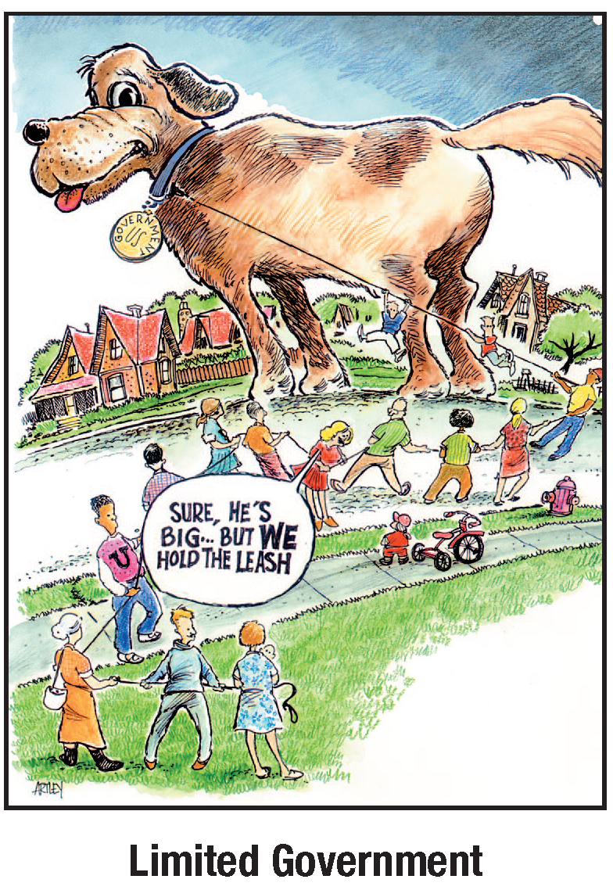
Limited Government
Government may only do those things the people have given it the power to do.
  obey the law.
  spells out limits on the government.

Slide 5
Time to think…not write
How does the separation of powers keep government from becoming too powerful?
  The Constitution divides power among the legislative, executive and judicial branches.
    keeps a strong central government from being too powerful.

Slide 6
Separation of Power
In order to limit power and keep the national government from abusing power, the founders divided powers between three branches:
  Legislative- to write laws
  Executive- to enforce laws
  Judicial- to interpret laws

Slide 7
Checks and Balances
Each branch can check the other.
  The President can veto bills passed by Congress
  The Senate can reject presidential appointees or refuse to ratify a treaty.
  Congress can vote to impeach a federal official.
  The federal courts can rule that executive and legislative acts are unconstitutional.

Slide 8
Judicial Review
The Courts can decide if a government action is constitutional.
  Power held by all federal courts and most state courts.
  Judicial review was established Marbury v. Madison in 1803.

Slide 9
Federalism
Federalism is a compromise between a central government and an independent state government.
  Too much governmental power threatened liberty.
  Helps prevent that power from being abused.

