Slide 1
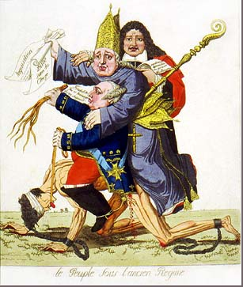

Slide 2
First Estate – Clergy
Catholic Church priests, bishops, abbots
1% of the population
10% of the land
Tax Exempt
Collected Tithes (Church Taxes)
Lived in luxury
Second Estate – Nobility
2% of the population
20% of the land
Tax Exempt
Heredity; Born into power
Privileged; top government JOBS reserved to ONLY them
Monarch – King Louis XVI
Lived in the extravagant “Palace of Versailles”
Lived in luxury
Deficient Spending
Third Estate – Commoners
97% of the population
70% of the land
Taxed Heavily
Blocked from top government JOBS

