Slide 1
Industrial Revolution
Part 3

Slide 2
The New Industrial Class Structure
The social class structure that emerged during the Industrial Revolution can be broken down as follows:​
Upper Class: Very rich industrial families; nobles​
Upper Middle Class: Businesspeople and professionals, including lawyers and doctors​
Lower Middle Class: Other professionals, including teachers, shop owners, and office workers​
Working Class: Factory workers and small farmers​
Impoverished: Itinerant workers and the unemployed​
Notes:
The social class structure that emerged during the Industrial Revolution can be broken down as follows:​
Upper Class: Very rich industrial families; nobles​
Upper Middle Class: Businesspeople and professionals, including lawyers and doctors​
Lower Middle Class: Other professionals, including teachers, shop owners, and office workers​
Working Class: Factory workers and small farmers​
Impoverished: Itinerant workers and the unemployed

Slide 3
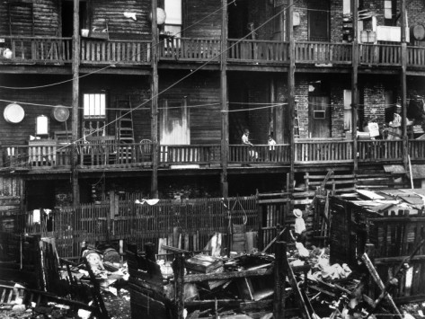
Lower Class Housing
In the rush to build houses for workers moving to the cities, builders quickly constructed tenements. ​
These row apartment houses tended to be overcrowded and unsanitary, and landlords did not adequately maintain them.
Notes:
Working class housing:​
In the rush to build houses for workers moving to the cities, builders quickly constructed tenements. These row apartment houses tended to be overcrowded and unsanitary, and landlords did not adequately maintain them. In one typical example, 17 people from different families lived in a 15 by 12 foot area. Some tenements had yards in the back with an outdoor toilet that all residents used. ​
​

Slide 4
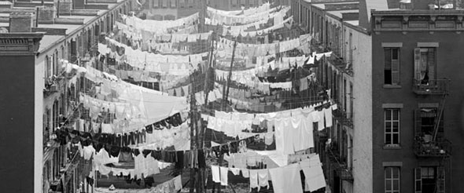
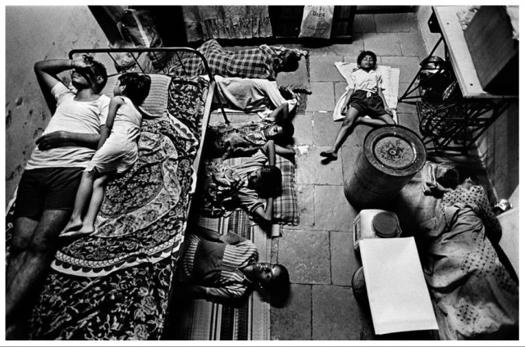
Tenement Life

Slide 5
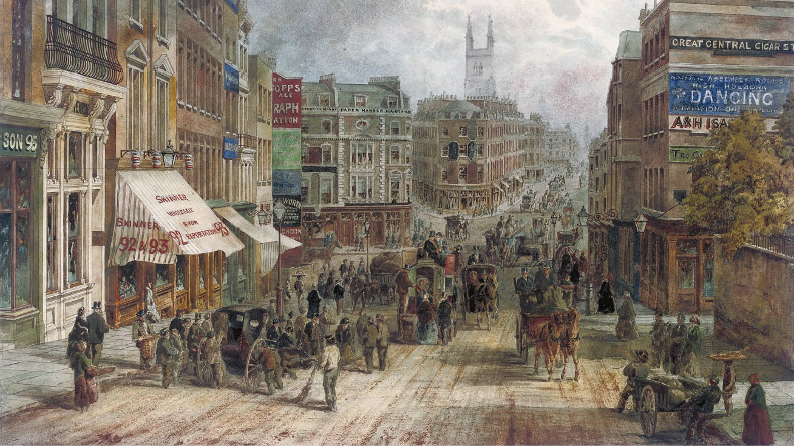
Middle Class Housing
Although its residents were wealthier, emerging middle class districts still suffered from the poor sanitation that plagued entire cities. ​
Disease spread quickly through cities, without regard to social distinctions. ​
Death rates rose, average age of living dropped
Notes:
Middle class housing:​
Although its residents were wealthier, emerging middle class districts still suffered from the poor sanitation that plagued entire cities. Disease spread quickly through cities, without regard to social distinctions.

Slide 6
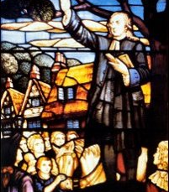
Methodism
Simple doctrine of “Instant salvation”​
John Wesley​
Comforted people who worked dangerous mine and factory jobs​
Preached in English
Notes:
Many members of the working class were attracted to a new religious movement called Methodism, founded by John Wesley. Methodism was a simple doctrine stating that people could go to heaven by acting morally and believing in God. This idea of “instant salvation” appealed to the working classes, who had little time or money to devote to religious activities and donations. Methodism’s simple message comforted people who worked dangerous mine and factory jobs: these workers faced increasing economic insecurity in a rapidly industrializing world. Charismatic preachers spoke directly to people in English rather than in Latin and made them feel socially accepted. Revival meetings, which included singing and preaching, took place in cottages and barns.

Slide 7
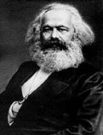
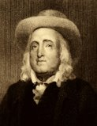
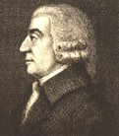
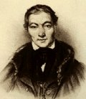
New Economic Theories
Notes:
New social and political philosophies arose as a response to increasing industrialization and changes in working conditions​
​
In the following slides, we will look some of the leading economic thinkers from this period.

Slide 8
Adam Smith 1723-1790
Concept of the free market:​
Self-interest guides efficient use of resources in a nation’s economy.​
Public welfare occurs as a by-product.​
Predicted negative outcome of industrialization.
Notes:
Born in Scotland, Adam Smith is often considered the founder of economics as a discipline. In his 1776 book, An Inquiry into the Nature and Causes of the Wealth of Nations, Smith postulated that self-interest guides the most efficient use of resources in a nation's economy, and that public welfare occurs as a by-product of pursuit of economic self-interest. Smith then argued that government efforts to promote the social good are ineffective compared to unbridled market forces; he also opposed government interference in the economy. His most influential work was The Wealth of Nations, published in 1744. ​
​
Adam Smith and the other economic philosophers shown on the following slides addressed many fundamental economic issues related to the Industrial Revolution. Because many of these men predicted the negative outcomes of continued industrialization, economics became known at the time as the “dismal science.”

Slide 9
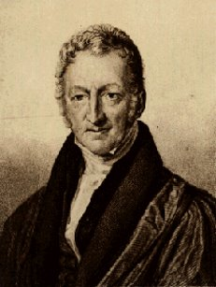
Thomas Malthus 1766-1834
Predicted that the food supply would not meet the needs of the growing population.​
Argued that demand for food would keep the price of labor low. ​
Only “moral restraint” could check excessive population growth.
Notes:
Thomas Malthus postulated that food shortages would decrease population, thus bringing the food supply into better balance with the remaining population. This balance, however, could be disrupted by rising birth rates, which would eventually cause food shortages to reappear.​
​
Malthus further argued that the population’s demand for food would always keep the price of labor low because more individuals would enter the work force in search of funds to buy increasingly expensive food. Malthus believed that only “moral restraint” (including late marriage and sexual abstinence) could check excessive population growth.

Slide 10
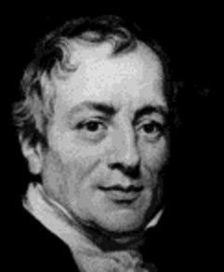
David Ricardo 1772-1823
The “Iron Law of Wages” ​
Wages naturally tend toward a minimum level. ​
He saw the working class as trapped in their subsistence-level conditions without any solution out.
Notes:
David Ricardo’s “Iron Law of Wages” theorized that wages naturally tend toward a minimum level that corresponds to the subsistence needs of workers. Ricardo’s ideas were even more “dismal” than those of Malthus because he saw the working class as trapped in their subsistence-level conditions. He did not offer any convenient solutions to the cycle of poverty.

Slide 11
Karl Marx 1818-1883
Philosopher, social scientist, and revolutionary, Karl Marx is regarded by many as the most influential economic and social thinker of the 19th century​
Theorized the struggle between social classes was fundamental to society
Notes:
Karl Marx theorized that the struggle between social classes was fundamental to society. He believed that society faced a constant struggle between the rich and the working classes, and that this class division could be blamed in large part on private ownership of the means of production (e.g., corporations, factories). In order for class conflict to be resolved, Marx believed that the major means of production had to be publicly owned. ​
​
Marx had a tremendous impact on the world’s political systems. Two of his most influential writings are:​
The Communist Manifesto, written with Friedrich Engels in 1848, the same year as the revolutionary uproar that swept across Europe.​
Das Kapital (The Capital), in which he outlined his economic theory in great detail. ​
​
Marx was eventually forced to move to London to avoid political persecution. He lived in poverty his entire life and died nearly penniless, despite having radically changed the political and economic foundations of Europe.

Slide 12
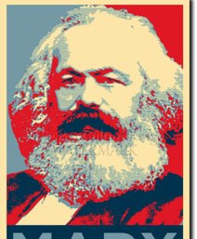
Karl Marx
Class division could be blamed in large part on private ownership of the means of production.​
Public ownership would solve problems​
Wrote the communist manifesto in 1848.​
Cause of many European revolutions​
Forced to move to London, where he died penniless.

Slide 13
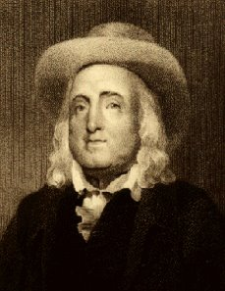
Jeremy Bentham 1748-1832
Utilitarianism: “The greatest good for the most people” or “The greatest good over the least pain”
Notes:
Jeremy Bentham studied law and legislation to arrive at his theory of utilitarianism, which stressed that all actions should be completed with the intention of achieving the greatest happiness for the greatest number of people

Slide 14
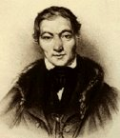
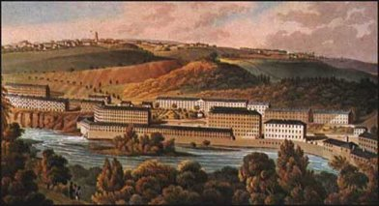
Robert Owen 1771-1858
“Utopian” (Idealistic society) socialist:​
Founded New Lanark Mills in Scotland as a model cooperative factory ​
Provided improved working and living conditions for all his workers.​
Notes:
Despite the many appalling pictures of working class life under industrialization, utopian socialists such as Robert Owen believed in the power of communal organization. Preceding Marx by a full generation, Owen showed (albeit in microcosm) the potential profitability of treating workers and children well.​
​
At his New Lanark Mills cooperative in Scotland, Owen provided improved working and living conditions for all his workers—particularly children. He soon stopped employing children under ten years old and arranged for their education. ​
​
Not all utopian socialists had as much success as Owen, but many achieved notoriety for their ideas and efforts, including Count de Saint-Simon, Charles Fourier, and Étienne Cabet. ​

Slide 15
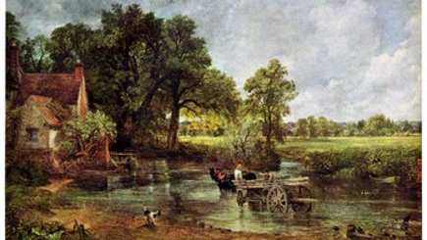
Cultural Impact: Romanticism
The Romantics glorified the divine power of nature as a reaction to the Industrial Revolution’s achievement of controlling nature through technology.
Encouraged people to commune with nature
Notes:
Romanticism was a literary and artistic movement in the late 18th and early 19th centuries. Romantics hailed individualism and creativity and rejected the mechanization of daily life that the Industrial Revolution had brought. They encouraged people to commune with nature and to allow themselves to experience greater emotional interaction and feeling. ​
​
Several well-known Romantic figures include:​
William Wordsworth (English poet)​
Samuel Taylor Coleridge (English poet)​
William Blake (English poet)​
Ralph Waldo Emerson (American poet and essayist)​
Henry David Thoreau (American essayist)​
James Wyatt (English architect) ​
Robert Schumann (German composer)​
Richard Wagner (German composer)​
John Constable—a famous landscape artist who painted this scene, called the Hay Wain​

Slide 16
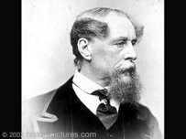
Cultural Impact: Literature
Charles Dickens 1812-1870
Defined the poverty of the Industrial Revolution with works like, Hard Times, Great Expectations, and A Christmas Carol.​
His writing contained many descriptions of urban life during the Industrial Revolution and illustrated the plight of the poor.
Notes:
Charles Dickens’s literature defined the poverty of the Industrial Revolution. His works include Hard Times, Oliver Twist, Great Expectations, and A Christmas Carol.​
​
Dickens’s writings contained many descriptions of urban life during the Industrial Revolution and illustrated the plight of the poor, whom he supported and championed throughout his career.

Slide 17
Effects of the I.R.
Changed Western society significantly:​
Thousands moved from rural to urban centers which led to overcrowding and the creation of slums. ​
New social class divisions emerged​
High levels of environmental pollution​
Increased food production and manufactured goods which meant lower prices and more availability. ​
Westerners consumed more and lived longer.

Slide 18
Summary
Was the Industrial Revolution more beneficial or harmful?
Notes:
The Industrial Revolution changed Western society significantly. Consider the following:​
--Thousands of people moved from rural to urban centers where manufacturing was located. This led to crowding and the creation of slums in the cities.​
--New social class divisions emerged including a new wealthy “bourgeoisie” (middle class), the owners of the factories and other industrial enterprises, as well as a new lower working class, which often had poor working conditions and lived in poverty.​
--Industrialization brought significantly high levels of environmental pollution. The burning of coal for energy and home heating often blackened city skies. ​
--Increased food production and manufactured goods meant greater availability and lower prices. This meant economic improvement for many people in the industrialized countries and a higher standard of living. By 1900, many people in the Western world consumed more and lived longer than their predecessors.​
​
(The teacher can discuss the question on the slide with the class.)​

