Slide 1
Reconstructing Society
Section 12.2

Slide 2
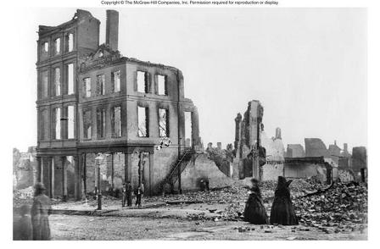
Conditions in the Postwar South
Economic Problems
Property Damage
Confederate Debt
No Labor Force
Increased taxes help pay for public works projects – schools, hospitals, RRs, bridges

Slide 3
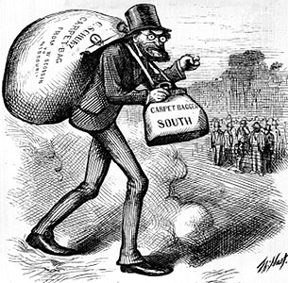
Politics in the Postwar South
Scalawags: White Southerners who joined the Republican Party.
Carpetbaggers: Northerners who moved South after the war.

Slide 4
Politics in the Postwar South
African American Voters
Outnumber white voters in many areas
Majority are Republican
Republican Party splits over commitment to civil rights and Northern interference in Southern politics.

Slide 5
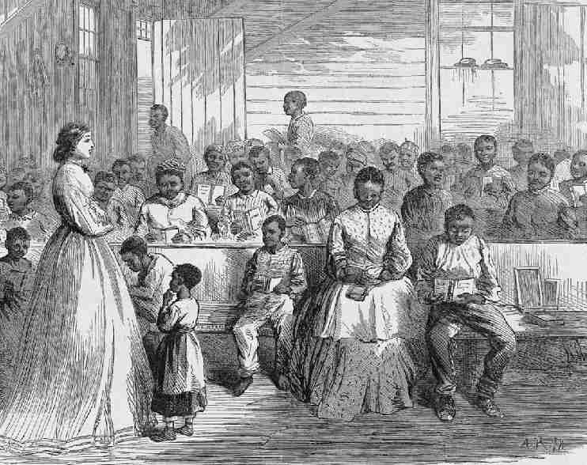
Former Slaves Face Challenges
Postwar Victories
Families are reunited
Take advantage of educational opportunities
Form churches and volunteer organizations
Enter into politics
Hiram Revels – First African American Senator

Slide 6
Former Slaves Face Challenges
Postwar Challenges
Hesitate to test freedom
Many families never find each other
Violence
Sharecropping

Slide 7
Changes in the Southern Economy
“Forty Acres and a Mule”
Promise made by General Sherman to freed slaves to receive land of old Plantations
President Johnson orders land returned to original owners
Rather, 44 million acres of poor land given to former slaves

Slide 8
Changes to the Southern Economy
White plantation owners face labor shortages
Alternatives to Wage Labor
Sharecropping: Supplies given to laborers; laborers give % of their crops back
Tenant Focus: Laborers rent land, provide own tools, and keep all their crops

Slide 9
Changes to the Southern Economy
Cotton Loses Value
Overproduction → Low Prices
Southern banks fail frequently and can’t offer credit to people
Anger taken out on African Americans

