Slide 1
Reign of Terror (Radical Stage of the French Revolution)
1792-1794

Slide 2
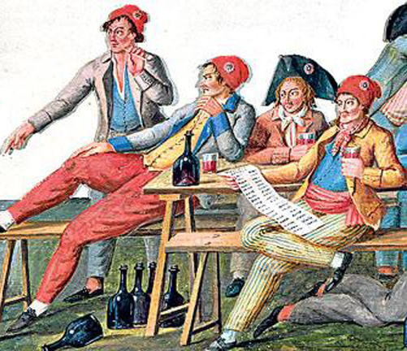
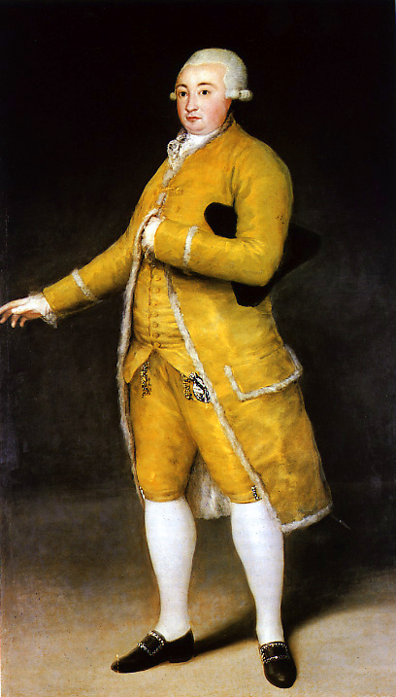
Sans-Culottes (without culottes: knee breeches)
Urban Workers
Violent Revolutionaries
Suffered from:
Food shortage
Unemployment
Low wages
Wanted:
Price controls on food
The right to vote for all men
Tax the rich
Question:
Which picture represents the “sans-culottes?”
Why do you think the sans-culottes wanted price controls on food, all men to have the right to vote, and to tax the rich?
Notes:
Sans-Culottes (san-quu-lot) – The sans-culottes (literally meaning “without culottes” which means people who wore trousers and not the knee breeches worn by the nobility called culottes).
They were urban workers such as shopkeepers, artisans, and wage earners.
They wanted economic equality through wage increases, price controls on food, higher taxes for the rich, and land redistribution.
They supported a nation of small shopkeepers and small farms.
They also supported a democratic republic that gave all men the right to vote no matter what their economic status was.

Slide 3
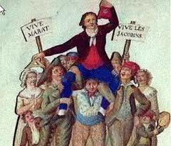
Jacobins
Group within the French Government
Allied with the sans-culottes
Gained control of the government
Supported government action to deal with the economic crisis, war, and counterrevolution
Question:
Why was gaining the support from the sans-culottes important for the Jacobins to rise to power?
Why do you think the sans-culottes supported the Jacobins?
Notes:
Jacobins – In 1793, the Jacobins gain support from the sans-culottes.
The Jacobins wanted government action to deal with the economic crisis and the war; this caused the sans-culottes to support them.

Slide 4
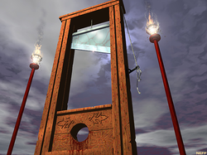
Committee of Public Safety (1793)
Created by the Jacobins
A committee within the government
Designed to win the counterrevolution and the war
Became a “dictatorial oligarchy”
Ordered the arrests & executions of people against the revolution
Question:
What’s the irony of the name: Committee of Public Safety?
Is it ever possible to provide “safety” through “killing?”
Notes:
The Jacobins gained control of the Revolutionary government and set up a cabinet within the government called the “Committee of Public Safety” which was designed to organize the nation’s defenses, foreign policy, supervise government officials, order arrests, and impose central government control throughout France.

Slide 5
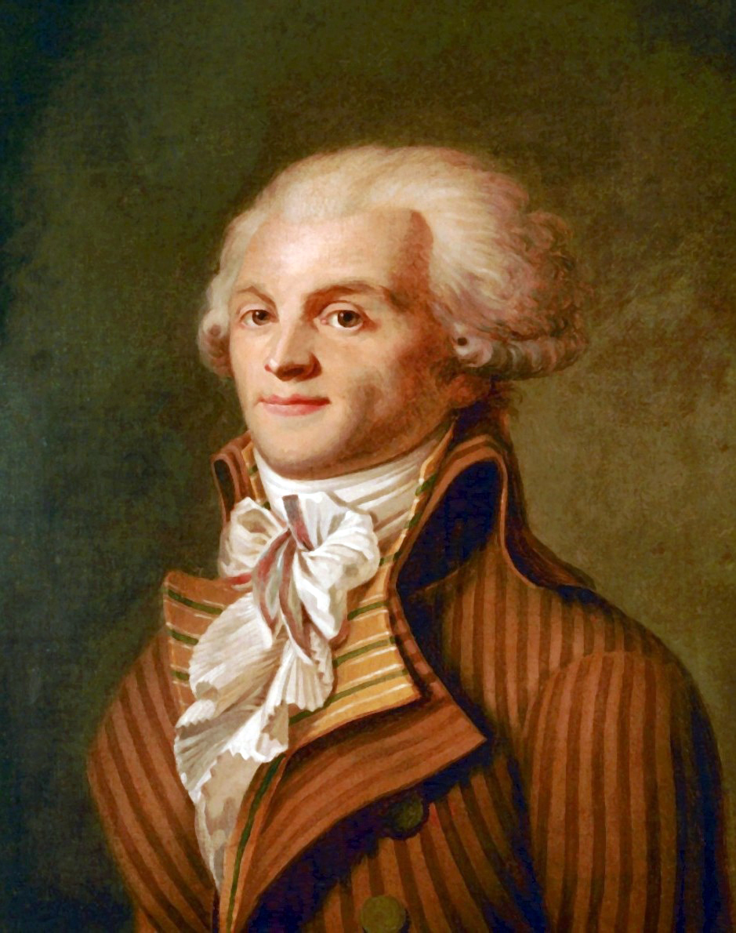
Maximilian Robespierre (1758-1794)
Leader of the Committee of Public Safety
Temporarily suspended liberty and rights in order to save the revolution
Believed anyone against the General Will must be executed
Knew what was best for France, those that disagreed, were opposing what is best
Opposing what is best = DEATH
Question:
What is Robespierre’s version of the “General Will?”
What is wrong with Robespierre’s logic?
Notes:
Robespierre – A Jacobin that was a part of the “Committee of Public Safety.” He helped temporarily suspend the French Republic in order to save it.
The Committee of Public Safety under his leadership became a dictatorial oligarchy that centralized the power in France.
Robespierre believed in Rousseau’s idea of the “General Will,” and Robespierre believed that anyone against the Republic and the Revolution is against the General Will and must be executed.
Robespierre and the Committee of Public Safety saw their actions using the guillotine necessary to save the republic and its revolutionary ideals; they believed they knew what was best for France and that their beliefs was the General Will for France, so if people opposed or disagreed with them, then those people were going against the General Will and must be eliminated in order for the French Republic to prosper.

Slide 6
Take out:
Reign of Terror Worksheet
“The people want what is good, but they do not always see it.”
-Robespierre
Discuss:
What does he mean?
“If the spring of popular government in time of peace is virtue, the springs of popular government in revolution are at once virtue and terror: virtue, without which terror is fatal; terror, without which virtue is powerless. Terror is nothing other than justice, prompt, severe, inflexible...It has been said that terror is the principle of despotic government. Does your government therefore resemble despotism? Yes, as the sword that gleams in the hands of the heroes of liberty resembles that with which the henchmen of tyranny are armed.”
-Robespierre
Speech on the Justification of the Use of Terror
Discuss:
Why does he think “terror” is necessary?

Slide 7
Take out:
Reign of Terror Worksheet
Citizen-representatives of the people…
…In order to lay the foundations of democracy among us and to consolidate it, in order to arrive at the peaceful reign of constitutional law, we must finish the war of liberty against tyranny and safely cross through the storms of the revolution: that is the goal of the revolutionary system which you have put in order. You should therefore still base your conduct upon the stormy circumstances in which the republic finds itself…
“Social protection is due only peaceful citizens; there are no citizens in the Republic but the republicans. The royalists, the conspirators are, in its eyes, only strangers or, rather, enemies… Are not the enemies within the allies of those without? ...
“We must smother the internal and external enemies of the Republic or perish…”
-Robespierre
Discuss:
What must the “Republic” do in order to survive according to Robespierre?

Slide 8
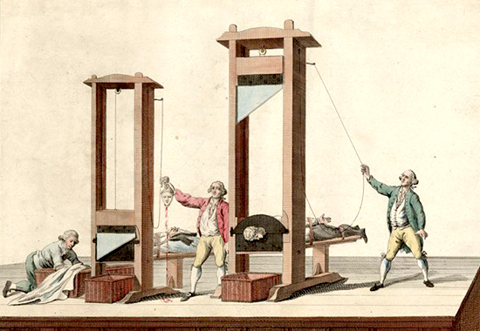
Reign of Terror (1793-1794)
Guillotine used (see picture)
Started with:
King Louis XVI executed (January 1793)
Queen Marie Antoinette executed (October 1793)
40,000 people were executed from 1793-1794
Victims:
Counterrevolutionaries
Anyone who disagreed OR suspected of disagreeing
Notes:
To save the Republic Robespierre and the Committee of Public Safety executed, using the guillotine, opposing political forces, counterrevolutionaries (nobles, priests, and peasants), people who wanted to make peace with the foreign invaders, and sans-culottes, the very supporters who helped bring the Jacobins to power, because the Committee of Public Safety saw that they could undermine central authority and cause anarchy.
Killed over 40,000 people

Slide 9
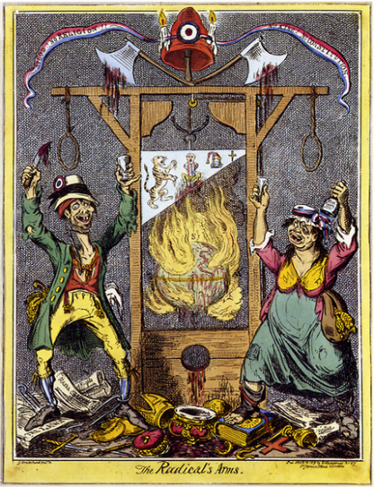
Reign of Terror (Continued…)
A description of The Terror at Bordeaux.
“A Woman was charged with the crime of having wept at her husband’s execution…she was condemned to sit for hours under the blade which shed upon her, drop by drop the blood of her dead husband…before she was released by death…”
Jean-Baptiste Henry
A journeyman tailor, aged 18, was convicted of sawing down a tree of liberty.
Executed September 6, 1793.
Francis Bertrand
Aged thirty-seven, convicted of producing “sour wine injurious to the health of citizens,” guillotined.
1819 - Caricature by Englishman George Cruikshank. Titled: "The Radical's Arms”. "No God! No Religion! No King! No Constitution!" is written in the republican banner.

Slide 10
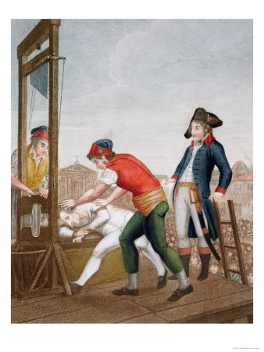
End of the Terror (Robespierre’s Downfall)
SUCCESS!
Counterrevolution oppressed!
Winning war against Austria & Prussia!
Robespierre executed some members of the Committee of Public Safety for disagreeing with him
No more crisis = No need to take radical actions
Robespierre is executed (July 1794)
Notes:
Fall of Robespierre – On July 28, 1794 the guillotine executes Robespierre.
Before this, the actions by the Committee of Public Safety helped ended the threat of a foreign invasion and the counterrevolution from ending the republic.
With no threat, Robespierre and the Jacobins lost their support. Robespierre’s opponents feared that they might be executed arrested Robespierre and executed him with the guillotine. The Revolution became more moderate after this, but many Jacobin supporters were executed throughout France in the years proceeding Robespierre’s death.

Slide 11
Constructed Response (see Reign of Terror Worksheet)
Maximilian Robespierre and the Jacobins successfully saved the Republic and the all of the changes that the revolution created! They pushed back the invading forces of the Austrian & Prussian armies, and suppressed the counterrevolution. However in order to accomplish their successes, they ruled as a dictatorial government, suspended liberty and other rights, and executed over 40,000 people using the guillotine.
Were their actions justified? Is a government ever justified in using violence against those it identifies as a hostile threat to the State? Who gets to decide?
Please explain (Write 1 paragraph).

