Slide 1
Estates General & National Assembly
The beginning of the French Revolution

Slide 2
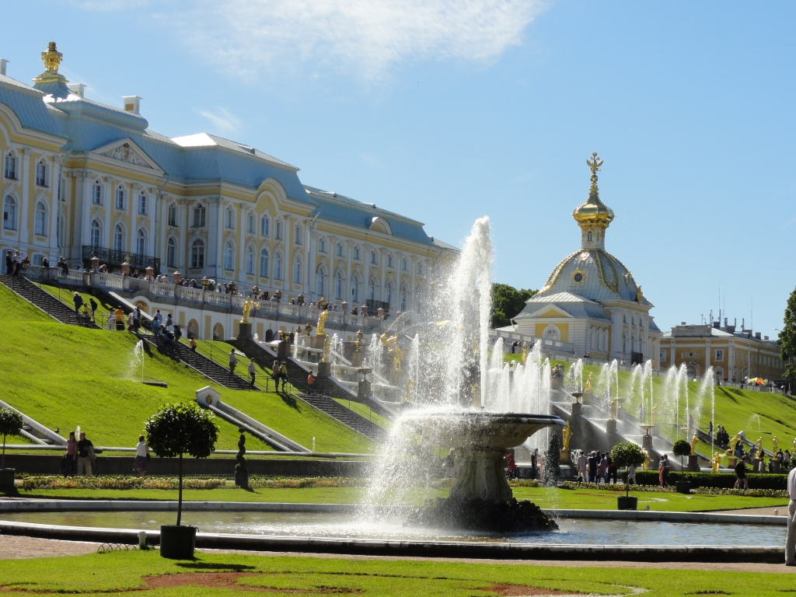
Deficit Spending
Remember… (You do not need to write this slide )
France was in DEBT!
Question:
2. Why was France in debt?
Wars (Seven Years War & the American Revolutionary War)
Excessive Spending (i.e. Palace of Versailles)
Solution:
Estates General
Notes:
“Deficit spending” (spending more money than it takes in). From extravagant royal buildings like the Palace of Versailles to wars like the Seven Years’ War (French and Indian War) and the American Revolution had all left France in debt. France needed to cut spending, increase taxes, or both.
France was in debt.
The clergy and the nobility did not want to loss their privilege of not being taxed.
Economic Decline – France on the 1770’s experienced an economic decline similar to a depression which caused people like Urban Workers to loss their jobs and it caused the Nobility to increase their “manor” taxes on their peasants.
Food Shortages – In the late 1780’s, bad harvests caused there to be a lack of food and for the price of food to increase which caused hunger and starvation to occur in France.

Slide 3
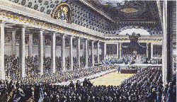
Estates General (May 1789)
A legislative/general assembly of representatives of the French Estates
Had NOT met for 175 years
The THREE Estates met to discuss solutions to the debt
First Estate
Clergy
Second Estate
Nobility
Third Estate
Commoners
Questions:
Knowing the inequalities of the estates, do you think the Estates General was capable of solving the debt crisis? Why or why not?
Notes:
Estates General was a legislative/general assembly similar to a parliament or a congress, that had representatives from the all three Estates meet to discuss and solve the debt crisis.
Estates General had not met for 175 years, because France became an Absolute Monarchy during that time.
Reason – Due to the mounting economic troubles in France, the king, Louis XVI called for an Estates General, the meeting of all three estates, to discuss grievances and figure out solutions.

Slide 4
Voting
Estates General – Continued…
Question:
1. What solution would the Third Estate recommend to decrease the debt?
Tax the First & Second Estates!
1 vote
Voting Choices:
1. Each Estate gets ONE vote
OR
2. Each member gets a vote; “vote by head”
1 vote
Question:
2. How should the voting occur?
Questions:
3. What voting system do you think the Third Estate preferred?
4. What voting system do you think the First & Second Estates preferred?

Slide 5
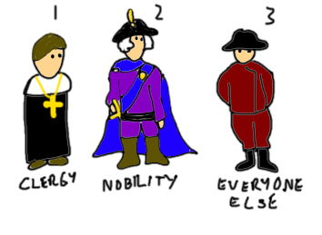
Voting Continued…
One Vote Each Estate
Vote by head
Proposal: Tax the Clergy & Nobility.
VS.
Vote:
NO!
Vote:
NO!
Vote:
YES!
Question:
Which one was chosen?
And the Winner is…
One Vote Each Estate!
Question:
Why might this be a problem?
Third Estate will always be out voted 2 to 1
Caused “Deadlock” at the Estates General
Third Estate out voted 2 to 1
Notes:
Voting – The first debate in the Estates General before any issues were discussed was how would the voting occur. Traditionally, each estate had one vote each, but with issues like taxation and royal privileges, the Third Estate would always be outvoted 2 to 1. The Third Estate who represented 97% of France, wanted voting to be counted “by head,” but the Estates General was deadlocked on how to vote.

Slide 6
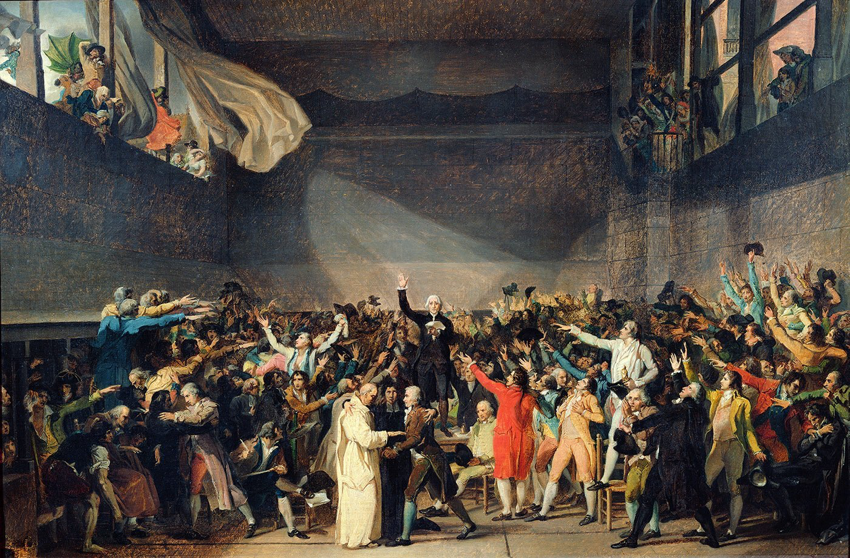
National Assembly (June 1789)
Third Estate:
Left the Estates General
Declared themselves the TRUE representatives of France
Started the National Assembly to solve the French debt crisis
Tennis Court Oath:
Locked out of their meeting hall
Met in an indoor tennis court
Pledged not to disband until a Constitution was written
Declared France a “Constitutional Monarchy”
Question:
Why could this be considered “revolutionary?”
How do you think King Louis XVI responded?
Notes:
National Assembly – The Third Estate, seeing that nothing was getting resolved, declared themselves the true representatives of France and called themselves the “National Assembly.” They invited members from the First and Second Estates to join them to write a constitution for France.
Tennis Court Oath – The National Assembly attempted to meet but found that their meeting hall was locked and guarded. They thought that Louis XVI was planning on dismissing them, so they met in an indoor tennis court and pledged not to disband until a constitution had been written.

Slide 7
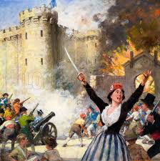
Storming of the Bastille (July 14, 1789)
France suffered from: Hunger & Starvation
King Louis XVI sent his Royal Army to Paris to keep law and order
Parisians felt threatened by the Royal Army. They thought the army might stop the National Assembly
To get weapons for defense, a mob of Parisians attacked the Bastille prison
The French Revolution has begun…
Notes:
In Paris, food prices continued to soar which caused the people to go hungry. The people were also afraid that the National Assembly would be disbanded by the king. Some of the people in Paris wanted weapons to defend the National Assembly and believed that the Bastille prison had weapons, so they stormed the Bastille on July 14, 1776. They captured the commander, killed him, beheaded him, put his head on a stake, and paraded it along with his soldiers’ heads around Paris. They found no weapons at the Bastille but had started the French Revolution.

