Slide 1

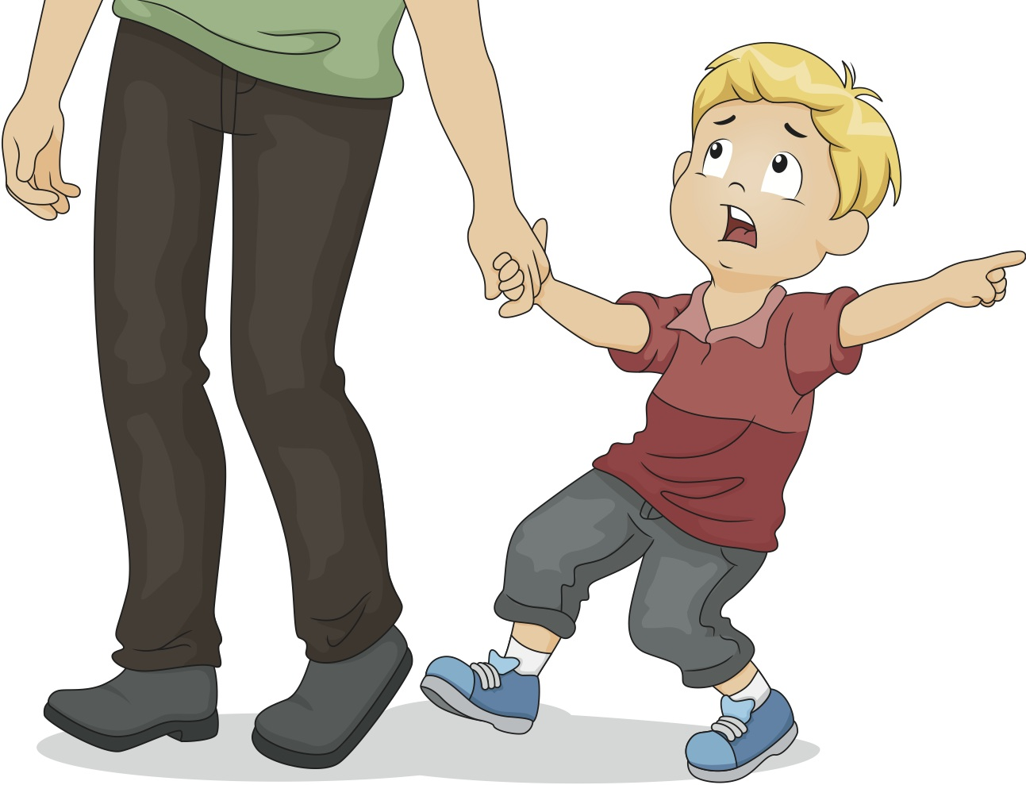
DEMAND

Slide 2
TERMS
Demand
Law of Demand
The quantity of a good or service that buyers are willing and able to buy at all possible prices during a period of time.
As the price of a good or service rises (or falls), the quantity of that good or service that people are willing and able to buy during a certain period of time falls (or rises)

Slide 3



The Law of DEMAND
IF
THEN
P
Q
d
All things being equal,

Slide 4
The Law of DEMAND
INVERSE RELATIONSHIP
IF
THEN
P
Q
d
All things being equal,

Slide 5

Role of Consumer –
DEMAND CURVE
$
PRICE | QUANTITY
$ 27 | 3900
$ 28 | 2100
$ 29 | 1500
$ 30 | 1000
30
Price per Sweater
29
28
27
D
QTY
1000
2000
3000
4000
Number of Sweaters

Slide 6
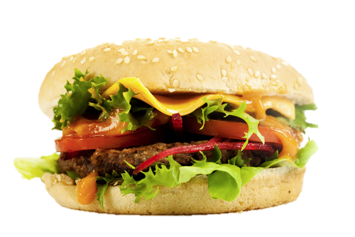
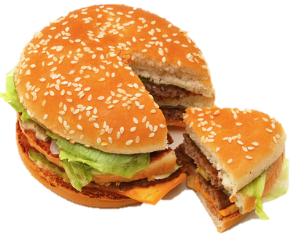
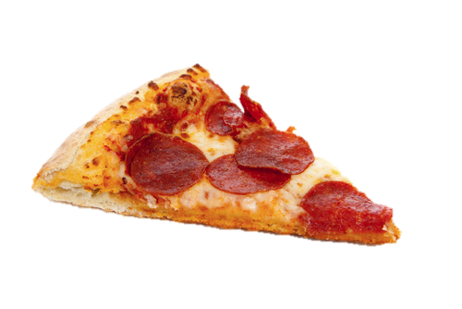
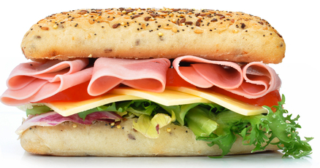
SUBSTITUTION EFFECT
If price goes up for the Big Mac, consumers will simply buy more of another good
P
Q
d

Slide 7
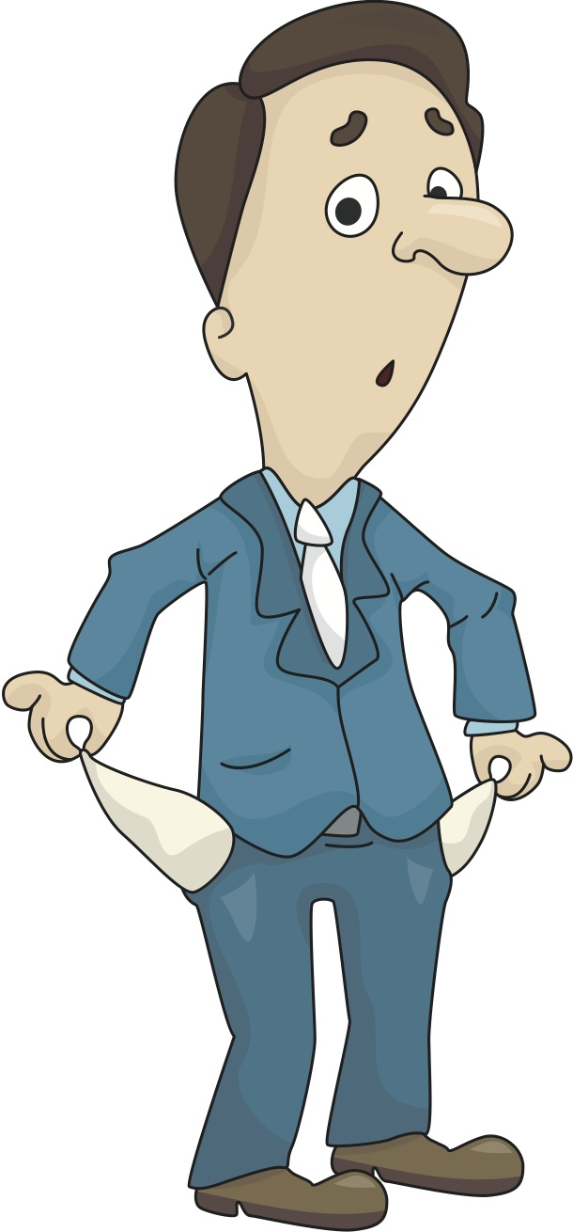
INCOME EFFECT
A rise in price for the Big Mac will cause an impact to a person’s income
P
Q
d

Slide 8


SHIFTS in the Demand Curve
What factors would cause a SHIFT in the demand for coffee?
$1.25
D
10
25
40
Notes:
Demonstrate the concept that demand can go up or down WITHOUT a change in price. (Even though the price doesn’t change, people may want more or less of a product)

Slide 9

SHIFTS in the Demand Curve
NORMAL
GOOD -
You could buy more coffee
Income
$1.25
D
2
What would happen if you receive an increase in income?
D
25
40
More coffee is demanded at $1.25

Slide 10
SHIFTS in the Demand Curve
If you would buy the same amount of a good/service regardless of a change in income you would have a
NEUTRAL GOOD
(perhaps like toilet paper or toothpaste)
Income
INFERIOR
GOOD –
You could buy better coffee
$1.25
What would happen if your income were to increase…BUT demand went down?
D
D
2
10
25
0
Less coffee is demanded at $1.25

Slide 11
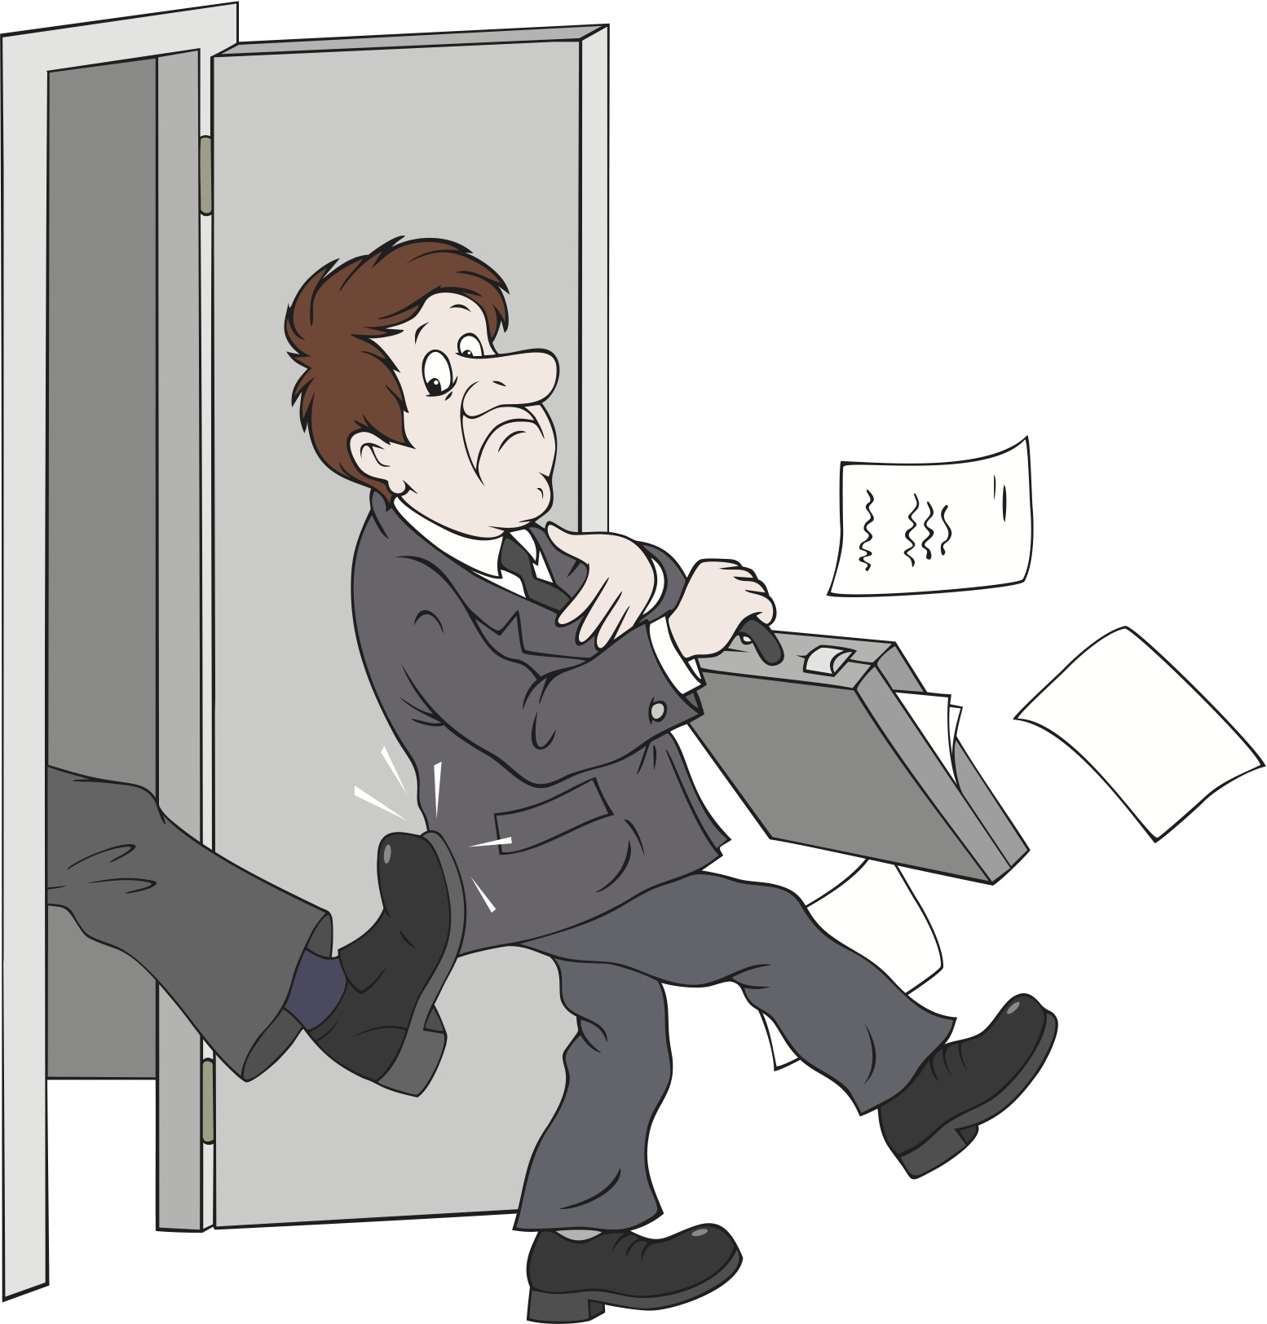
SHIFTS in the Demand Curve
Income
$1.25
What would happen if your incomes were reduced?
D
D
2
10
25
0
Less coffee is demanded at $1.25

Slide 12

SHIFTS in the Demand Curve
Change in Preferences
$1.25
D
2
D
What if you began to enjoy coffee more than before?
25
40
More coffee is demanded at $1.25

Slide 13

SHIFTS in the Demand Curve
Change in Preferences
$1.25
D
D
What if you started to get sick of drinking coffee?
2
10
25
0
Less coffee is demanded at $1.25

Slide 14


SHIFTS in the Demand Curve
Expectations
$1.25
D
What if you knew there was going to be a sale on coffee next week?
D
2
10
25
0
Less coffee is demanded at $1.25

Slide 15
SHIFTS in the Demand Curve
Expectations
LAST
DAY
$1.25
D
2
What if you knew that a sale on coffee was ending tonight?
D
25
40
More coffee is demanded at $1.25

Slide 16
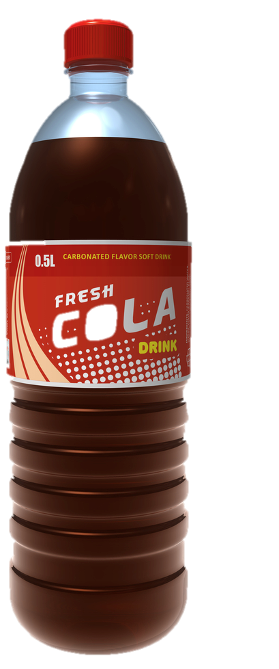


SHIFTS in the Demand Curve
Price of Related Goods
SUBSTITUTES
$1.25
D
D
2
10
25
0
Less coffee is demanded at $1.25

Slide 17
SHIFTS in the Demand Curve
Price of Related Goods
SUBSTITUTES
$1.25
D
2
D
25
40
More coffee is demanded at $1.25

Slide 18
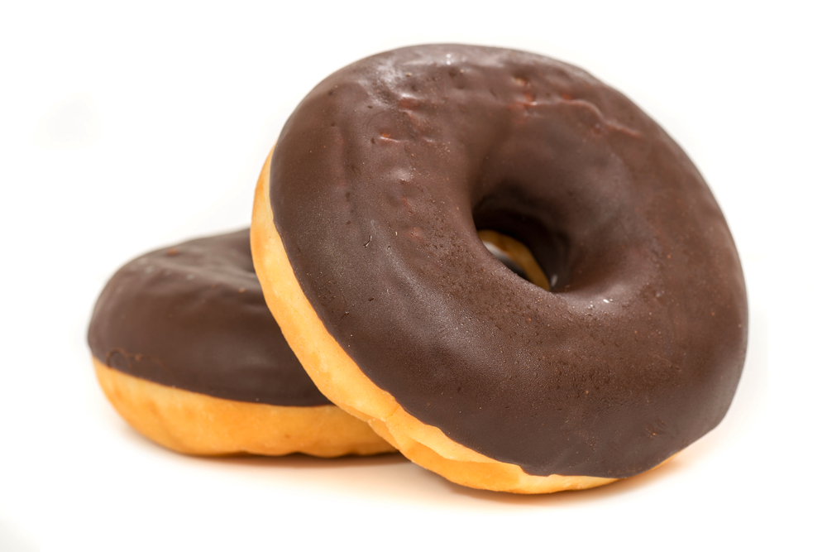
SHIFTS in the Demand Curve
Price of Related Goods
COMPLIMENTS
$1.25
D
2
D
What if the price of donuts went down?
25
40
More coffee is demanded at $1.25

Slide 19
SHIFTS in the Demand Curve
Price of Related Goods
COMPLIMENTS
$1.25
D
D
2
What if the price of donuts went up?
10
25
0
Less coffee is demanded at $1.25

