Slide 1
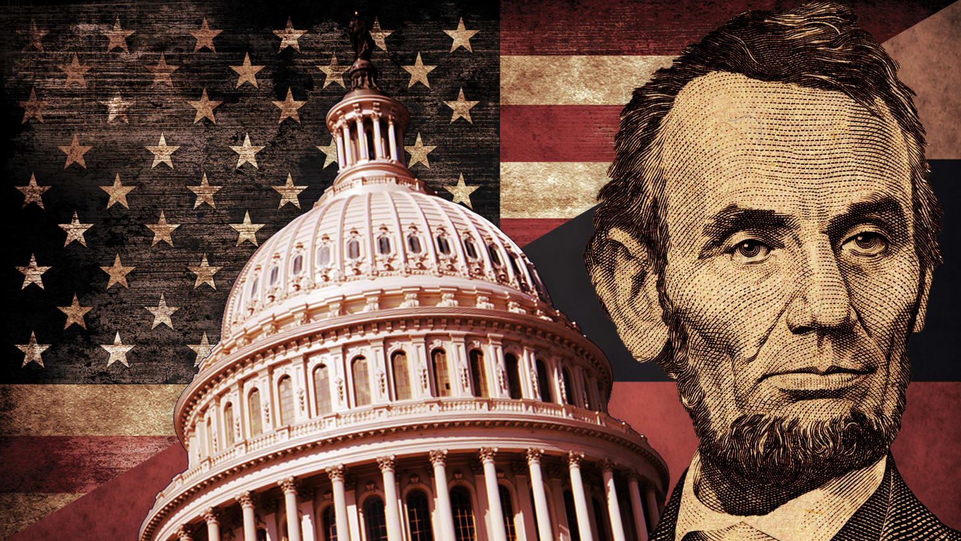
THE CIVIL WAR
The Birth of Modern America
Notes:
Animated picture pans in window with fade-in captions
(Advanced)
Tip: For best results, select a high-resolution, vertically oriented picture, where the picture height is larger than the slide height. The picture in the example above is 15” high and 10” wide. (Normal slide dimensions are 7.5” high and 10” wide.)
To reproduce the picture effects on this slide, do the following:
On the Home tab, in the Slides group, click Layout, and then click Blank.
On the Insert tab, in the Images group, click Picture. In the Insert Picture dialog box, select a picture, and then click Insert.
Select the picture. Under Picture Tools, on the Format tab, in the Size group, click the Size and Position dialog box launcher. In the Format Picture dialog box, resize or crop the image so that the height is set to 15” and the width is set to 10”. To crop the picture, click Crop in the left pane, and in the right pane, under Crop position, enter values into the Height, Width, Left, and Top boxes. To resize the picture, click Size in the left pane, and in the right pane, under Size and rotate, enter values into the Height and Width boxes.
On the Home tab, in the Drawing group, click Arrange, point to Align, and then do the following:
Click Align to Slide.
Click Align Top.
Click Align Center.
The remainder of picture will extend beyond the bottom edge of the slide area. You may need to zoom out to view your slide. To zoom out, on the View tab, in the Zoom group, click Zoom. In the Zoom dialog box, select 33%.
To reproduce the shape effects on this slide, do the following:
On the Home tab, in the Drawing group, click Shapes, and then under Rectangles click Rounded Rectangle (second option from the left). On the slide, drag to draw a rounded rectangle.
Select the rounded rectangle. Under Drawing Tools, on the Format tab, in the Size group, do the following:
In the Shape Height box, enter 2.5”.
In the Shape Width box, enter 8”.
Also on the Format tab, in the Shape Styles group, do the following:
Click the arrow next to Shape Fill, and then click No Fill.
Click the arrow next to Shape Outline, and then under Theme Colors click White, Background 1 (first row, first option from the left).
Also on the Format tab, in the bottom right corner of the Shape Styles group, click the Format Shape dialog box launcher. In the Format Shape dialog box, in the left pane, click Line Style. In the Line Style pane, in the Width box, enter 12.5 pt.
Also in the Format Shape dialog box, in the left pane, click 3-D Format, and then do the following in the 3-D Format pane:
Under Bevel, click the button next to Top, and then under Bevel click Circle (first row, first option from the left).
Under Surface, click the button next to Material, and then under Standard click Warm Matte (second option from the left). Click the button next to Lighting, and then under Cool click Freezing (second option from the left).
On the Home tab, in the Drawing group, click Arrange, point to Align, and then do the following:
Click Align to Slide.
Click Align Middle.
Click Align Center.
On the Home tab, in the Drawing group, click Shapes, and then under Rectangles click Rectangle (first option from the left). On the slide, drag to draw a rectangle.
Select the rectangle. Under Drawing Tools, on the Format tab, in the Size group, do the following:
In the Shape Height box, enter 2.51”.
In the Shape Width box, enter 10”.
Also on the Format tab, in the Shape Styles group, click the arrow next to Shape Outline, and then click No Outline.
Also on the Format tab, in the Shape Styles group, click the arrow next to Shape Fill, point to Gradient, and then click More Gradients.
In the Format Shape dialog box, click Fill in the left pane, select Gradient fill in the Fill pane, and then do the following:
In the Type list, select Linear.
Click the button next to Direction, and then click Linear Down (first row, second option from the left).
Under Gradient stops, click Add gradient stops or Remove gradient stops until two stops appear in the slider.
Also under Gradient stops, customize the gradient stops as follows:
Select the first stop from the left in the slider, and then do the following:
In the Position box, enter 0%.
Click the button next to Color, and then under Theme Colors click Black, Text 1 (first row, second option from the left).
In the Transparency box, enter 0%.
Select the second stop from the left in the slider, and then do the following:
In the Position box, enter 100%.
Click the button next to Color, and then under Theme Colors click Black, Text 1, Lighter 25% (fourth row, second option from the left).
In the Transparency box, enter 0%.
On the Home tab, in the Drawing group, click Arrange, point to Align, and then do the following:
Click Align to Slide.
Click Align Top.
Click Align Center.
Select the rectangle. On the Home tab, in the Clipboard group, click the arrow next to Copy, and then click Duplicate.
On the Home tab, in the Drawing group, click Arrange, point to Rotate, and then click Flip Vertical.
Also on the Home tab, in the Drawing group, click Arrange, point to Align, and then do the following:
Click Align to Slide.
Click Align Bottom.
Click Align Center.
Also on the Home tab, in the Drawing group, click Shapes, and then under Rectangles click Rectangle (first option from the left). On the slide, drag to draw a rectangle.
Select the rectangle. Under Drawing Tools, on the Format tab, in the Size group, do the following:
In the Shape Height box, enter 2.55”.
In the Shape Width box, enter 1.06”.
Under Drawing Tools, on the Format tab, in the bottom right corner of the Shape Styles group, click the Format Shape dialog box launcher. In the Format Shape dialog box, in the left pane, click Line Color. In the Line Color pane, select No line.
Also in the Format Shape dialog box, in the left pane, click Fill. In the Fill pane, select Solid fill, click the button next to Color, and then under Theme Colors click Black, Text 1, Lighter 25% (fourth row, second option from the left).
On the Home tab, in the Drawing group, click Arrange, point to Align, and then do the following:
Click Align to Slide.
Click Align Right.
Click Align Middle.
Select the rectangle. On the Home tab, in the Clipboard group, click the arrow next to Copy, and then click Duplicate.
Select the duplicate rectangle. On the Home tab, in the Drawing group, click Arrange, point to Align, and then do the following:
Click Align to Slide.
Click Align Left.
Click Align Middle.
On the Home tab, in the Editing group, click Select, and then click Selection Pane. In the Selection and Visibility pane, select the rounded rectangle.
On the Home tab, in the Drawing group, click Arrange, and then click Bring to Front.
In the Selection and Visibility pane, press and hold CTRL, and then select the rounded rectangle and four rectangles.
On the Home tab, in the Drawing group, click Arrange, and then click Group.
To reproduce the text effects on this slide, do the following:
On the Insert tab, in the Text group, click Text Box. On the slide, drag to draw a text box.
Type the text you want to appear in the text box, and then select the text. Format the text in the textbox using the following steps:
On the Home tab, in the Font group, choose the Calibri font and a font size of 26.
Click the arrow next to Font Color, and then under Theme Colors click White, Background 1 (first row, first option from the left).
In the Paragraph group, click Align Text Left.
Drag the text box to the lower left part of the rounded rectangle.
To reproduce the animation effects for the picture on this slide, do the following:
On the slide, select the picture.
On the Animations tab, in the Advanced Animation group, click Add Animation, and then, under Entrance, click Fade.
Also on the Animations tab, in the Timing group, in the Start list, select With Previous.
Also on the Animations tab, in the Timing group, in the Duration box, type 2.
On the Animations tab, in the Advanced Animation group, click Add Animation, and then click More Motion Paths.
In the Add Motion Paths dialog box, under Lines and Curves, click Up.
Also on the Animations tab, in the Timing group, in the Start list, select With Previous.
Also on the Animations tab, in the Timing group, in the Duration box, type 20.
On the slide, select the Up motion path, and then do the following:
Press and hold SHIFT, and then drag the end point (red arrow) of the motion path to the top edge of the slide.
Press and hold Shift, and then drag the starting point (green arrow) of the motion path to the bottom edge of the slide.
To reproduce the animation effects for the text on this slide, do the following:
On the slide, select the text box.
On the Animations tab, in the Advanced Animation group, click Add Animation, and then, under Entrance, click Fade.
Also on the Animations tab, in the Timing group, in the Start list, select With Previous.
Also on the Animations tab, in the Timing group, in the Duration box, type .5.
Also on the Animations tab, in the Timing group, in the Delay box, type 3.0.
Also on the Animations tab, in the Advanced Animation group, click Add Animation, and then, under Exit, click Fade.
Also on the Animations tab, in the Timing group, in the Start list, select With Previous.
Also on the Animations tab, in the Timing group, in the Duration box, type .5.
Also on the Animations tab, in the Timing group, in the Delay box, type 8.0.
On the slide, select the text box. On the Home tab, in the Clipboard group, click the arrow next to Copy, and then click Duplicate.
On the slide, click in the second text box and edit the text.
On the Animations tab, in the Advanced Animation group, click Animation Pane.
In the Animation Pane, do the following:
Select the entrance animation on the second text box. Click the arrow to the right of the effect, and then click Timing. In the Fade dialog box, on the Timing tab, in the Delay box, enter 8.5, and then click OK.
Select the exit animation on the second text box. Click the arrow to the right of the effect, and then click Timing. In the Fade dialog box, on the Timing tab, in the Delay box, enter 13.0, and then click OK.
On the slide, select the second text box. On the Home tab, in the Clipboard group, click the arrow next to Copy, and then click Duplicate.
On the slide, click in the third text box and edit the text.
In the Animation Pane, do the following:
Select the entrance animation on the third text box. Click the arrow to the right of the effect, and then click Timing. In the Fade dialog box, on the Timing tab, in the Delay box, enter 13.5, and then click OK.
Select the exit animation on the third text box. Click the arrow to the right of the effect, and then click Timing. In the Fade dialog box, on the Timing tab, in the Delay box, enter 19.5, and then click OK.
On the slide, press and hold CTRL, and then select the three text boxes. On the Home tab, in the Drawing group, click Arrange, point to Align, and then do the following:
Click Align Selected Objects.
Click Align Middle.
Click Align Center.
To reproduce the animation effects for the shapes on this slide, do the following:
On the slide, select the rounded rectangle and the group of shapes that form the background of the slide.
On the Animations tab, in the Advanced Animation group, click Add Animation, and then click More Emphasis Effects. In the Add Emphasis Effect dialog box, under Basic, click Grow/Shrink.
Also on the Animations tab, in the Timing group, in the Start list, select After Previous.
Also on the Animations tab, in the Timing group, in the Duration box, type 2.
On the Animations tab, in the Animation group, click Effect Options, and then click Horizontal.
On the Animations tab, in the Advanced Animation group, click Add Animation, and then click More Exit Effects. In the Add Emphasis Effect dialog box, under Basic, click Fade.
Also on the Animations tab, in the Timing group, in the Start list, select With Previous.
Also on the Animations tab, in the Timing group, in the Duration box, type 1.

Slide 2
Ken Burn’s Civil War
disc 1 Prologue (10 minutes)
*Make sure we are following along with worksheet!

Slide 3
Causes
Many people agree slavery was the main cause for the war.
In addition, sectional differences led to conflicts.
Differences in the economic life of the North and the South
The North’s economy focused on financing and manufacturing and the South specialized in Crops and the agricultural trade.
Southern states also began to question the extent of the federal government’s power.

Slide 4
Ken Burn’s Civil War
Disc 1 Scene 2: The Cause/All Night Forever (10:30)

Slide 5
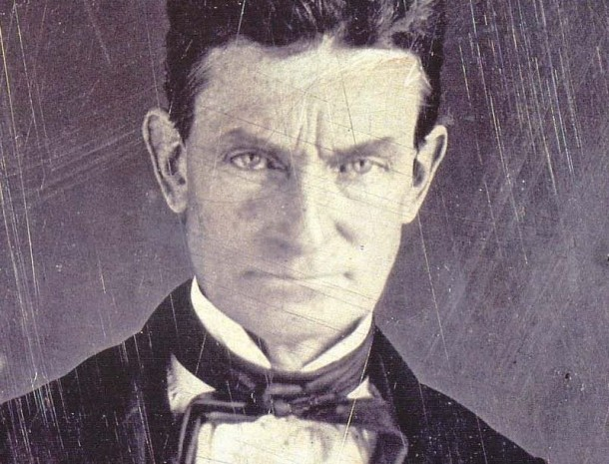
The Meteor
Abolitionist- Someone who favors the destruction of slavery.
John Brown led the raid on Harper’s Ferry on Oct. 16, 1859
This raid failed and he was executed for treason.
His execution split the nation with the North looking at him as a martyr and the South as a representation of the hostile North.
“I John Brown, am quite certain that this guilty land’s crimes will never be cleaned or purged away but with blood.”

Slide 6
Ken Burn’s Civil War
Disc 1 Scene 5: Secessionistis (15:00)

Slide 7
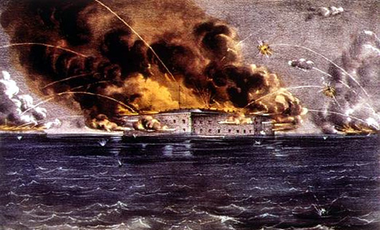
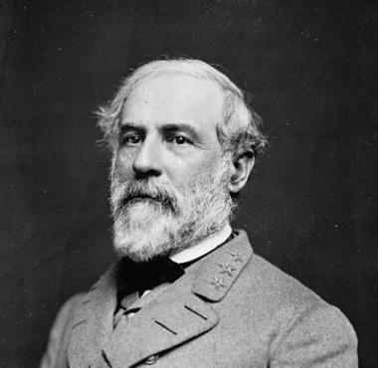
Start of the Civil War
4:30 AM April 12, 1861 -The shelling of Fort Sumter
Rebels capture the fort
Bloodless beginning to the bloodiest war in American history.
Both sides call men to enlist but neither is ready to fight.
Soldiers respond, seeking adventure.
Many had never left home.
The south had a population of 9 million
4 million were slaves.
The north had a population of 21 million
Lincoln offers the leadership of the army of the Potomac to General Robert E. Lee
He would not bear arms against Virginia.

Slide 8
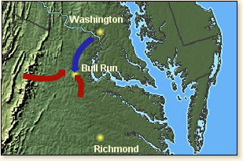
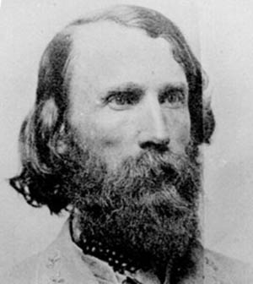
First Battle of Bull Run/ Manassas
Union goal: Cut the railroad & move on to Richmond the rebel capital.
Battle site is less than 25 miles from Washington DC
Many bring picnic baskets to enjoy the fight.
The Union overpowers the Rebels, who retreat until…
Gen. Jackson arrives:
“There’s Jackson with his Virginians standing like a stone wall!” the nickname sticks.
“Stonewall” Jackson tells him men to “yell like furies!” thus beginning the famous rebel yell.
The rebels retake the field as the Union retreats.
Fort the next week, men wander back into DC, drunk, muddy and discouraged.
The Great Skedaddle
The horror of death is now a reality for those adventure seeking soldiers.

Slide 9
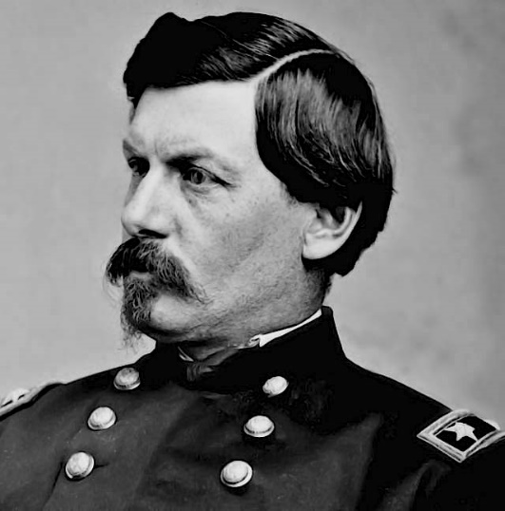
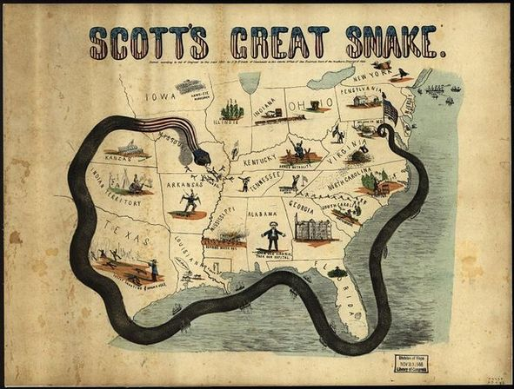
Results of First Bull Run/ Manassas
5 thousand + die for the Union
killed the notion that it would be a 90-day war.
Lincoln places George McClellan as General Chief of Command of the Union Army.
Master driller and prepares men.
Called “Young Napoleon” and “Little Mac.”
He suggests the Anaconda Plan which has three phases:
Drive into Virginia to take Richmond
From Richmond, drive down into Kentucky, Tennessee and into Alabama
Surround the Confederacy by sea, chocking off any chance of reinforcements /supplies
“I can do it all!”… yet he does nothing all summer and fall.

Slide 10
Ken Burn’s Civil War
Disc 2 Episode 2: Prologue (5:00)
Disc 2 Episode 2: Politics (5:15)

Slide 11
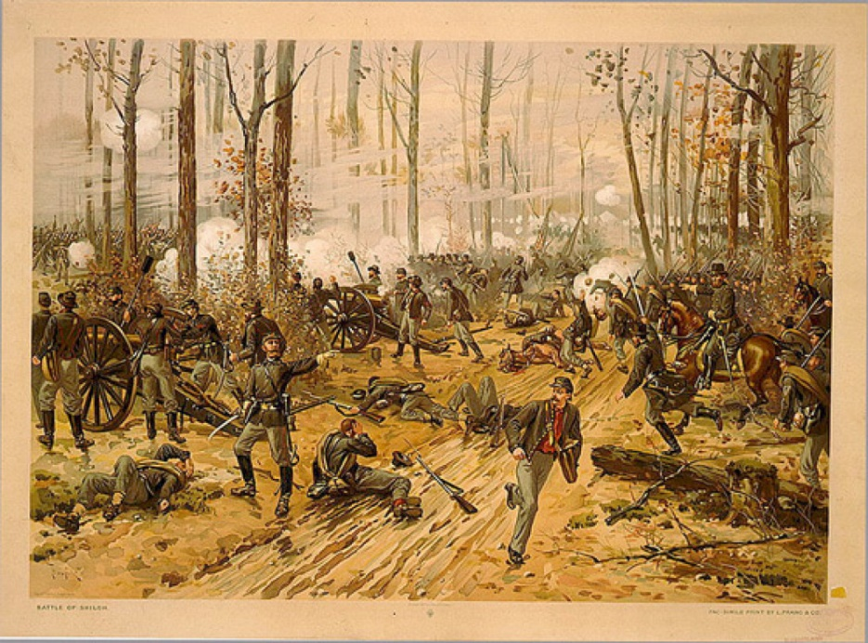
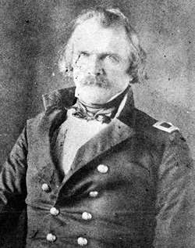
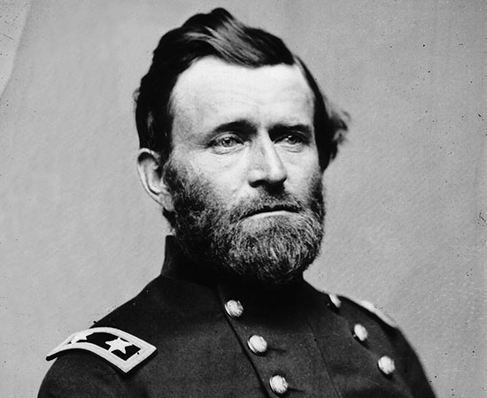
The Battle of Shiloh
Fought in early April. This was a dirty, fistfight of a battle with men whirling at each other.
Confederates poured out of the woods to attack the Union front near Pittsburg Landing on the Tennessee River.
Led by General Sidney Johnston, the rebels drove the Union, led by U.S. Grant, back towards the river.
The fighting happened over a 3-mile front. The worst was in the middle, known as the “Hornet’s Nest.” The rebels had the Union backed up to the Tennessee river.
Grant called to “Maintain the position at all costs!” The rebels led multiple charges but were unable to overtake them.
Johnston is mortally wounded at the end of the day
stalls the rebel efforts.
That night dying soldiers screamed in agony as the rain fell.
Grant’s perseverance- “Lick ‘em tomorrow.”

Slide 12
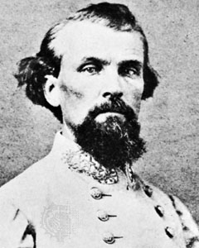
Shiloh Results
Before dawn, Grant receives reinforcements
Outnumbers the rebels 54,000 to 30,000 by the morning.
Grant leads a counteroffensive, overpowering the Confederate forces and driving them from the field.
Nathan Bedford Forrest leads one last Calvary charge and his fighting becomes legendary.
Results: 2,477 killed, 23,000 + casualties
Bloodiest battle in American history to that point.
More than all casualties from all the previous wars combined

Slide 13
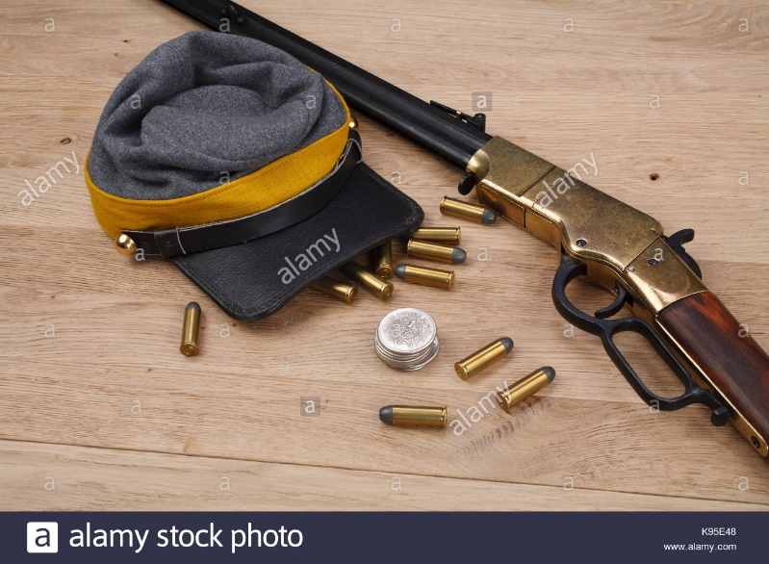
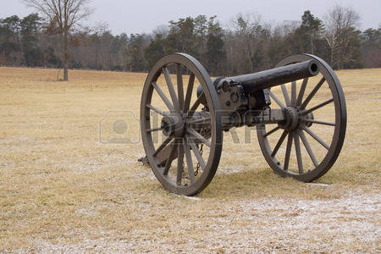
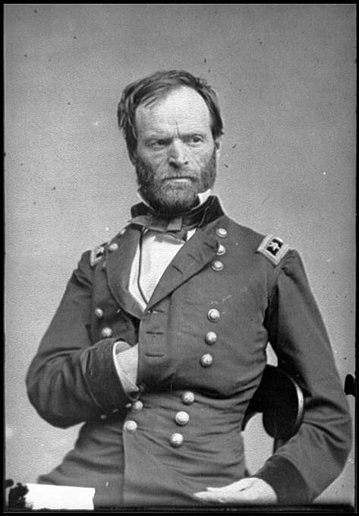
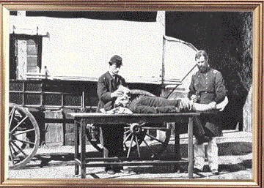
The Arts of Death
The armies fighting in the Civil War were the best equip in history.
It is also the reason that casualties were so high--
the technology was ahead of the war tactics.
Along with technology of warfare, many new inventions helped us understand war better.

Slide 14
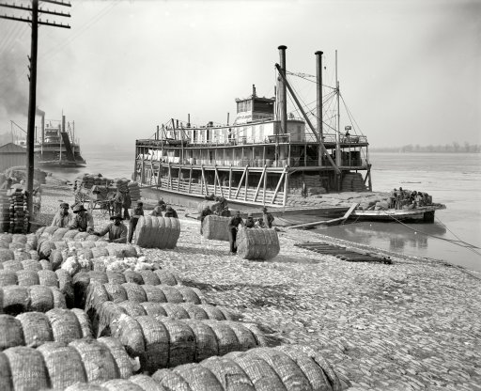
1862 The Civil War: Year 2.
As war enters into its second year, the confederacy, though victorious in battle, is struggling to feed and protect its citizens.
Hoping European’s reliance on cotton will get them to enter into the war on the side of the south,
They burn their cotton
In the north, Lincoln faces pressure to free the slaves. He writes the Emancipation Proclamation but must wait for a Union victory to deliver it.

Slide 15
Robert E. Lee V. McClellan
Rebel General Johnston is killed in action, elevating Robert E. Lee to overall commander of the Rebels.
Lee surprises McClellan at Mechanicsville, dividing his force to engage the Union, meanwhile protecting Richmond.
Battle lasts 7 days.
All but one were Union victories.
Lee loses 20 thousand men but unnerves McClellan who retreats, abandoning his aim on Richmond.
Lee’s strength
read opposing general’s mind

Slide 16
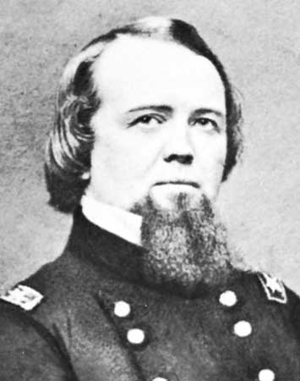
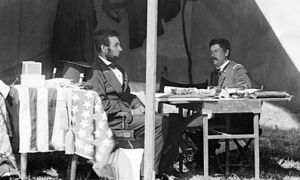
Second Bull Run
Lincoln Frustrated with McClellan removes him
Puts General Pope in command.
Pope charges back into Virginia, setting the stage for the second Manassas/Bull Run.
Another Union disaster.
The union lose 25 thousand men, 5 times the first battle.
Lincoln removes Pope and puts McClellan back in command.
“We must use the tools we have at hand.”

Slide 17
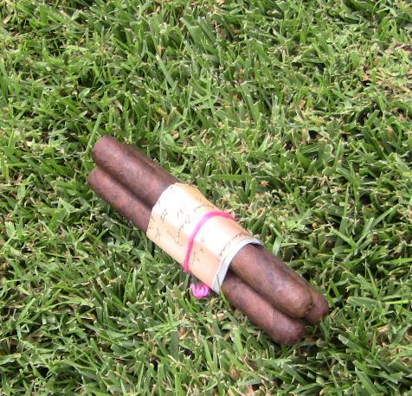
Results
Britain is ready to step in to recognize the Confederacy and stop the war.
One more confederate victory would seal the fate.
Lee Understands this and takes his army into the North.
He marches into Harrisburg, Pennsylvania.
Meanwhile, a union soldier finds Lee’s battle plans wrapped around cigars.
McClellan now has the key to defeat Lee…
He does nothing...for 18 crucial hours!

Slide 18
Ken Burn’s Civil War
Disc 2 Episode 3: Antietam (44:52-1:02:20)(17:00)

Slide 19
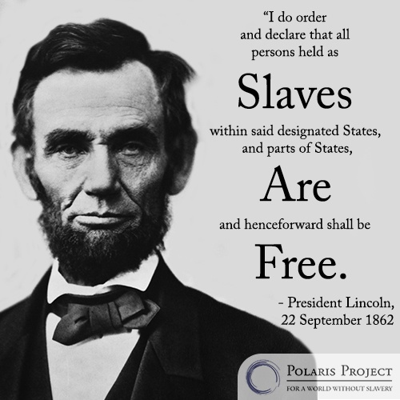
Emancipation Proclamation Results
Lincoln Issues E.P. Which gives a new cause for fighting the war. This is the end of the union as it was.
Does it really do anything?
The south is outraged. Also Highly unpopular with the North who claimed they were not fighting for slaves but for the Union.
The political goal of the EP works as Great Britain refused to enter into a war for freedom. South must fight without the hope of foreign aid.

Slide 20
Ken Burn’s Civil War
Disc 3 Episode 4: Northern Lights (8:20-18:00)(10:00)

Slide 21
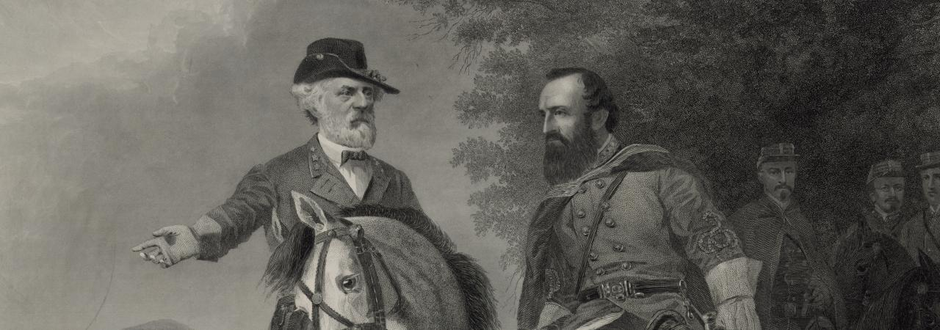
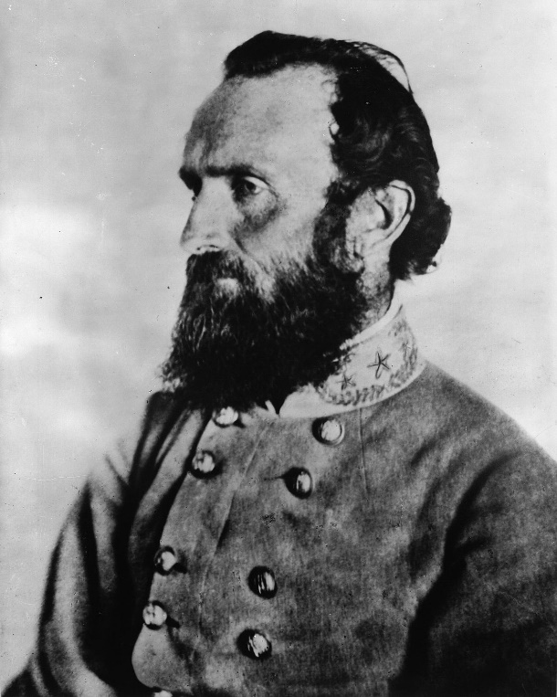
Stalled at Chancellorsville
The Rebels score a partial victory but fail to take the field due to a late start.
Lee outnumbered, divides his forces twice in the sight of the enemy to defeat Hooker.
This is Lee’s Masterpiece.
In the darkness while scouting for a nighttime raid, Stonewall Jackson is shot by friendly fire.
Lee laments “He has lost his left arm, and I have lost my right.”
He dies on a Sunday.
Reb’s lose 13,000 men, Union 17,000.

Slide 22
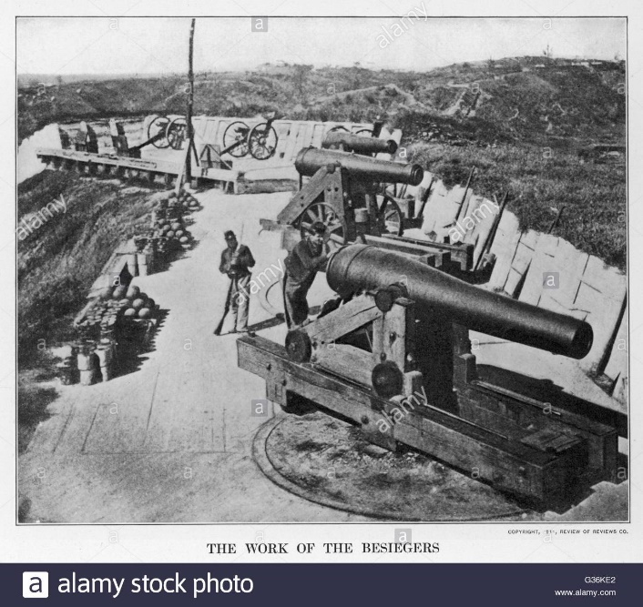
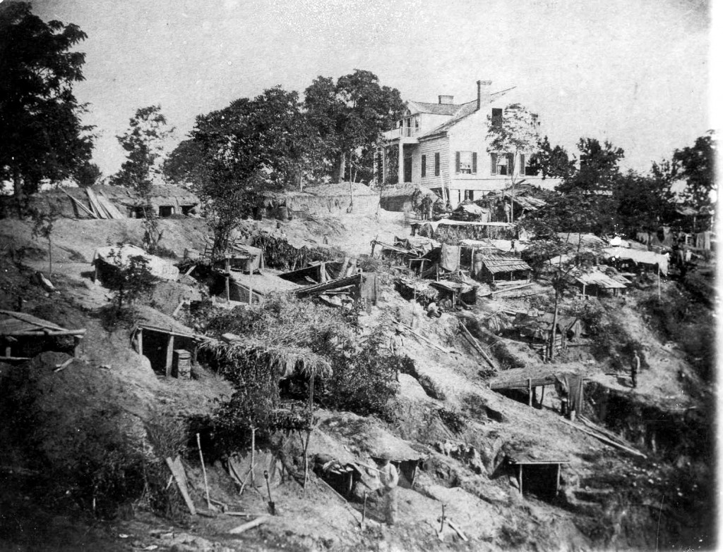
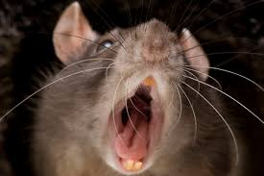
Vicksburg
Grant’s army marches 180 miles in three weeks to surround Vicksburg by siege.
Cut off and starve the army/town
Civilians dig caves
When food ran short many ate mules, horses, rats and even dogs.
To take pressure off of Vicksburg, Lee prepares another invasion of the north into Pennsylvania where he hoped to take Washington and force Lincoln to sue for peace.

Slide 23
Ken Burn’s Civil War
Disc 3 Episode 5:

Slide 24
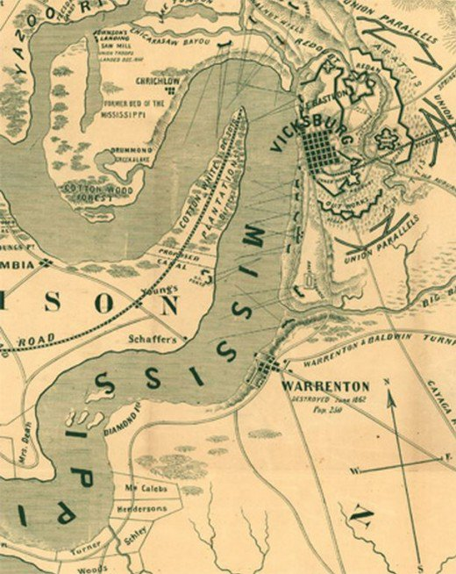
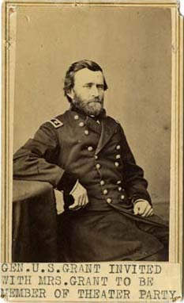
Vicksburg Results
Grants Siege is working.
Continuous firing from land and boat.
31,000 surrender on July 4th (same day as Gettysburg).
Grant is again a hero.
Confederacy is cut in half East and West.
The 4th of July will not be celebrated in Vicksburg for 81 years.

Slide 25
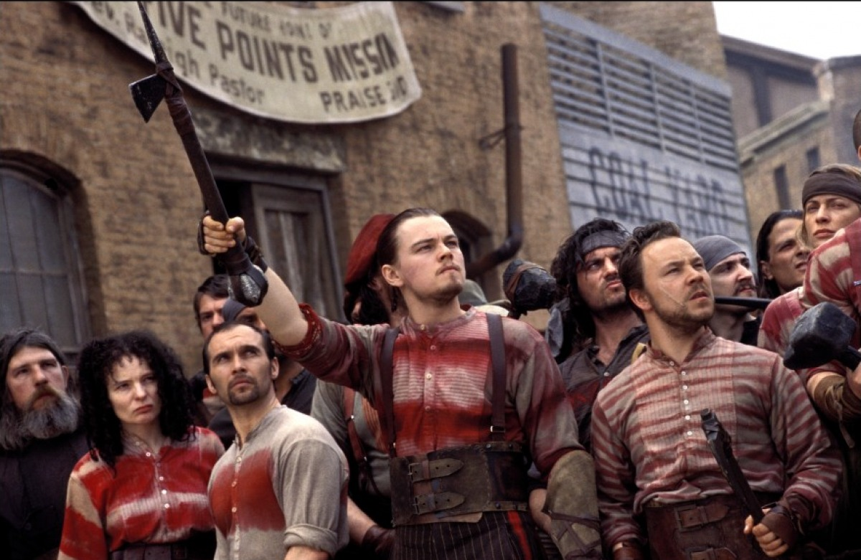
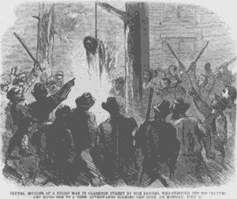
Union Draft
Lincoln issues the first Union Draft July.
Not the first. Rebels already had a draft.
It favored the wealthy.
You could pay $300 or hire a substitute to be exempt.
Anger fuels the New York Draft Riots.
Immigrant Irish take to the streets.
Sunday July 12th is the first day the draft results are printed. Draft office attacked.
3 days of rioting.
Blacks are targeted, beat up, killed, and one is lynched. 100 people died.
Exhausted soldiers from Gettysburg restore order.

Slide 26
Ken Burn’s Civil War
Disc 4 Episode 6: (Beginning-5:32)

Slide 27
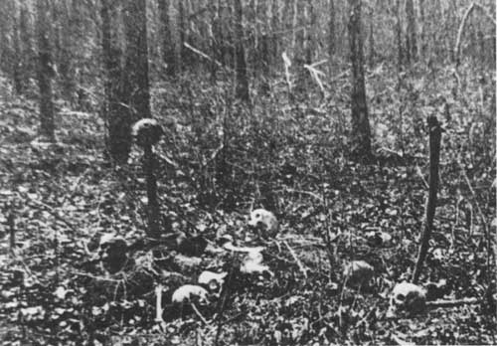
The Wilderness of Chancellorsville
After Gettysburg, Lee refused to meet Grant in the open.
Hiding his lower number of soldiers.
The new goal was to outlast Lincoln and hope for a new president in 1864.
Lee’s 60 thousand were waiting for Grant in the wilderness
Chaos ensues during battle with the Union nearly breaking the Rebels lines
Texas division helps to throw them back.
17 thousand union die.
Fires break out in the forests and burn alive those who were injured behind enemy lines.

Slide 28
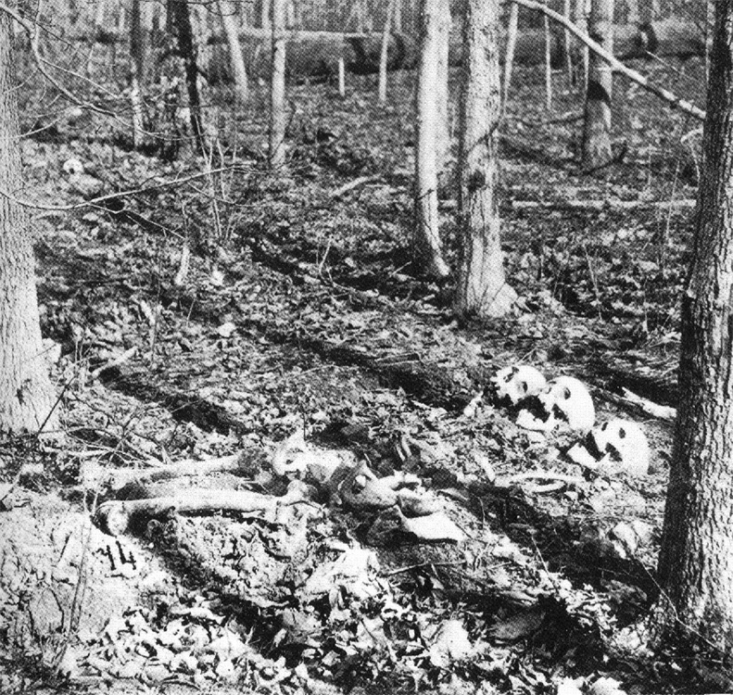
Chancellorsville Continued
Grant openly weeps during the night but wakes up resolved and ready to continue fighting.
He would not retreat and could not be broken like his predecessors.
In the first years of war, battles were bloody but sporadic. From now on it would go unceasingly.
Grant understands his mathematical advantage and knows the only way to beat the confederates is to use up their men.

Slide 29
Cold Harbor & Siege at Petersburg
Grant follows Lee as they head towards Richmond.
They meet at Cold Harbor.
Grant and the Union lose seven thousand men in 20 minutes.
It was a terrible mistake.
Earns him the nickname: “The Butcher”
Instead of repeating his mistake, he slips past Lee to Petersburg where both sides dig-in for a siege.
Lasts 10 months and is a foreshadow for the trench warfare of WWI.

Slide 30
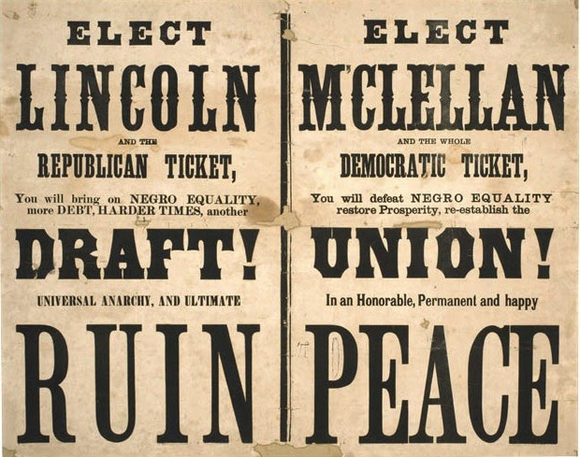
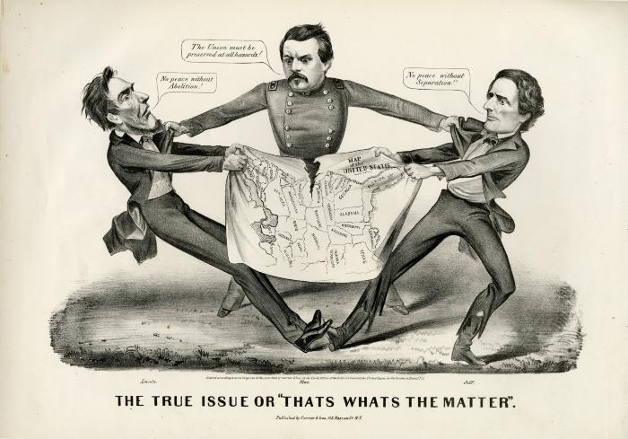
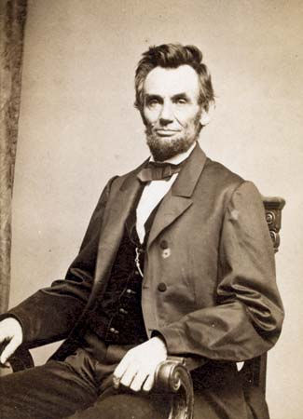
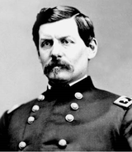
Re-election Campaign
No nation had ever held an election in the midst of a civil war.
Many believed that Lincoln’s reelection was an impossibility.
The Democrats wanted an end to the war with or without victory.
They chose George McClellan
Portrayed as the man of peace
The election turns into a referendum on the war.
Lincoln badly needs military victories.

Slide 31
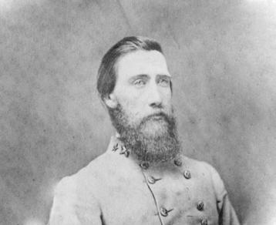
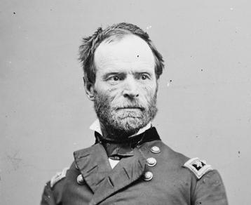
The Promised Land: Battle for Atlanta
Sherman arrives to Atlanta, where he faced John Bell Hood who had replaced Joseph Johnston.
Sherman was delighted, believing that finally Hood would attack.
The union army was recently armed with the newest technology of the Henry repeating rifles that could shoot 15 shots before reloading.

Slide 32
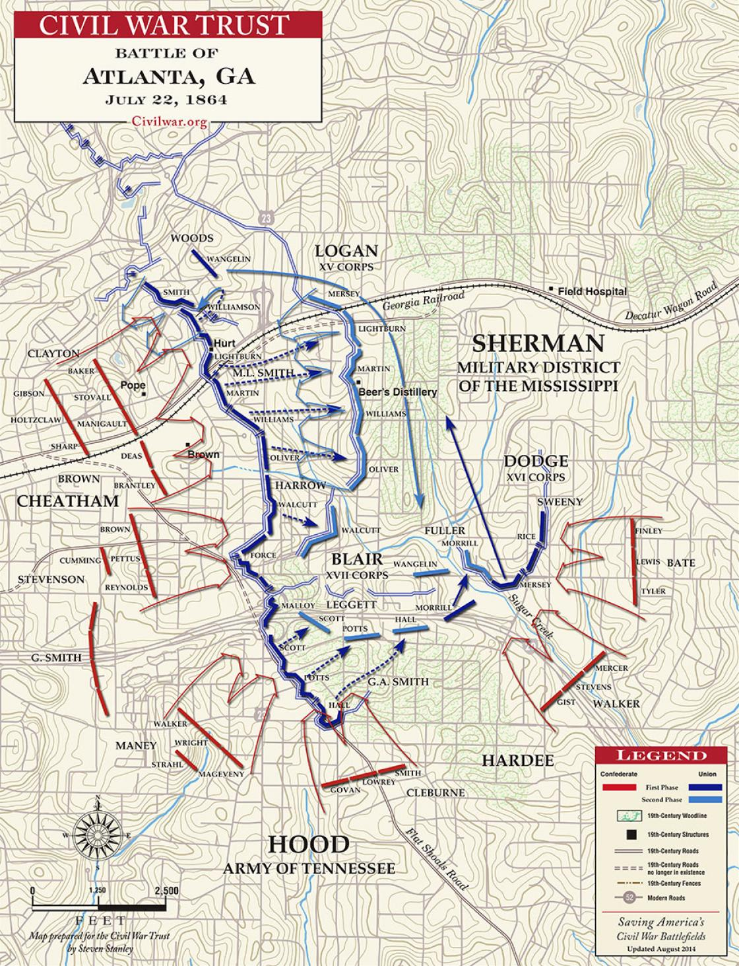
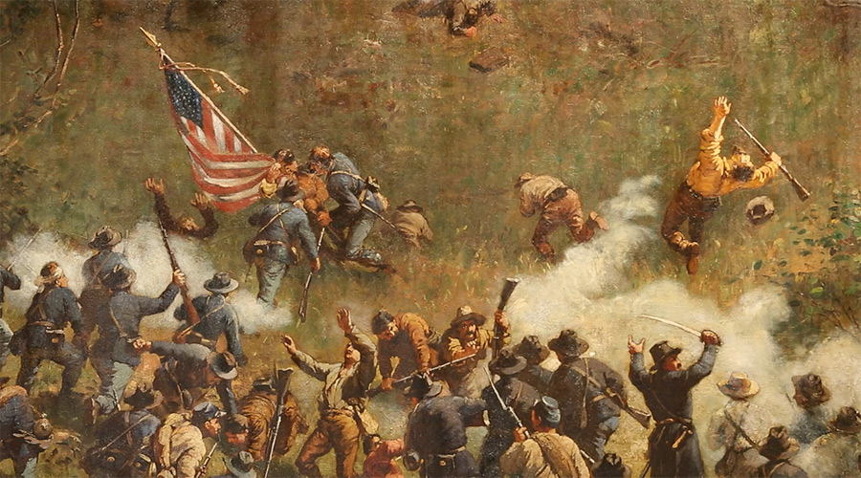
Cont. The Promised Land: Battle for Atlanta
When a Union force went to cut off Atlanta from the railroad lines, Hood attacked.
It cost the rebels 20 thousand men (1/3 of their army)
Hood fell back to Atlanta where they built defenses and waited for an attack.
Sherman saw no need to attack. He simply cut off their supplies and waited.
Both sides suffered.
September 1st, 1864 Atlanta fell as Hood retreated.
This is the biggest feat for the Union thus far.

Slide 33
Ken Burn’s Civil War
Disc 4 Episode 7: (47:20-54:20)

Slide 34
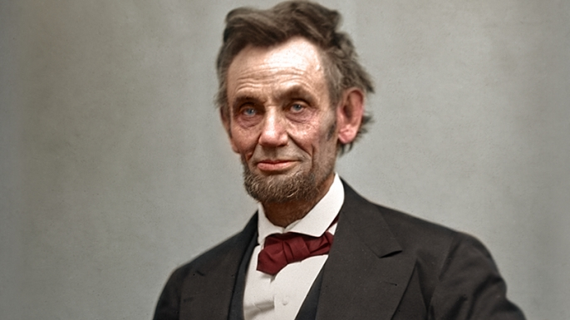
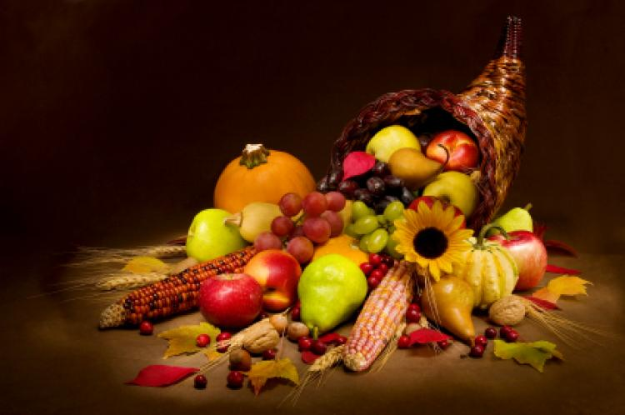
Re-election of 1864
Lincoln wins reelection.
He wins 55% of the popular vote.
Nearly all of the army voted for him over McClellan.
With his victory, the confederacy’s outcome is becoming more certain.
They could not win the war without foreign recognition and aid
Just like in the Revolutionary War
Lincoln declares Thanksgiving a National Holiday.
12o thousand turkeys delivered to Grant’s men at Petersburg
Rebels hold fire out of respect

Slide 35
Ken Burn’s Civil War
Disc 5 Episode 8: Prologue (0-5:32)

Slide 36
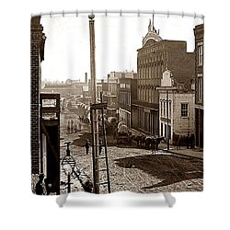
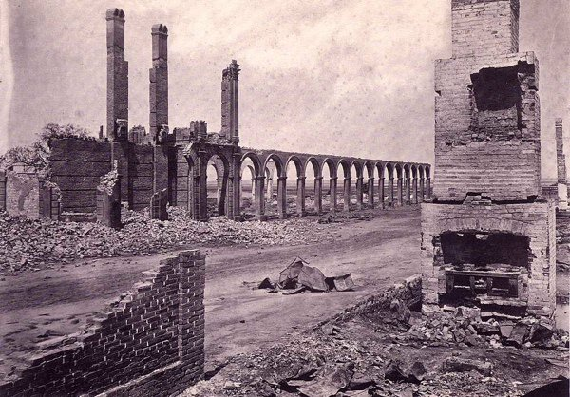
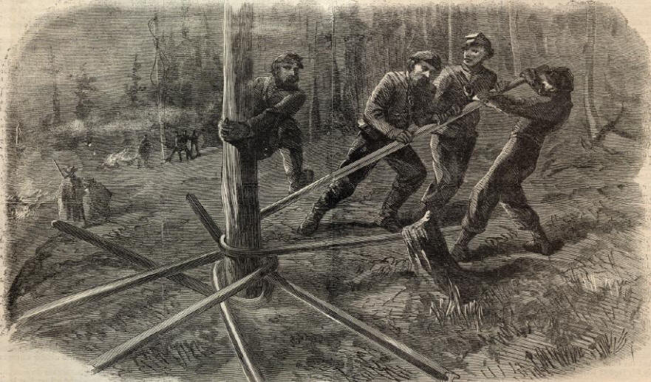
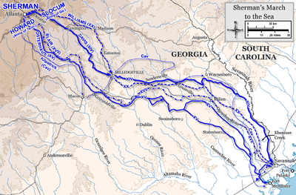
Sherman’s March to the sea
“Gentleman, you cannot qualify war in harsher terms than I will. War is cruelty, and you cannot refine it; and those who brought war into our country deserve all the curses and malediction a people can pour out.” -Sherman
He is the first modern general in that he made war on civilians because he understood the concept of total war, which is to deprive the army of what keeps it going.
Sherman marches from Atlanta, through Georgia to Savana on the coast, living off the land. “I can make this march, and make Georgia Howl!”
Before leaving Atlanta, he lights it on fire so it can no longer aid the south in the war.
62 thousand soldiers then marched, living off the land, destroying cities, burning fields, bending railroad ties.

Slide 37
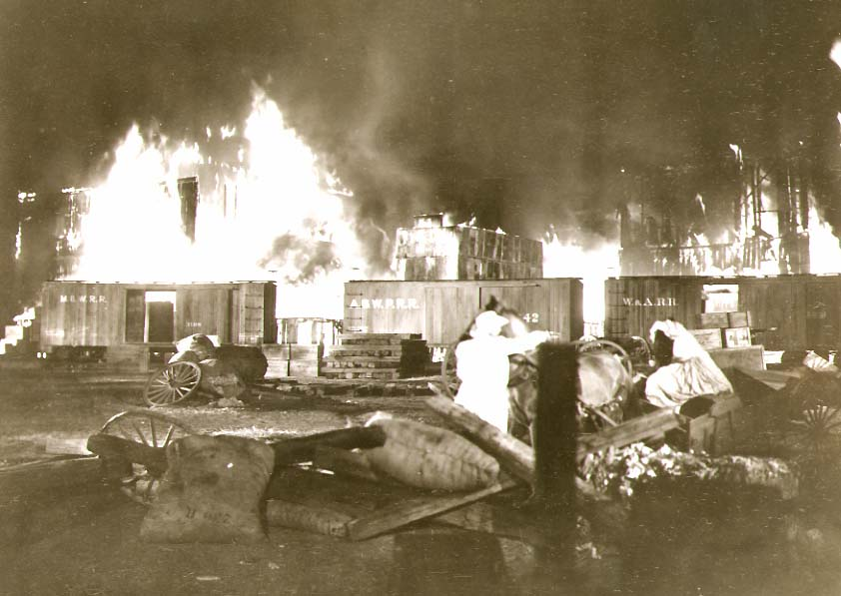
Sherman’s March to the Sea
Sherman’s Army crossed 425 miles and caused 100 million dollars of damage.
The south would never forget.
Sherman’s army emerges at Savanah on Christmas.
He then heads through South Carolina.
They get even worse treatment from Sherman because:
“This is where treason began.”
He burned Charleston to the ground.
Thousands of Confederate civilians turn into refugees and flee to Texas to start a new life.

Slide 38
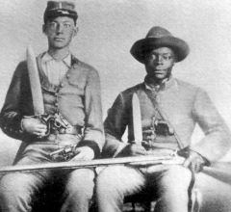
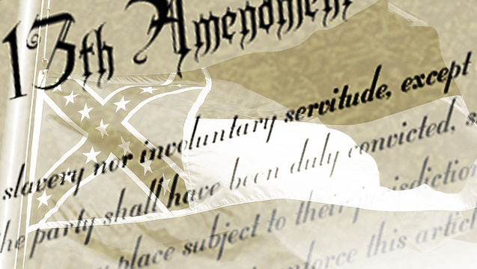
Situations for slaves’ changes
Low on supplies and men,
Hundreds desert each day= Sherman
Lee asks the Confederate Congress to arm their slaves.
They reluctantly agree.
At the same time, Lincoln passes the 13th amendment
abolishing slavery in the Union forever.

Slide 39
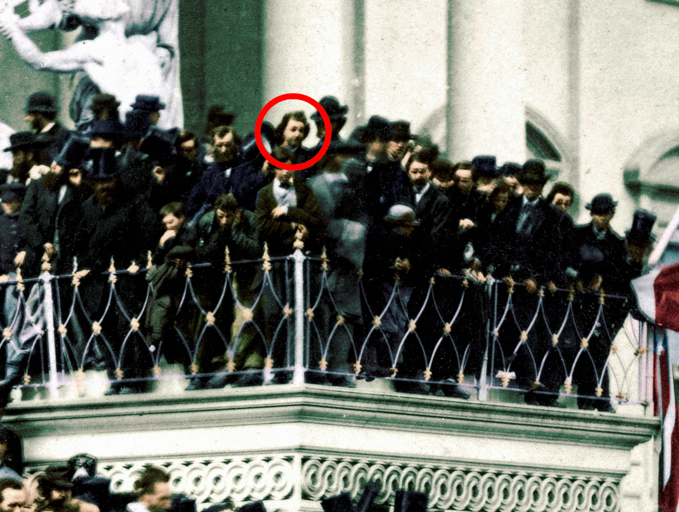
Lincoln’s Second Inaugural Address
As Lincoln gives his second inaugural address, John Wilkes Booth and friends listen and Booth turns to a friend and acclaims that it will be the last speech he ever makes!

Slide 40
The fall of Richmond
March 25, 1865, Grant finally wins Petersburg and has access to Richmond.
90 thousand confederates deserted in the 9 month siege.
April 3, 1865 As the confederates retreat out of Richmond, they light it on fire so it can be no use to Yankees.
Lee flees west and Grant stays right behind him.

Slide 41
The Night They Drove Old Dixie Down By The Band
https://www.youtube.com/watch?v=v3JaosE-gZE

Slide 42
Ken Burn’s Civil War
Disc 5 Episode 8: Appomattox (49:26-1:04:00)

Slide 43
The Villain of the War
After the surrender at Appomattox, Jefferson Davis is still defiant, flees south, but is captured.
Rumored to be wearing women’s clothing.
N and S, he becomes the chief villain of the war.
South does not want to blame their generals, so Davis becomes scapegoat.

Slide 44
Effects of the war
3.5 million went to war
620 K were killed.
More than all other American wars combined.
¼ of white southern men are dead.
In Mississippi in 1866, 1/5 of the state budget was spent on artificial limbs.
The war made the country an actuality.
Boys who had never left home had traveled the country, seen the land and now understand they have this great country because they had been there, and experienced it.

Slide 45
Effects of the war
Jefferson Davis spent 2 years in prison.
He was released on bond and worked on his memoirs:
“The Rise and Fall of the Confederacy.”
Mary Todd Lincoln entered a deep depression and eventually was put into a mental hospital.

Slide 46
Effects of the war
Robert E Lee swears allegiance to the Union
Later becomes the president of Washington College.
His statues would rise all over southern states in the early nineteen hundreds, and later be the center of debate before being removed in 2017.

Slide 47
Effects of the war
Hero of the war, Grant became 18th President.
His administration very corrupt.
He is bankrupted after the white house and has cancer of the throat.
Wrote his memoirs to provide for his family and restore his name.
Died a week after he finished.

Slide 48
Effects of the war
The Union won the war but…
Was fiercely divided.
Slaves got their freedom but…
Jim Crow Laws keep them as second class citizens.
This racial battle still rages today.

